Slide 1


QUALITY CONTROL & ASSURANCE THROUGH SMART APPLICATION TOOLS
G Shravan Kumar
Executive Vice President - Technical Due Diligence & Project Management
Cube Highways Technologies Pvt. Ltd.
Private and confidential

Slide 2

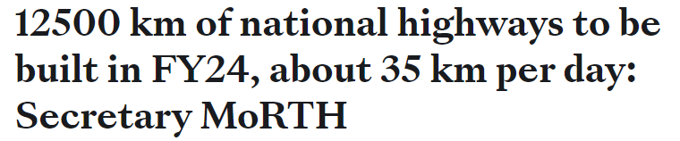
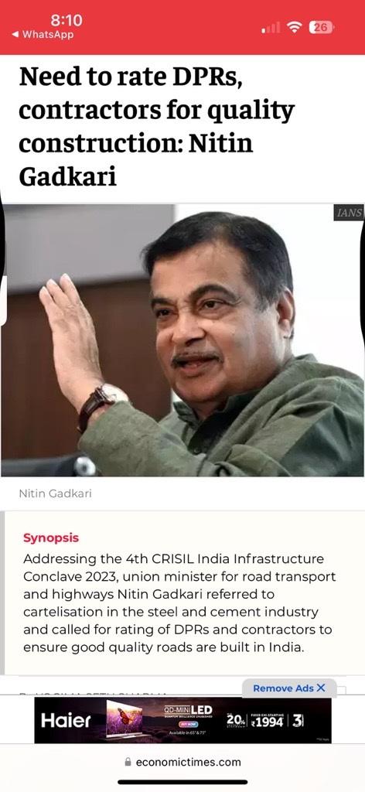
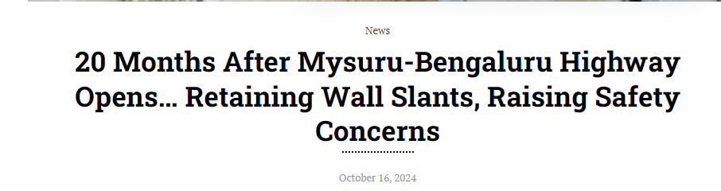
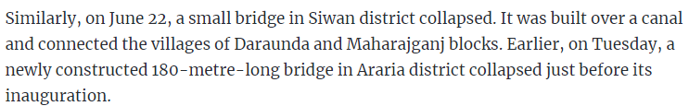
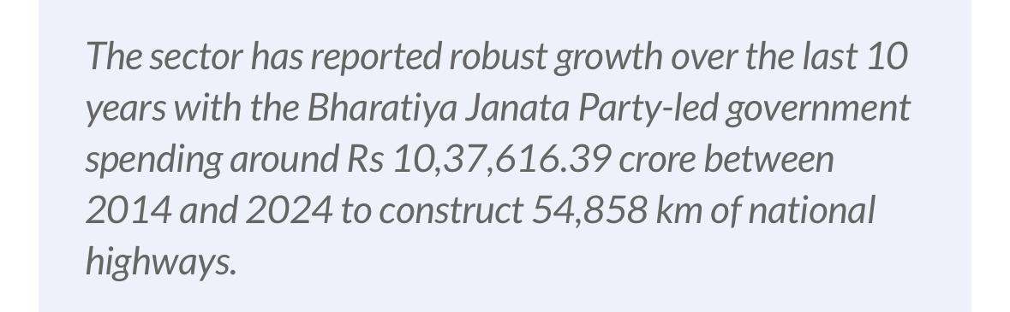
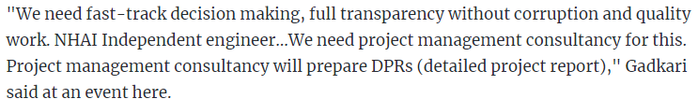
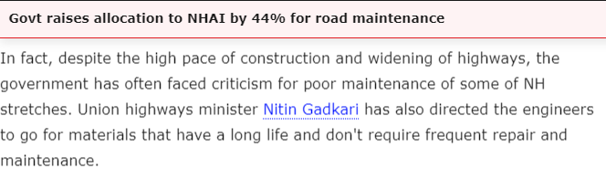
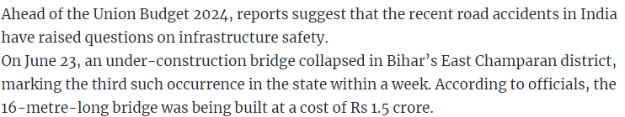
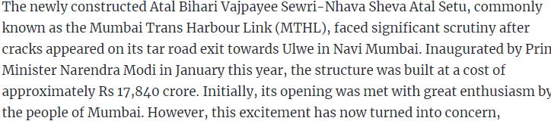
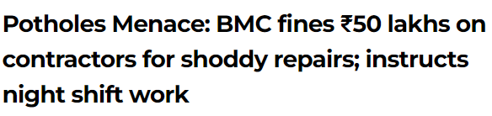
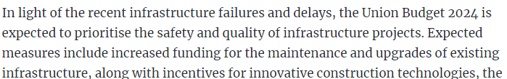
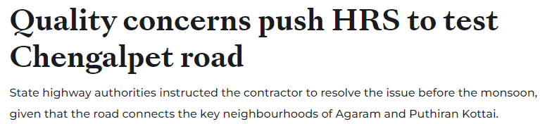
Topic Name
Private and confidential

Slide 3
Agenda
Introduction
Problem Statement
Solution
Benefits
Summary
Private and confidential

Slide 4
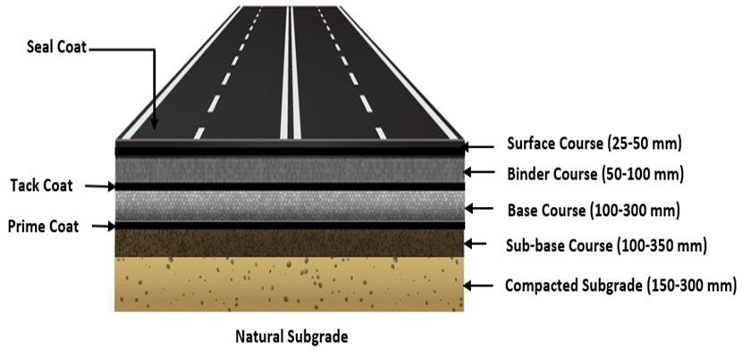
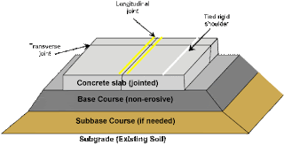
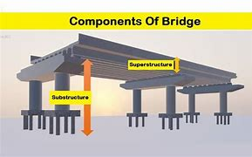
Introduction
MoRTH and IRC codes has set guidelines for quality tests and checklists to ensure systematic and high-quality construction
Lack of compliance can lead to critical quality issues, as highlighted in MoRTH Quality control zone and NHAI circulars dated 01st November 2020 and 09th August 2024, respectively.
Deficient thickness of granular/bituminous/concrete layers.
Settlements near approach slabs
Depressions or cracks in concrete slabs.
Inadequate slope and compaction of earthen shoulders and embankments.
Use of non-specified grades of bitumen. Bitumen quantity not adhering to design mix requirements.
Failure to follow step-by-step procedures for embankment or subgrade construction, leading to early settlement, particularly near approach slabs.
Tests for materials and proprietary items must be conducted at site laboratories or by third parties; these are often overlooked.
Inadequate protection works.
The frequency of material testing does not comply with IRC and MoRTH specifications.
Quality Assurance Plans (QAP) are too generic and lack project-specific details.
Earth filling in embankments/subgrades is not being done with the required layer thickness according to MoRTH specifications
PCC/CC has been backdated, yet many permanent/safety works remain incomplete, and some completed works show poor construction practices.
Private and confidential
04

Slide 5
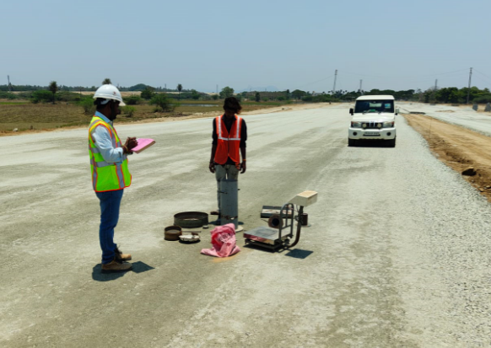
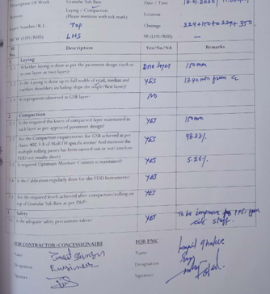

Problem Statement
Challenges associated with paper-based reporting
The Frequency of testing of different material & products viz. Steel, Cement, Aggregate, Emulsion, MBCB material tests, etc. being used at site is not in accordance with IRC:SP-112 and MoRTH specifications for Roads & Bridges as per circular dated 09-08-2024.
Limited inspection scope of current quality monitoring practices by IE/AE.
Absence of real-time quality control monitoring and a centralized database for comprehensive project oversight for all stakeholders
Early failures in pavement and structures caused by non-adherence to standard construction procedures outlined by IRC/MoRTH
Requirement for a unified platform for standardized quality control
Non updation of checklists with the updation of new technologies and methodologies.
Inconsistent adherence to site instructions and non availability of issue tracking methods.
Absence of predate connectors to identify the recurring issues.
Insufficient oversight on overall construction quality ratings and absence of an overall project quality index.
Figure: Paper based reporting at site
Issues
Time Consuming
Storage space and Security issues
Prone to damage and document loss
Environmental damage
Document transportation
Delays
Collaboration
Course corrections
Decision-making
Dispute resolution
Private and confidential

Slide 6
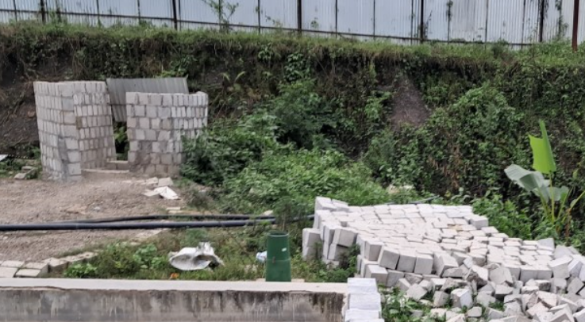
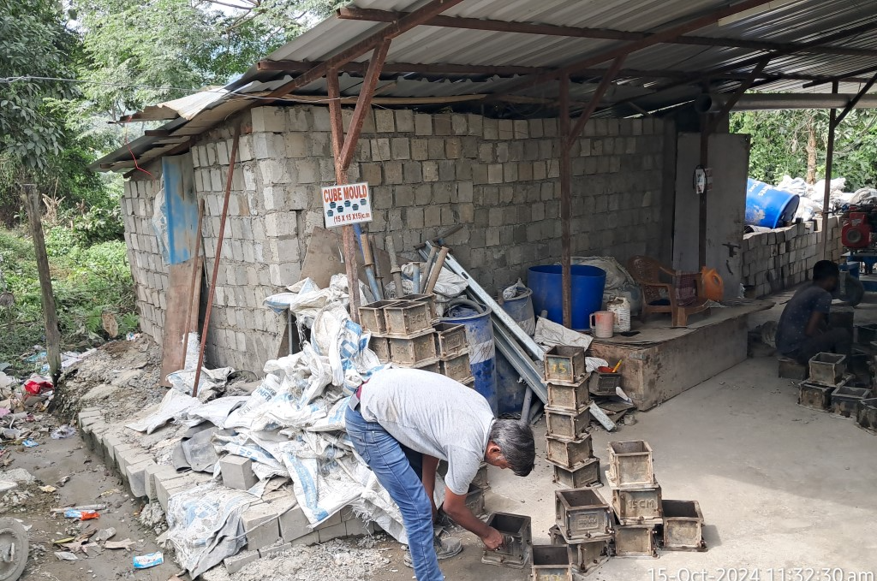
Problem Statement
Challenges associated with paper-based reporting
The Frequency of testing of different material & products viz. Steel, Cement, Aggregate, Emulsion, MBCB material tests, etc. being used at site is not in accordance with IRC:SP-112 and MoRTH specifications for Roads & Bridges as per circular dated 09-08-2024.
Limited inspection scope of current quality monitoring practices by IE/AE.
Absence of real-time quality control monitoring and a centralized database for comprehensive project oversight for all stakeholders
Early failures in pavement and structures caused by non-adherence to standard construction procedures outlined by IRC/MoRTH
Requirement for a unified platform for standardized quality control
Non updation of checklists with the updation of new technologies and methodologies.
Inconsistent adherence to site instructions and non availability of issue tracking methods.
Absence of predate connectors to identify the recurring issues.
Insufficient oversight on overall construction quality ratings and absence of an overall project quality index.
Private and confidential
Figure: Untested Concrete cubes

Slide 7
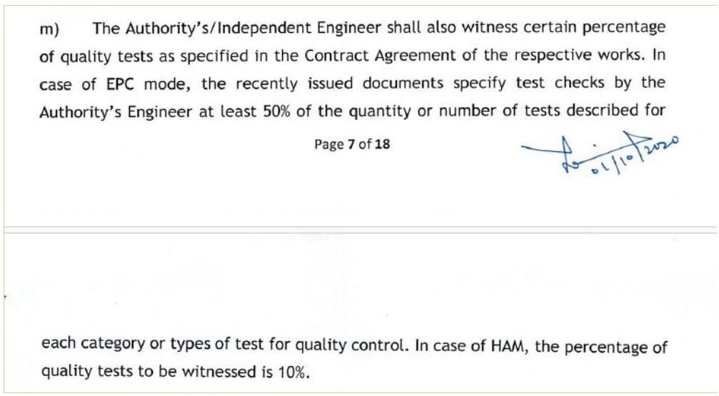
Challenges associated with paper-based reporting
The Frequency of testing of different material & products viz. Steel, Cement, Aggregate, Emulsion, MBCB material tests, etc. being used at site is not in accordance with IRC:SP-112 and MoRTH specifications for Roads & Bridges as per circular dated 09-08-2024.
Limited inspection scope of current quality monitoring practices by IE/AE.
Absence of real-time quality control monitoring and a centralized database for comprehensive project oversight for all stakeholders
Early failures in pavement and structures caused by non-adherence to standard construction procedures outlined by IRC/MoRTH
Requirement for a unified platform for standardized quality control
Non updation of checklists with the updation of new technologies and methodologies.
Inconsistent adherence to site instructions and non availability of issue tracking methods.
Absence of predate connectors to identify the recurring issues.
Insufficient oversight on overall construction quality ratings and absence of an overall project quality index.
Problem Statement
Figure: MoRTH Quality Control Zone circular dated 01-10-20
Private and confidential

Slide 8
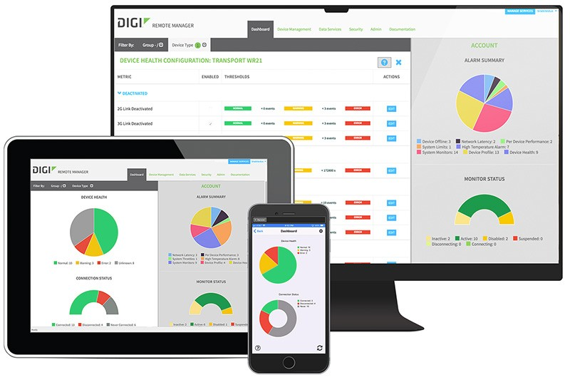

Challenges associated with paper-based reporting
The Frequency of testing of different material & products viz. Steel, Cement, Aggregate, Emulsion, MBCB material tests, etc. being used at site is not in accordance with IRC:SP-112 and MoRTH specifications for Roads & Bridges as per circular dated 09-08-2024.
Limited inspection scope of current quality monitoring practices by IE/AE.
Absence of real-time quality control monitoring and a centralized database for comprehensive project oversight for all stakeholders
Early failures in pavement and structures caused by non-adherence to standard construction procedures outlined by IRC/MoRTH
Requirement for a unified platform for standardized quality control
Non updation of checklists with the updation of new technologies and methodologies.
Inconsistent adherence to site instructions and non availability of issue tracking methods.
Absence of predate connectors to identify the recurring issues.
Insufficient oversight on overall construction quality ratings and absence of an overall project quality index.
Problem Statement
Private and confidential

Slide 9
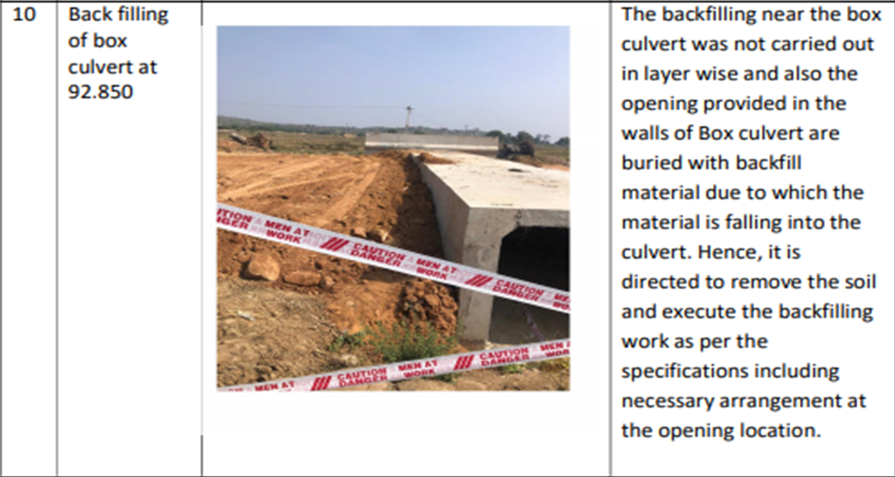
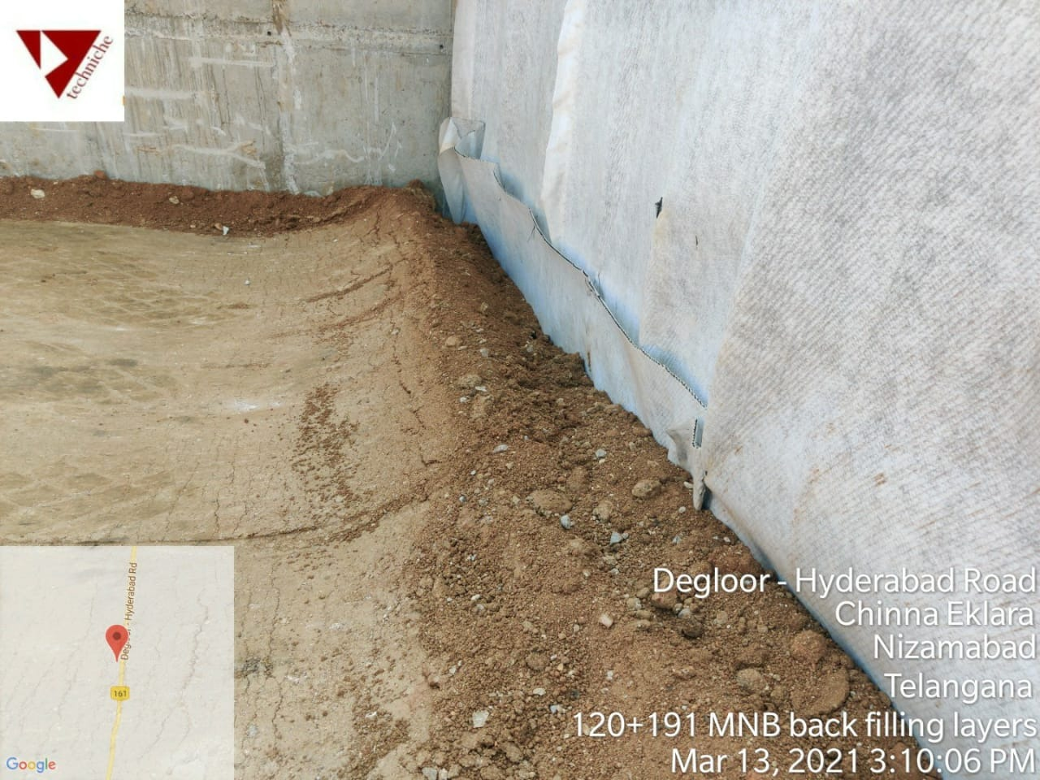
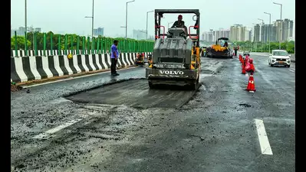
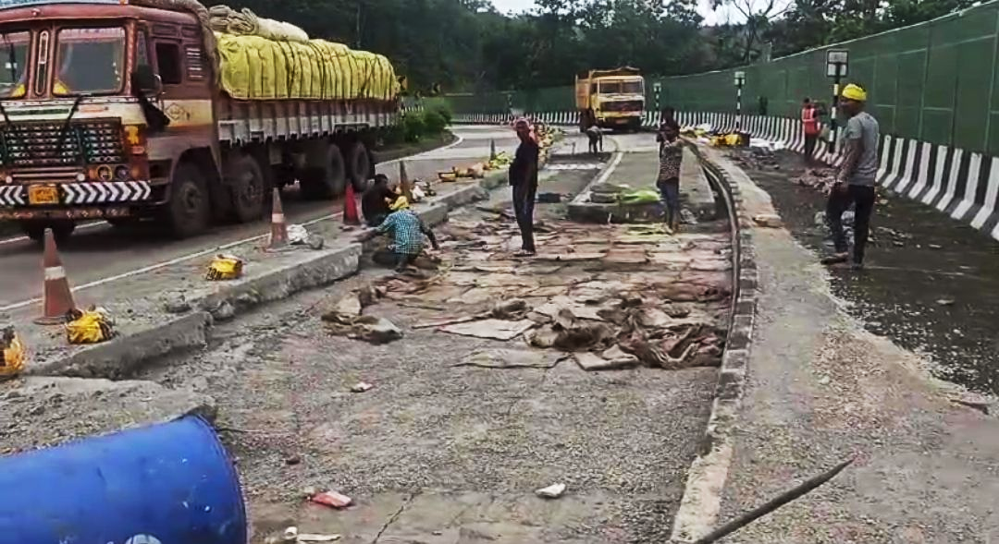
Challenges associated with paper-based reporting
The Frequency of testing of different material & products viz. Steel, Cement, Aggregate, Emulsion, MBCB material tests, etc. being used at site is not in accordance with IRC:SP-112 and MoRTH specifications for Roads & Bridges as per circular dated 09-08-2024.
Limited inspection scope of current quality monitoring practices by IE/AE.
Absence of real-time quality control monitoring and a centralized database for comprehensive project oversight for all stakeholders
Early failures in pavement and structures caused by non-adherence to standard construction procedures outlined by IRC/MoRTH
Requirement for a unified platform for standardized quality control
Non updation of checklists with the updation of new technologies and methodologies.
Inconsistent adherence to site instructions and non availability of issue tracking methods.
Absence of predate connectors to identify the recurring issues.
Insufficient oversight on overall construction quality ratings and absence of an overall project quality index.
Problem Statement
Figure: Non-adherence of standard construction procedure
Figure: Failure in recently constructed flexible pavement and rigid pavement
Private and confidential

Slide 10
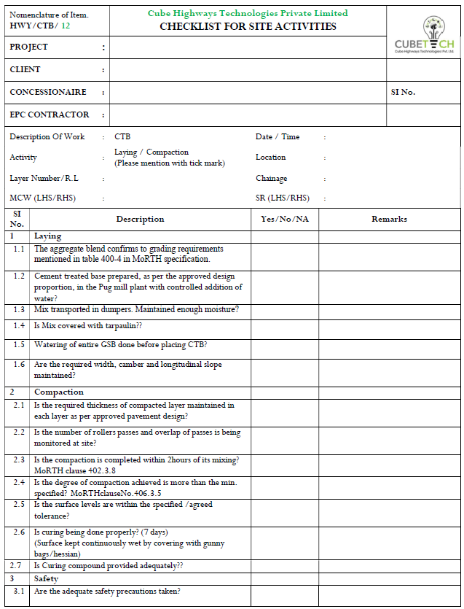
Challenges associated with paper-based reporting
The Frequency of testing of different material & products viz. Steel, Cement, Aggregate, Emulsion, MBCB material tests, etc. being used at site is not in accordance with IRC:SP-112 and MoRTH specifications for Roads & Bridges as per circular dated 09-08-2024.
Limited inspection scope of current quality monitoring practices by IE/AE.
Absence of real-time quality control monitoring and a centralized database for comprehensive project oversight for all stakeholders
Early failures in pavement and structures caused by non-adherence to standard construction procedures outlined by IRC/MoRTH
Requirement for a unified platform for standardized quality control
Non updation of checklists inline with new technologies and methodologies.
Inconsistent adherence to site instructions and non availability of issue tracking methods.
Absence of predate connectors to identify the recurring issues.
Insufficient oversight on overall construction quality ratings and absence of an overall project quality index.
Problem Statement
Private and confidential
Figure: Sample CTB Checklist (New Materials)

Slide 11
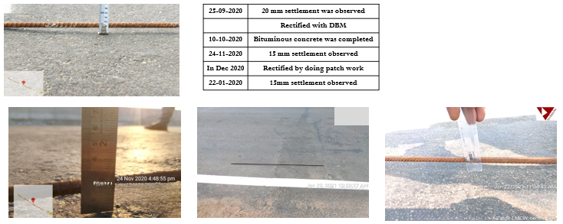
Challenges associated with paper-based reporting
The Frequency of testing of different material & products viz. Steel, Cement, Aggregate, Emulsion, MBCB material tests, etc. being used at site is not in accordance with IRC:SP-112 and MoRTH specifications for Roads & Bridges as per circular dated 09-08-2024.
Limited inspection scope of current quality monitoring practices by IE/AE.
Absence of real-time quality control monitoring and a centralized database for comprehensive project oversight for all stakeholders
Early failures in pavement and structures caused by non-adherence to standard construction procedures outlined by IRC/MoRTH
Requirement for a unified platform for standardized quality control
Non updation of checklists with the updation of new technologies and methodologies.
Inconsistent adherence to site instructions and non availability of issue tracking methods.
Absence of predate connectors to identify the recurring issues.
Insufficient oversight on overall construction quality ratings and absence of an overall project quality index.
Problem Statement
25-09-2020 | 20 mm settlement was observed
 | Rectified with DBM
10-10-2020 | Bituminous concrete was completed
24-11-2020 | 15 mm settlement observed
In Dec 2020 | Rectified by doing patch work
22-01-2021 | 15mm settlement observed
Figure: Issue tracking of settlement at a location
Private and confidential
Figure: Issue tracking of backfilling near box culvert`s

Slide 12
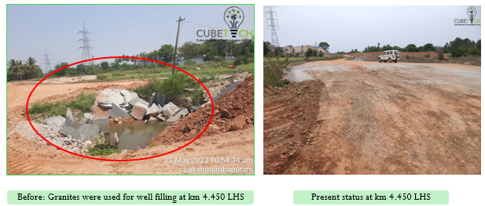
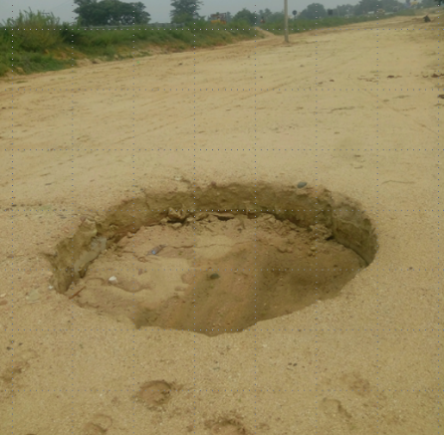
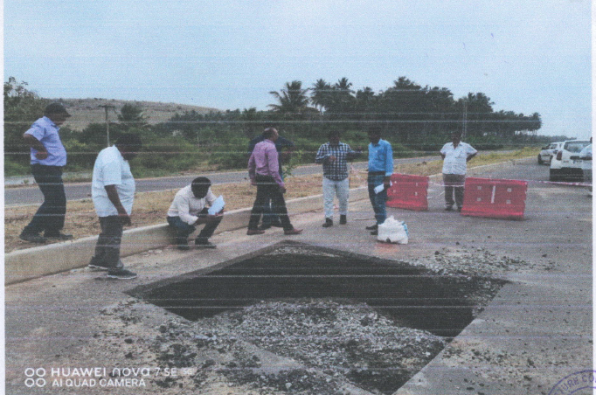
Challenges associated with paper-based reporting
The Frequency of testing of different material & products viz. Steel, Cement, Aggregate, Emulsion, MBCB material tests, etc. being used at site is not in accordance with IRC:SP-112 and MoRTH specifications for Roads & Bridges as per circular dated 09-08-2024.
Limited inspection scope of current quality monitoring practices by IE/AE.
Absence of real-time quality control monitoring and a centralized database for comprehensive project oversight for all stakeholders
Early failures in pavement and structures caused by non-adherence to standard construction procedures outlined by IRC/MoRTH
Requirement for a unified platform for standardized quality control
Non updation of checklists with the updation of new technologies and methodologies.
Inconsistent adherence to site instructions and non availability of issue tracking methods.
Absence of predate connectors to identify the recurring issues.
Insufficient oversight on overall construction quality ratings and absence of an overall project quality index.
Problem Statement
Figure: Issue tracking of Well Filling
Private and confidential

Slide 13
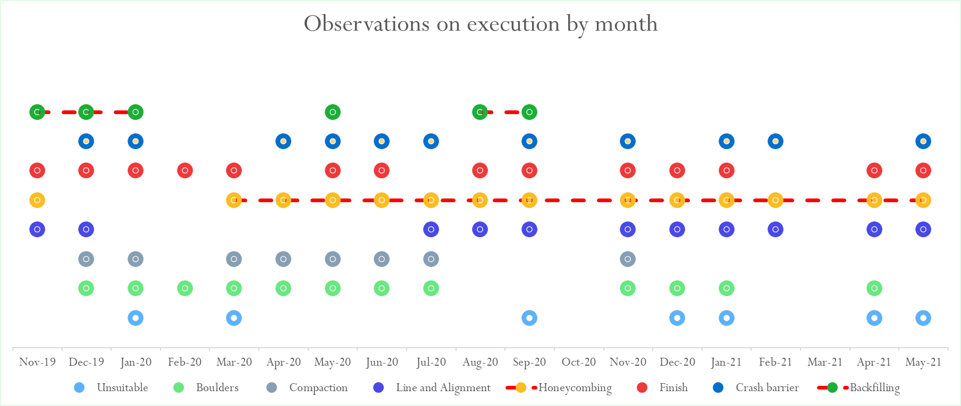
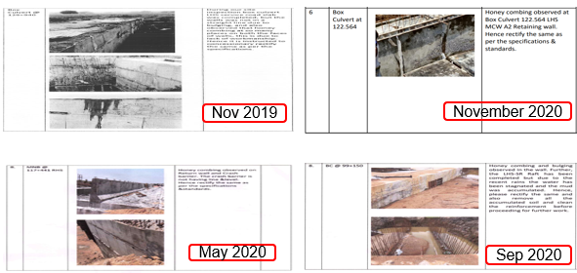
Challenges associated with paper-based reporting
The Frequency of testing of different material & products viz. Steel, Cement, Aggregate, Emulsion, MBCB material tests, etc. being used at site is not in accordance with IRC:SP-112 and MoRTH specifications for Roads & Bridges as per circular dated 09-08-2024.
Limited inspection scope of current quality monitoring practices by IE/AE.
Absence of real-time quality control monitoring and a centralized database for comprehensive project oversight for all stakeholders
Early failures in pavement and structures caused by non-adherence to standard construction procedures outlined by IRC/MoRTH
Requirement for a unified platform for standardized quality control
Non updation of checklists with the updation of new technologies and methodologies.
Inconsistent adherence to site instructions and non availability of issue tracking methods.
Absence of predate connectors to identify the recurring issues.
Insufficient oversight on overall construction quality ratings and absence of an overall project quality index.
Problem Statement
Figure: Recurring issues predate connector
Private and confidential
Figure: Recurring issue of Honey combing

Slide 14



Solution
Application development: Advanced digital tools offer an efficient solution by enabling the collection, storage, reporting, and compilation of data. These tools streamline processes, save time, and ensure accurate reporting. With the widespread use of mobile phones and internet availability across the country, cloud management and web data connectivity have improved significantly.
Application Integration
The quality control tests, Checklists, Request for Inspection (RFI), Daily Progress Report (DPR) and other procedures are integrated within the mobile application
The application serves as a centralized platform for real-time monitoring and documentation
Features and Functionality
User-friendly interface ensures ease of use for all stakeholders, from project managers to on-site engineers.
Designed to streamline quality control process which helps inspectors monitor and maintain job quality more effectively, minimizing construction errors
Continuous tracking of every construction process step, ensuring quality control requirements are met not only at task completion but throughout each phase
Introduce a Project Quality Index (PQI) that assigns scores to key activities based on defined quality attributes. This index offers a clear, objective measure to evaluate the quality of work performed by the contractor.
http://
Auditing and feedback for continuous improvement
The application’s auditing capabilities enable feedback to the executing team, pinpointing areas for corrective action based on PQI evaluations. This fosters ongoing improvement in quality management and standards compliance
The adoption of digital solutions contributes to sustainable infrastructure development.
Private and confidential

Slide 15
Benefits
05
01
Digital checklists for real-time monitoring
Reports and Dashboards
Data integration and reporting
Document trials
06
02
Enhanced inspection management
Benefits
Real-Time collaboration Decision making and increased productivity
Comprehensive documentation features
07
03
Cost and Resources saving Sustainability
08
04
Data access and Traceability
Private and confidential

Slide 16
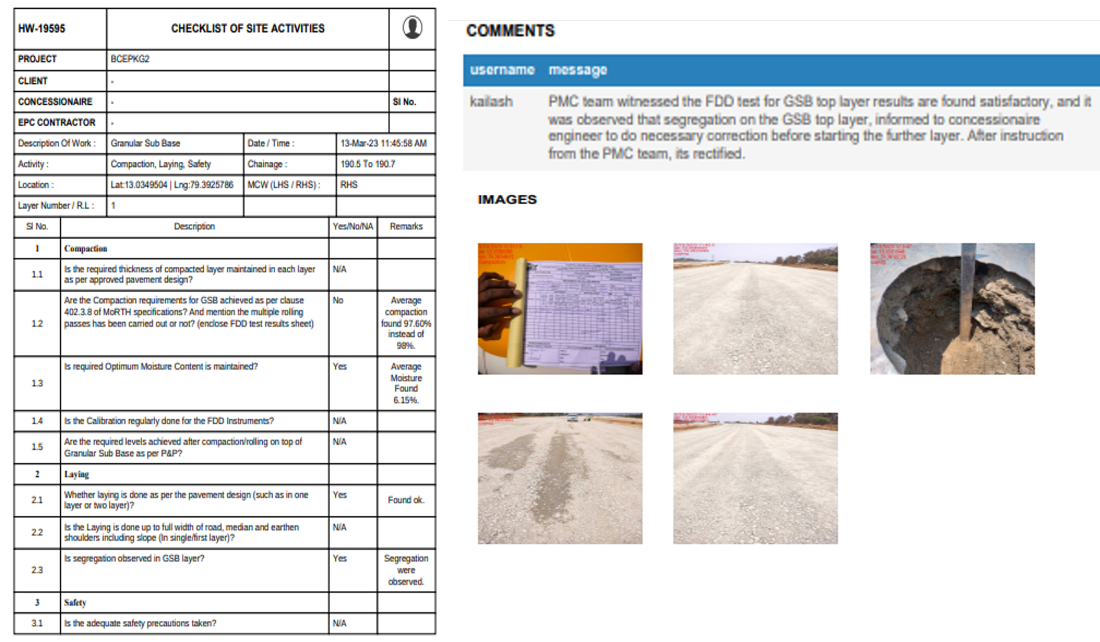
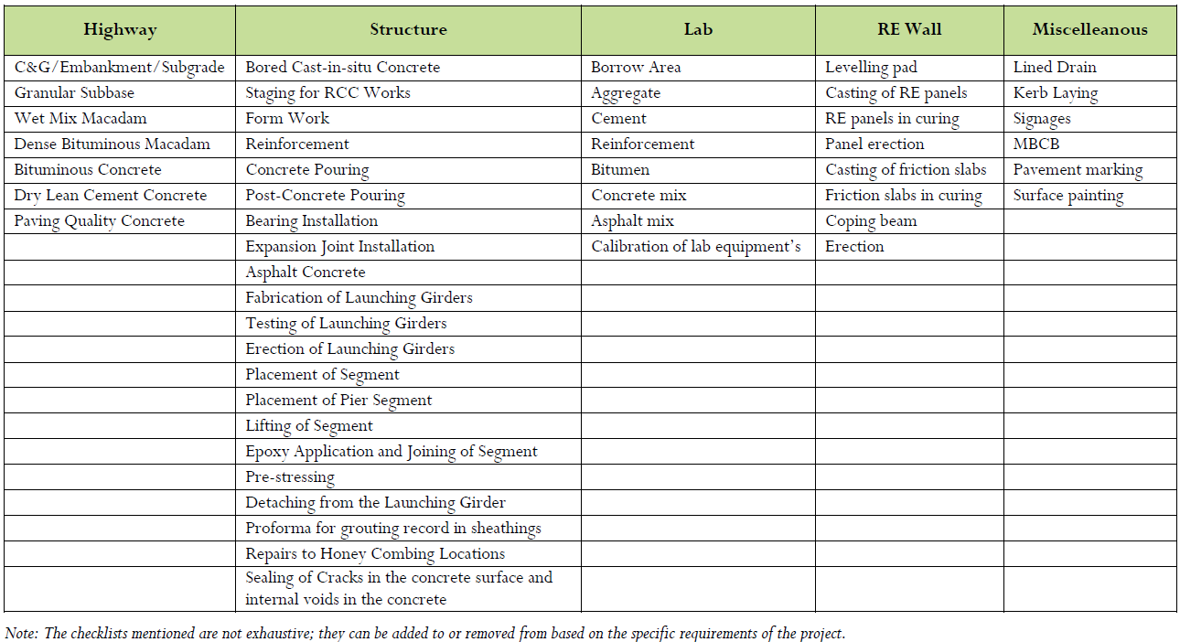
Benefits
Data integration and reporting
Document trials
Digital checklists for real-time monitoring
06
01
Real-Time collaboration Decision making and increased productivity
Enhanced inspection management
07
02
Enhancing project quality by using Project Quality Index feature
Comprehensive documentation features
08
Benefits
03
Offline functionality
Alerts and notifications
09
04
Data access and Traceability
Cost and Resources saving Sustainability
10
05
Reports and Dashboards
05
05
05
Private and confidential

Slide 17
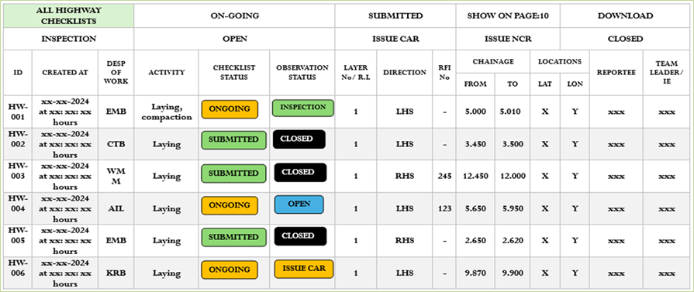
Benefits
Data integration and reporting
Document trials
Digital checklists for real-time monitoring
06
01
Real-Time collaboration Decision making and increased productivity
Enhanced inspection management
07
02
Enhancing project quality by using Project Quality Index feature
Comprehensive documentation features
08
Benefits
03
Offline functionality
Alerts and notifications
09
04
Data access and Traceability
Cost and Resources saving Sustainability
10
05
Reports and Dashboards
Private and confidential

Slide 18
Benefits
Data integration and reporting
Document trials
Digital checklists for real-time monitoring
06
01
Real-Time collaboration Decision making and increased productivity
Enhanced inspection management
07
02
Enhancing project quality by using Project Quality Index feature
Comprehensive documentation features
08
Benefits
03
Offline functionality
Alerts and notifications
09
04
Data access and Traceability
Cost and Resources saving Sustainability
10
05
Reports and Dashboards
05
Private and confidential

Slide 19
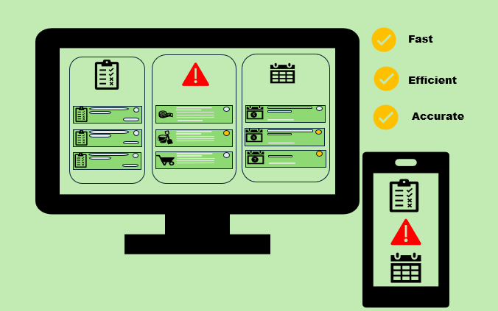
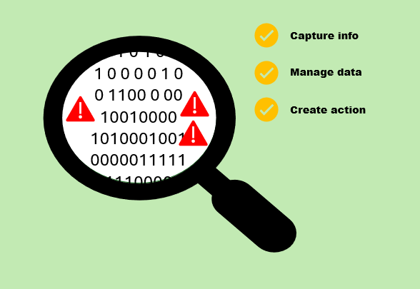
Benefits
Data integration and reporting
Document trials
Digital checklists for real-time monitoring
06
01
Real-Time collaboration Decision making and increased productivity
Enhanced inspection management
07
02
Enhancing project quality by using Project Quality Index feature
Comprehensive documentation features
08
Benefits
03
Offline functionality
Alerts and notifications
09
04
Data access and Traceability
Cost and Resources saving Sustainability
10
05
Reports and Dashboards
Private and confidential

Slide 20
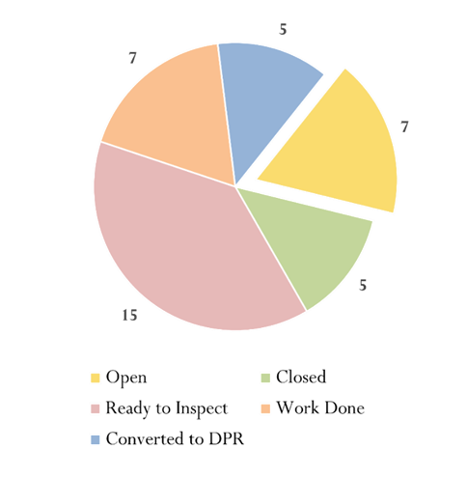
Benefits
Application
Data integration and reporting
Document trials
Digital checklists for real-time monitoring
Raising and assigning of RFI”s
06
01
Real-Time collaboration Decision making and increased productivity
Checklist of corresponding activity is populated
Enhanced inspection management
07
02
All the queries have been addressed
Enhancing project quality by using Project Quality Index feature
Comprehensive documentation features
08
Benefits
03
Submit
RFI
Offline functionality
Alerts and notifications
OPEN
CLOSED
09
04
Data access and Traceability
Convert to CAR
Cost and Resources saving Sustainability
10
05
CAR Closed
Reports and Dashboards
NO
YES
Convert to DPR
Convert to NCR
Private and confidential

Slide 21
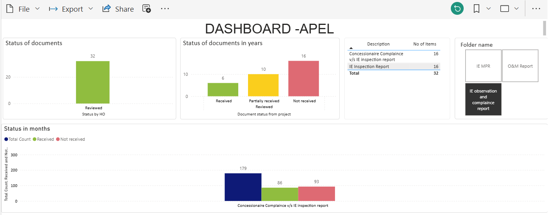
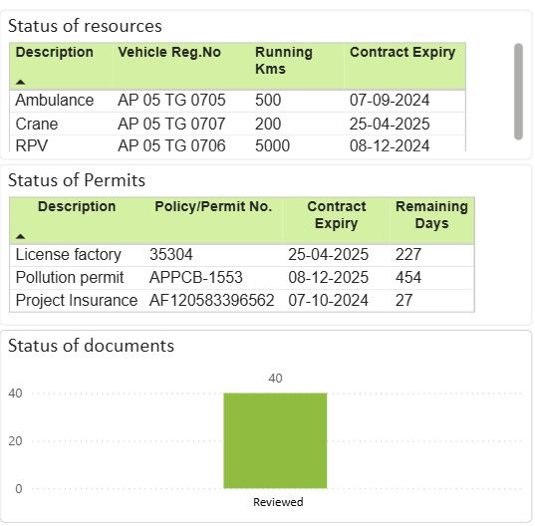
Example
Dashboard on with the help of Sharepoint & PowerBI
Private and confidential

Slide 22
Benefits
Data integration and reporting
Document trials
06
01
Digital checklists for real-time monitoring
Real-Time collaboration Decision making and increased productivity
Enhanced inspection management
07
02
Enhancing project quality by using Project Quality Index feature
Comprehensive documentation features
08
Benefits
03
Offline functionality
Alerts and notifications
09
04
Data access and Traceability
Cost and Resources saving Sustainability
10
05
Reports and Dashboards
Private and confidential

Slide 23
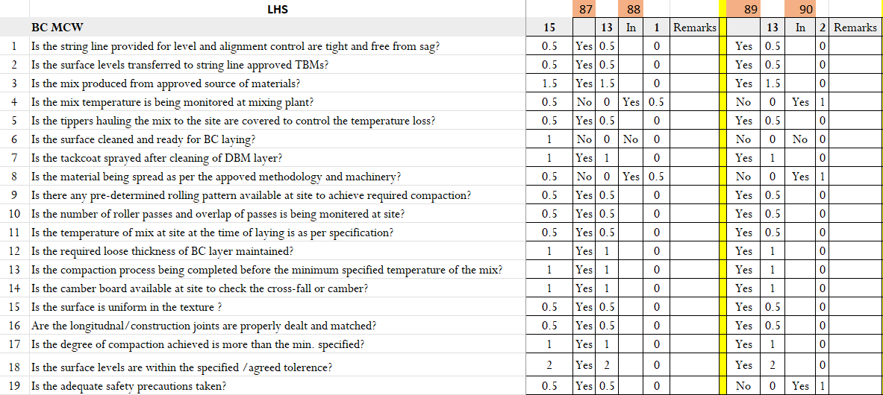
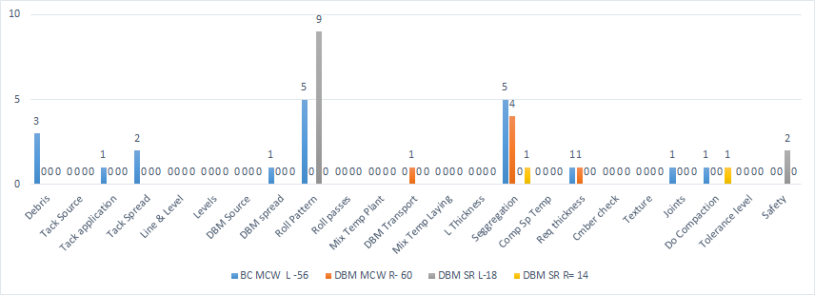
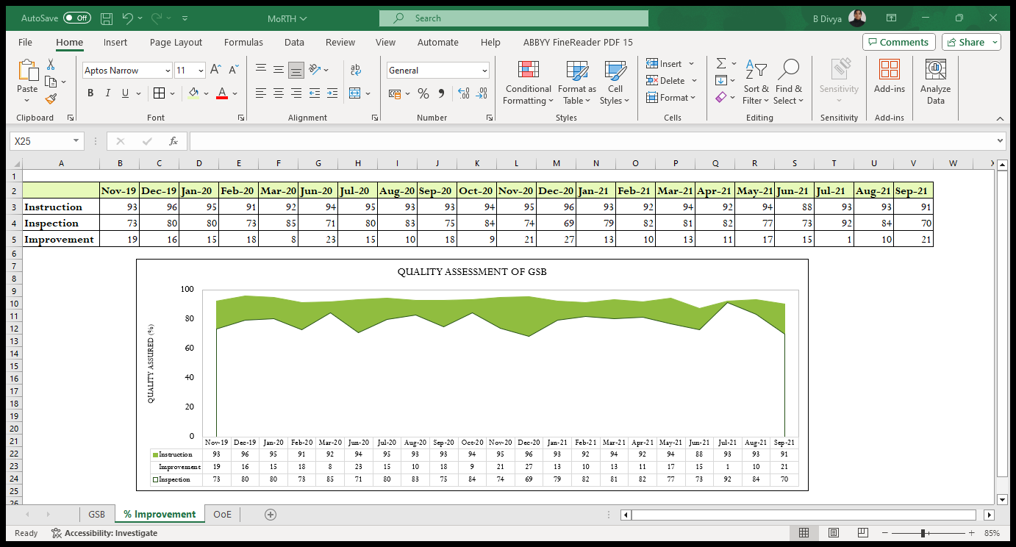
Example
Private and confidential

Slide 24
Example
S.No | Description of Work | From (km) | To (km) | Side | Depth in mm* | Length (km) | Remark
1 | Rutting on 2nd and 3rd lane | 89.600 | 93.300 | RHS | 20 | 3.7 | As per our records there was repeated issue of compaction in this stretch
 |  |  |  |  |  |  | Issue with WMM 1st layer compaction from km 90.130 to 91.500
 |  |  |  |  |  |  | Issue with WMM top layer - 7/10 observation had compaction issue from km 89.400 to km 93.900
 |  |  |  |  |  |  | From 89.600 -90.500 while executing DBM, the transported material was not covered with tarpaulin which could have resulted in temperature loss
 |  |  |  |  |  |  | From km 91.000 - km 91.600, issue raised w.r.t loose thickness of BC
2 | Rutting on Slow Lane | 107.550 | 108.250 | RHS | 20 | 0.7 | As per our records from Km 108.500 to 108.680 we reported deficiency in compaction of GSB layer
 |  |  |  |  |  |  | Bleeding 107.600 to 107.700 in BC
3 | Rutting on Slow Lane | 119.020 | 119.750 | RHS | 25 | 0.73 | As per our records from Km 119.000 to 119.850 we reported deficiency w.r.t segregation (3/4 observation) and 1 observation of compaction.
4 | Rutting on 3rd Lane | 120.780 | 121.550 | RHS | 20-25 | 0.77 | As per our record we made two observations from km 120.800 to km 121.230, in which segregation was reported in WMM 1st Layer
 |  |  |  |  |  |  | As per our record we made two observations of compaction out of which one failed from km 120.780 to km 121.230 in WMM top layer
Private and confidential

Slide 25
Example
Summary of observations by tagging the issues from IE inspection reports
S. no . | Defects/lapse s found as Per Site Observation | Improvement/ Rectification Suggested by IE | Status of Improvement/ Rectification for the month of
 |  |  | Jan’24 | Feb’24 | Mar’24 | Apr’24 | May’24 | June’24 | July’24
6 | Crash barrier damaged | Should be rectified immediately | No issues | No issues | Issue | Issue | Rectified | Rectified | Rectified
7 | Road Marking faded | Should be rectified immediately | No issues | Issue | Issue | Rectified | Rectified | Rectified | In Progress
8 | Kerb Painting Peel-off | Should be repainted | Issue | Increased 2x | Increased 2x | Increased 2x | In progress | In progress | In progress
9 | Replacement of tress | Should be planting trees immediately | Increased 2x | Increased 2x | Increased 4x | Increased 4x | In progress | In progress | In progress
10 | Blinker damaged | Should be rectified immediately | Rectified | Rectified | Rectified | Rectified | Rectified | Rectified | Rectified
Private and confidential

Slide 26
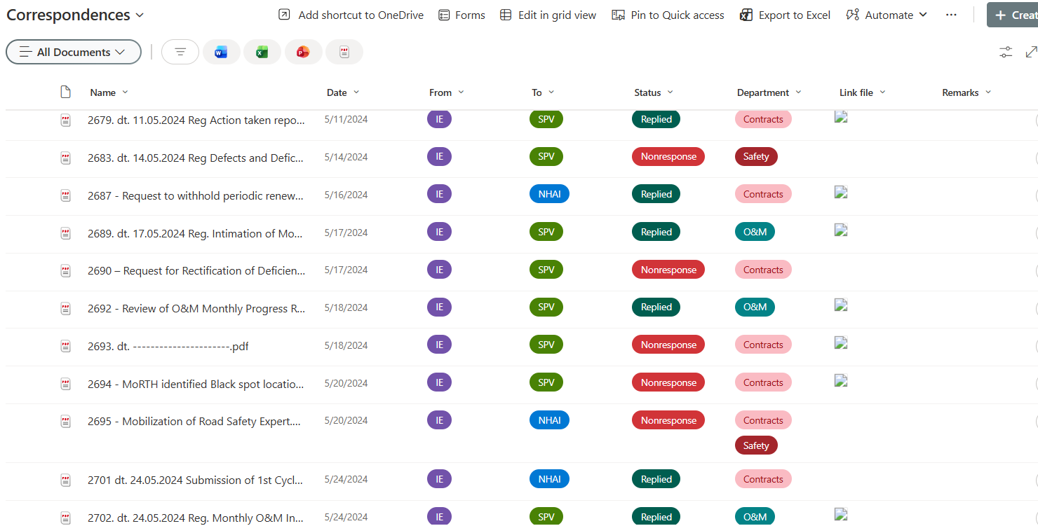
Example
Maintaining Correspondence in SharePoint
Private and confidential

Slide 27
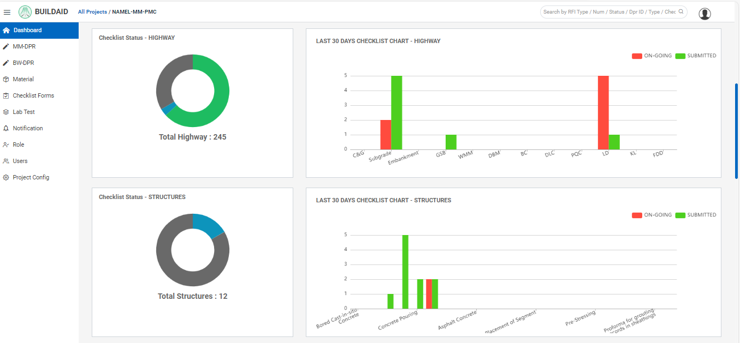
Benefits
Data integration and reporting
Document trials
Digital checklists for real-time monitoring
06
01
Real-Time collaboration Decision making and increased productivity
Enhanced inspection management
07
02
Enhancing project quality by using Project Quality Index feature
Comprehensive documentation features
08
Benefits
03
Offline functionality
Alerts and notifications
09
04
Data access and Traceability
Cost and Resources saving Sustainability
10
05
Reports and Dashboards
Private and confidential

Slide 28
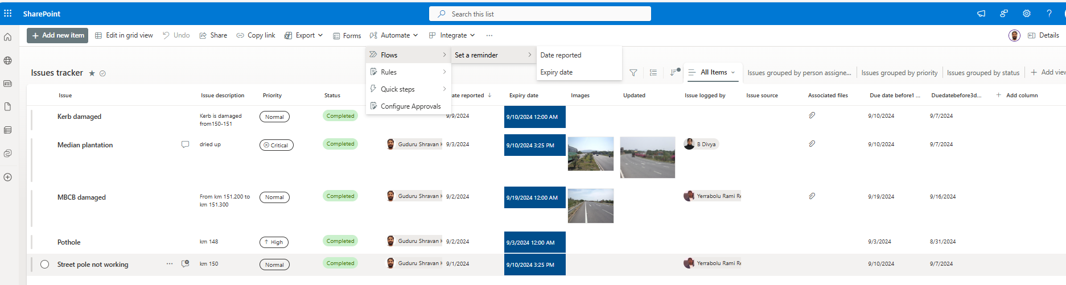
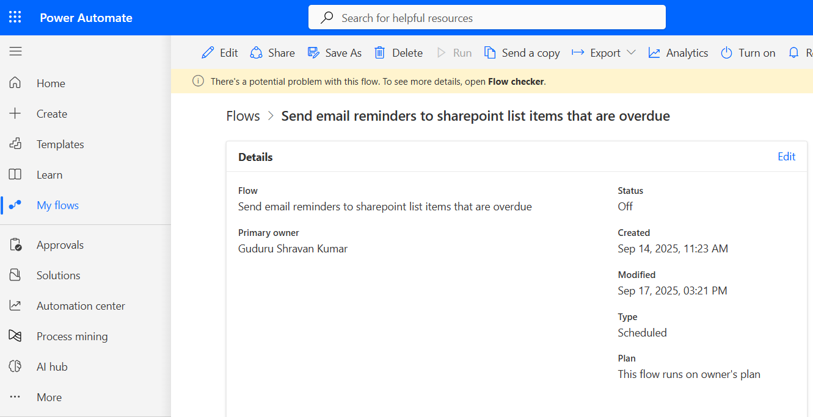
Example
Private and confidential

Slide 29
Example
Flexible Pavement Distress Monitoring –Recurring Failure
Distress​ | Jan- Mar 2025 Q1​ | Apr – June 2025​ Q2​ | July – Sept 2025​ Q3​ | Oct – Dec 2025​ Q4​ | Jan- Mar 2026 Q1​ | Remarks / Analysis​
Pothole​ | No​ | Pothole/ Patch repaired​ | No​ | Pothole/ Patch repaired​ | Pothole Reappeared​ | Investigate BC Mix/ base/sub-base & drainage​
Cracks​ | Low severity cracks​ | Moderate severity cracks​ | Cracks sealed​ | Cracks Reopened​ | Full depth Propagation​ | BC Mix / Structural Investigation​
Rutting​ | No​ | Minor rutting​ | Surface corrected​ | No​ | No​ | None​
No Distress
Minor Distress
Rectified
Recurring Distress
Critical Condition
Interpretation: Repeated rectification followed by recurring distress indicates unresolved root causes. Further investigation into bituminous mix properties, drainage, and base/sub-base structural integrity is recommended.
Private and confidential

Slide 30

Example
Private and confidential

Slide 31

Benefits
Data integration and reporting
Document trials
Digital checklists for real-time monitoring
06
01
Real-Time collaboration Decision making and increased productivity
Enhanced inspection management
07
02
Quality
Cost
Resources
Enhancing project quality by using Project Quality Index feature
Comprehensive documentation features
08
Benefits
03
Offline functionality
Alerts and notifications
09
04
Data access and Traceability
Cost and Resources saving Sustainability
08
05
Reports and Dashboards
Private and confidential

Slide 32
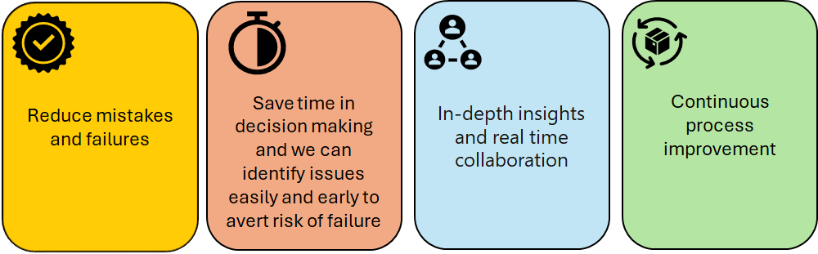
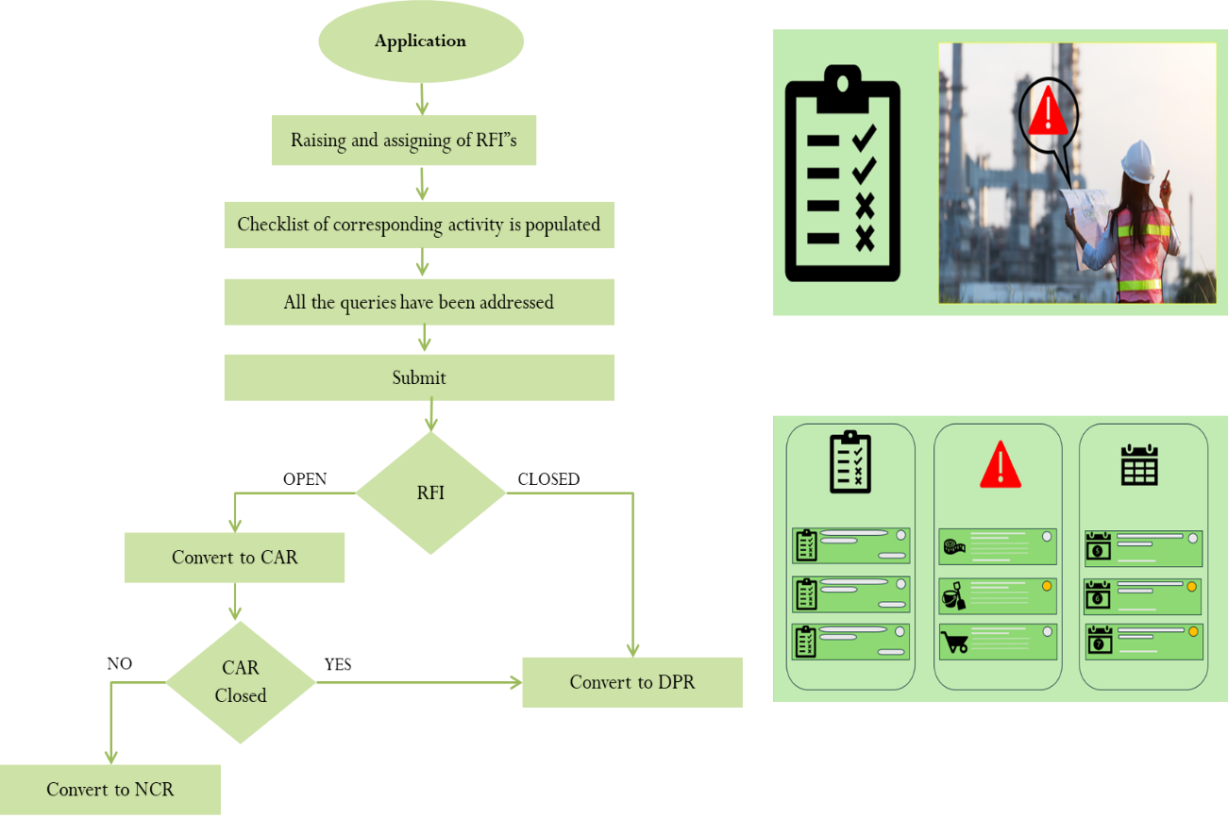
Solution
Digital checklists for real-time monitoring
Enhanced inspection management
Comprehensive documentation features
Data access and Traceability
Data integration and reporting
Document trials
Real-Time collaboration , decision making and increased productivity
Enhancing project quality by using Project Quality Index feature in the application.
Sustainability : Ensuring construction quality through app monitoring will extend the life of any project reducing the need for repair, rehabilitation and reconstruction which are resource intensive. It will also provide a base data for performance evaluation of any product, technology and the project itself over the lifecycle. The data will serve as a key input during any policy making, upgradation and modification in IRC specifications.
Private and confidential

Slide 33
A stitch in Time Saves Nine
It is better to fix a problem when it is small than to wait and let it become a bigger problem
Private and confidential

Slide 34
Thank You.
Private and confidential

