Slide 1


SMART Highways
The Journey so far and opportunities
Dhiraj Prakash Sethi
President – Safety, Systems, Audits & Head – ITS
Cube Highways Technologies Pvt Ltd
Private and confidential
01

Slide 2

Agenda
SMART Highways
AI & ITS Technologies for Traffic Management, Highway O&M
Challenges and Way Forward
Private and confidential
02

Slide 3
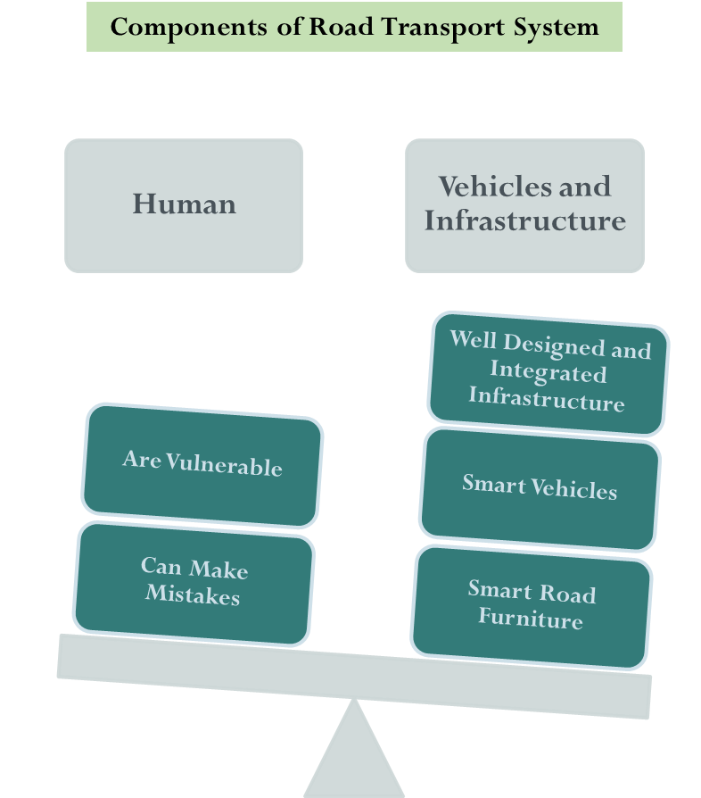

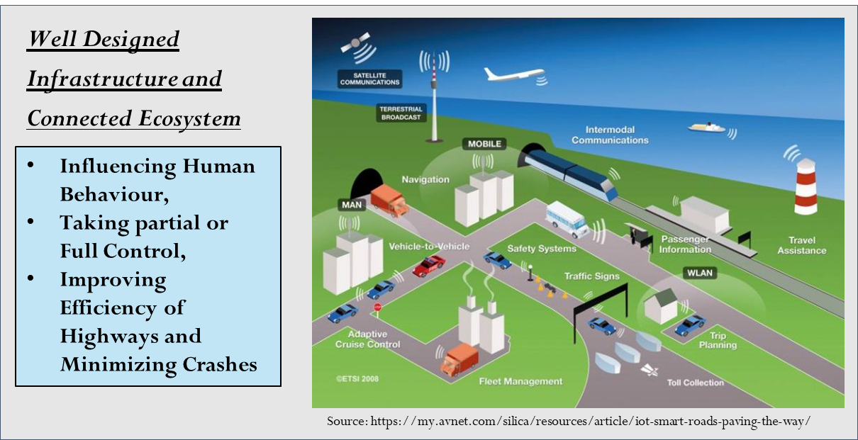
What is SMART Highway??
Private and confidential
02

Slide 4
Components of SMART Highways
Smart highways represent the future of transportation, integrating advanced electronic technologies to optimize road usage, enhance safety, and improve traffic management.”
SMART ROADS
Planning, Designs & Construction
Energy Optimization
Operations – Tolling, Traffic Management
Highway Health Monitoring and Maintenance
Incident Management and Emergency Response
Big Data based learnings and improved specs / practices
SMART ROADS – The Roads Think and Communicate
IoT Sensors and Networking - V2X Communication
AI and Data Analytics
Smart Signages and Signals
Smart Design, Construction & Predictive Maintenance
Innovative Materials, Energy and Lighting Solutions - Sustainable Infrastructure
Private and confidential
02

Slide 5
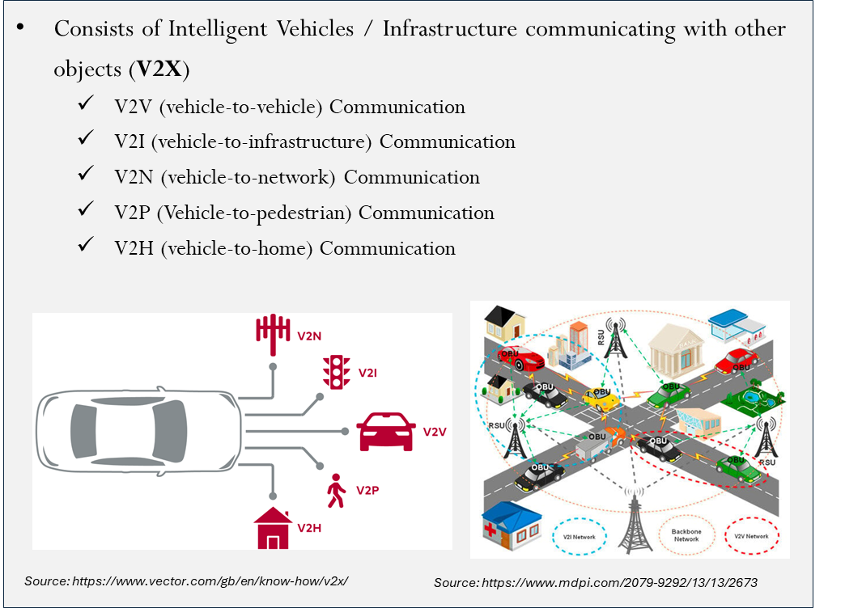
V2X Technologies
C-ITS: Cooperative Intelligent Transport Systems
V2X Technology Pilot Testing at NDEPL Project
Video
I2V Technology –
Infrastructure to Vehicle Communication leading to improved information and behaviour control opportunity
Private and confidential
02

Slide 6
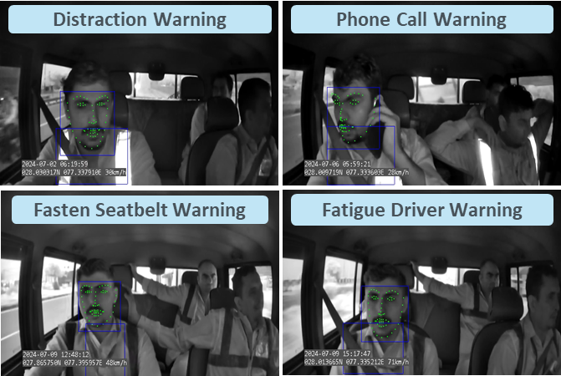
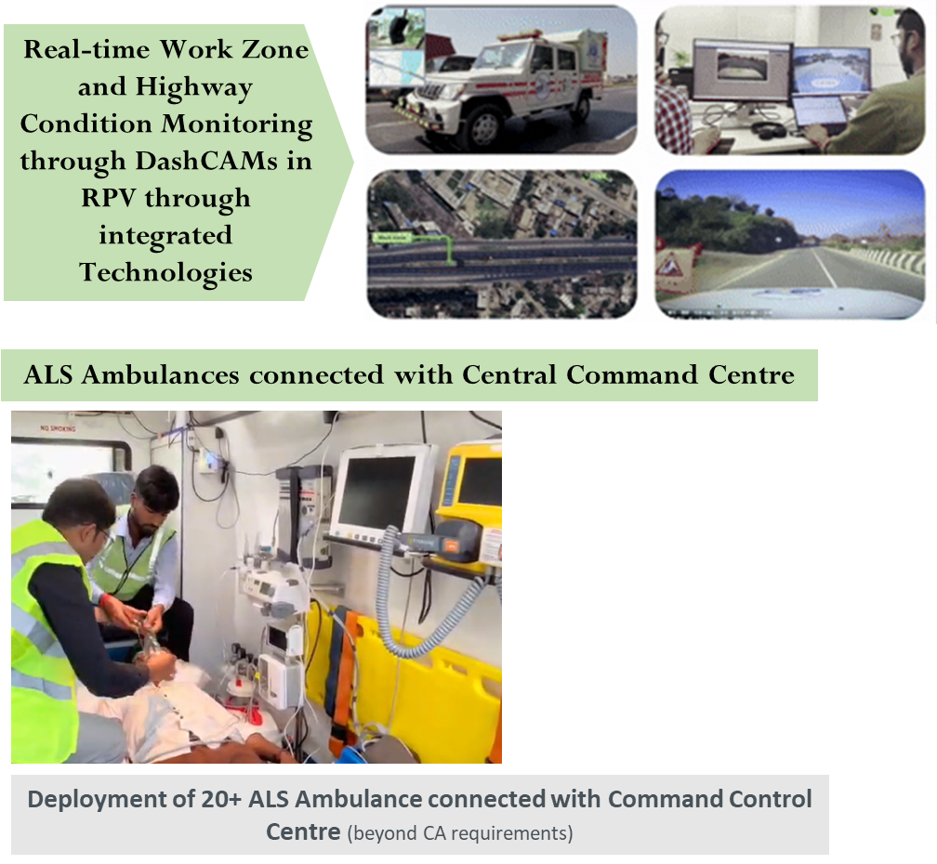
SMART O&M of Highways
VTS and Driver Monitoring System in RPV
Technology at Work Zone Monitoring
Video
Private and confidential
02

Slide 7
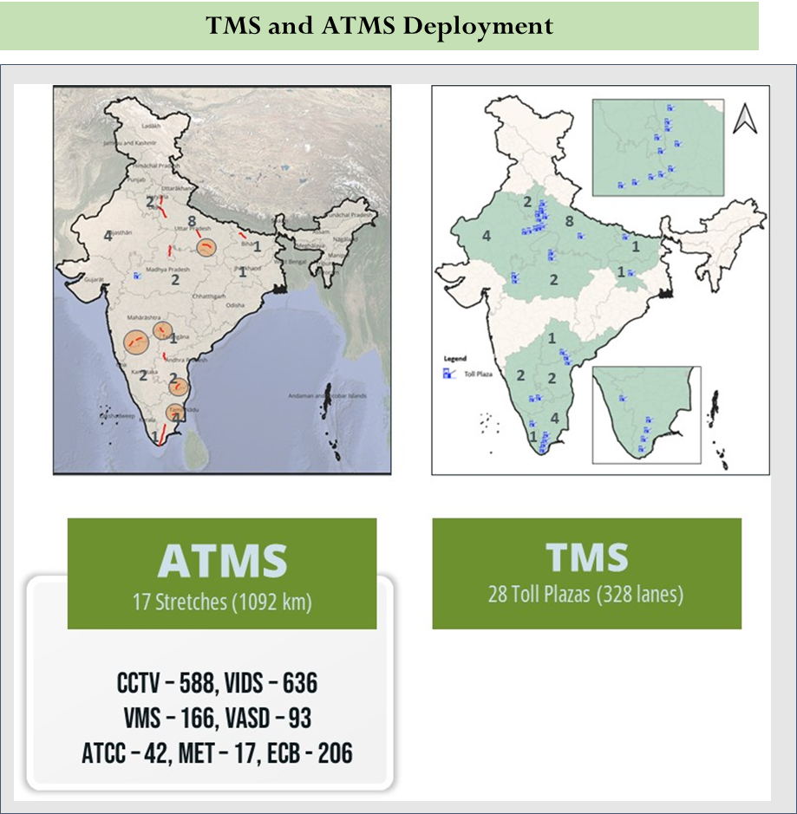
ITS @ Cube Highways Technologies
Private and confidential
02

Slide 8
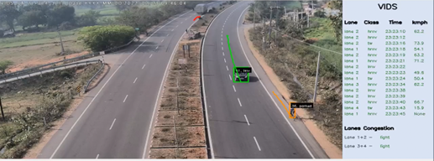
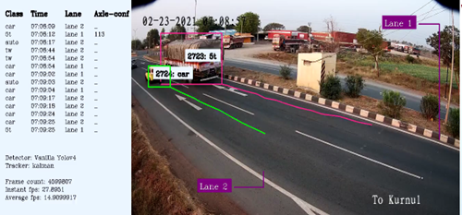
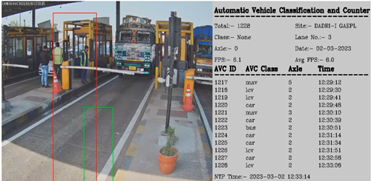
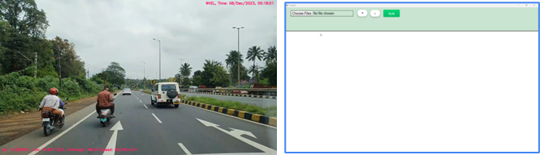
ITS @ Cube Highways Technologies
AI-Vision based Tools Developed and successfully implemented
Incident Detection and Response
Traffic Counting and Classification
Video
Highway Condition Assessment and Structural Health Monitoring
Video
Video
Private and confidential
02

Slide 9
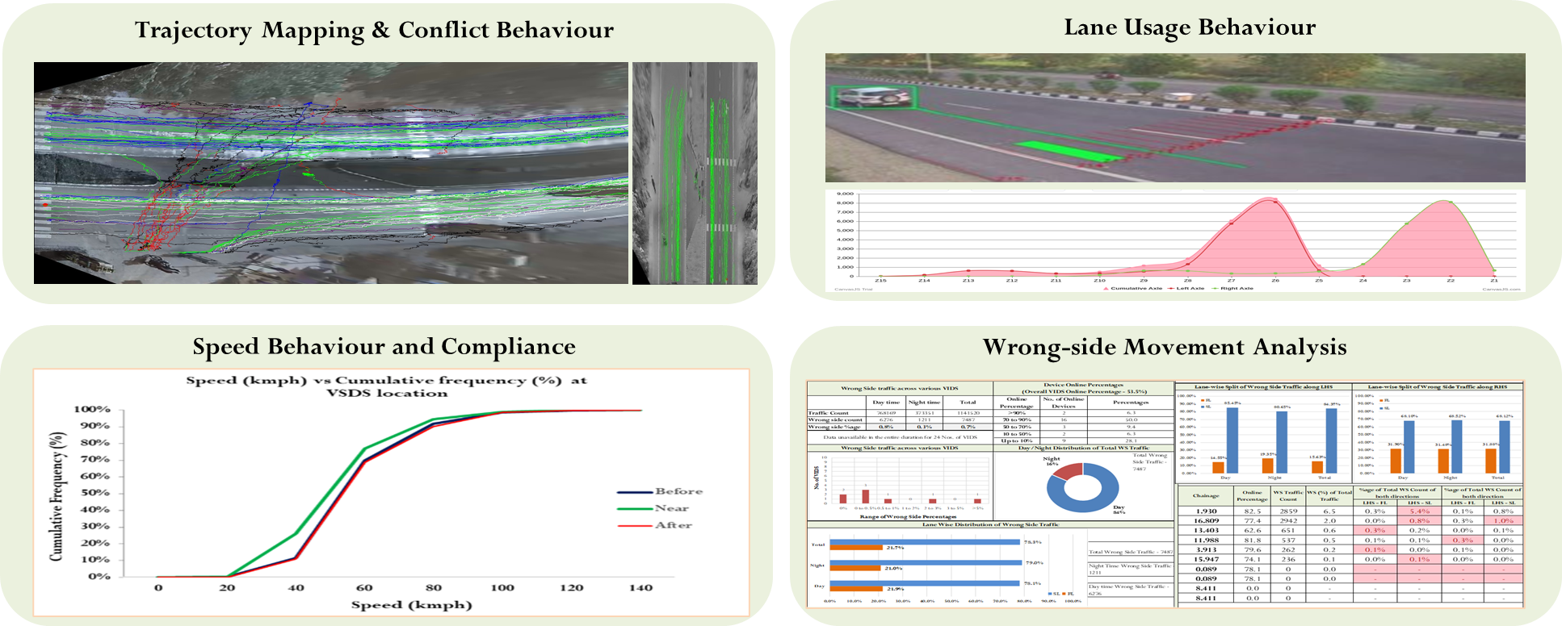

ATMS Utilization
Private and confidential
02

Slide 10
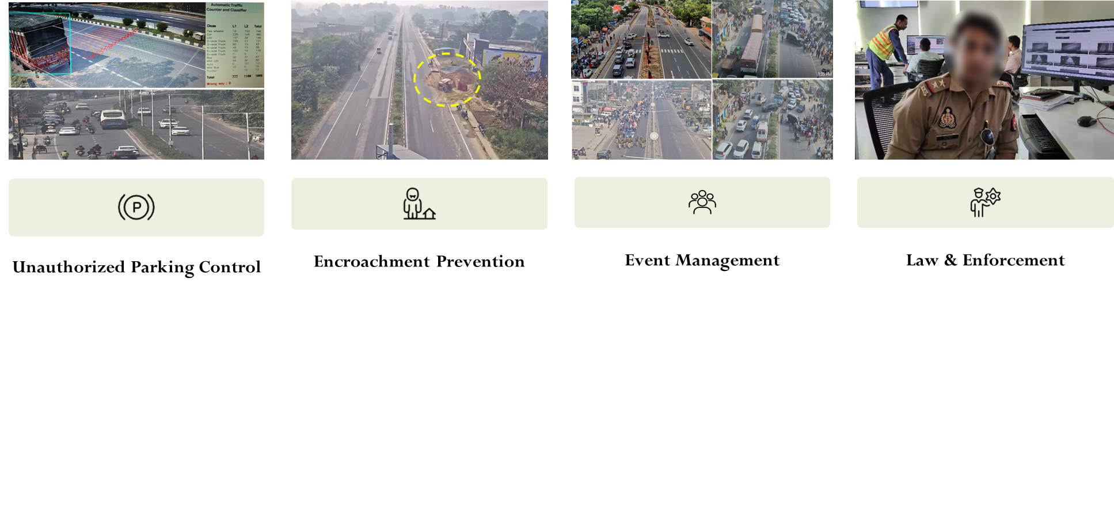
ATMS Utilization
Private and confidential
02

Slide 11
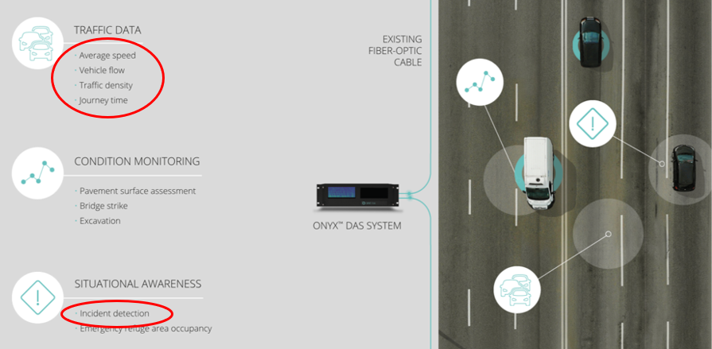
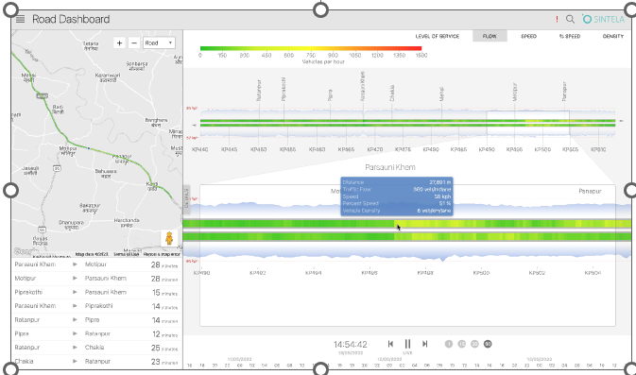
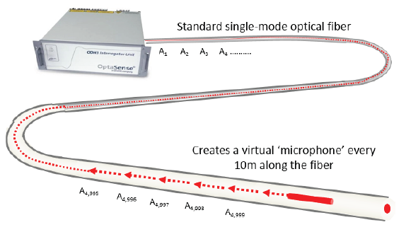
Camera less Traffic Monitoring and Incident Detection
Distributed Acoustic Sensing (DAS) - Fibre Optic Cables to deliver Intelligent Traffic Management (Pilot at KMTL)
Distributed Acoustic Sensing (DAS) is a technology that enables continuous, real-time measurements along the entire length of a new or existing, single mode fibre optic cable.
Video
Calibration Challenges - System is not able to detect smaller vehicles, surrounding factors along NH and junction situations.
However, technology is best suitable for expressways which needs to be studied further.
Private and confidential
02

Slide 12
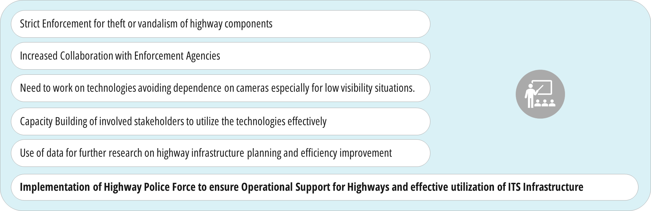
Way Forward for journey towards SMART Highways
Challenges and Suggestions
Private and confidential
03

Slide 13
Thank You.
Private and confidential

