Slide 1


Revolutionizing Bridge Inspection: SetuSTHITI-Driven Automation with Drone Integration
Private and confidential
01

Slide 2

Agenda
Current Practices
Introduction to Revolutionizing Bridge Inspection.
Functionality of Inspection.
Smart inspection using Drones survey and under water robots.
Advantages of Inspections.
Private and confidential
02

Slide 3
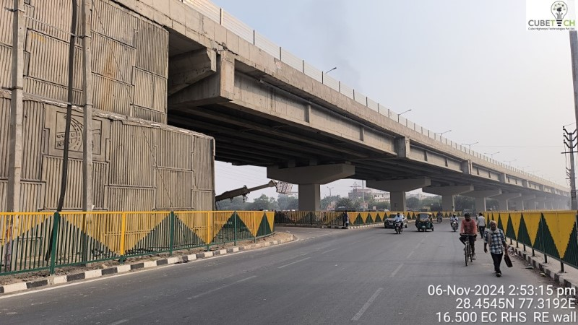
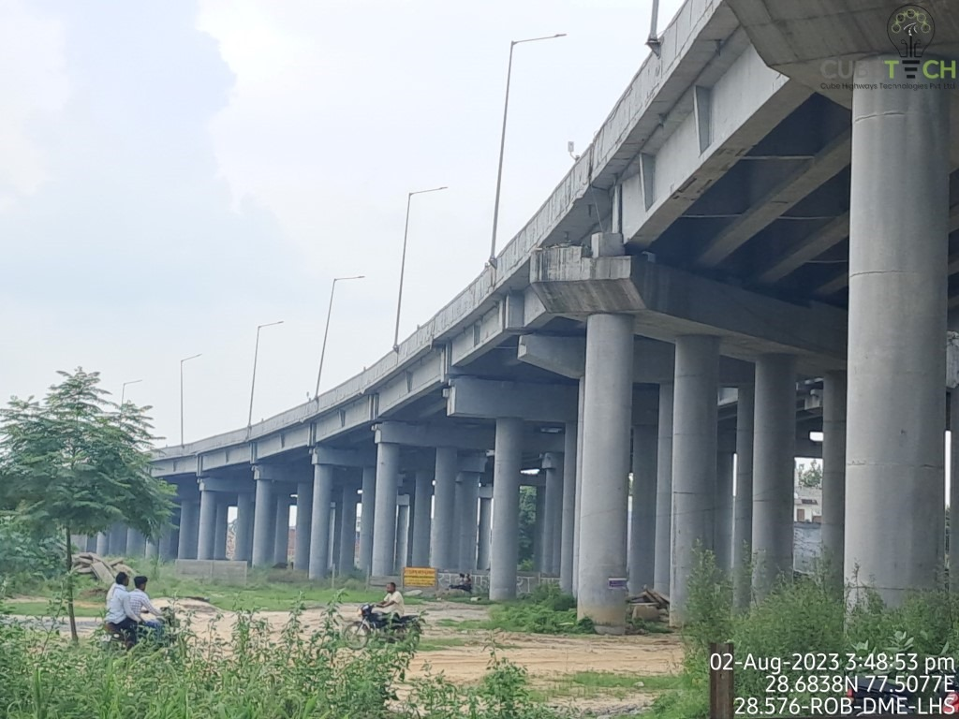
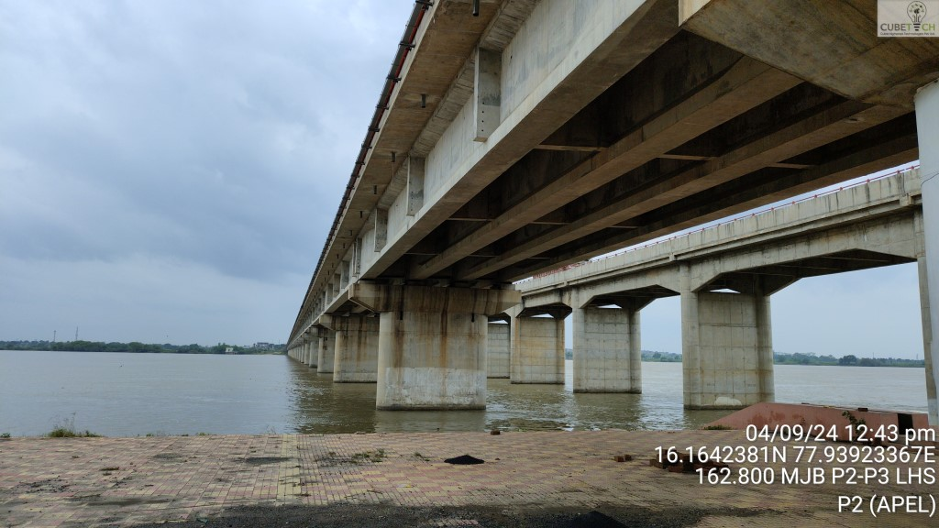
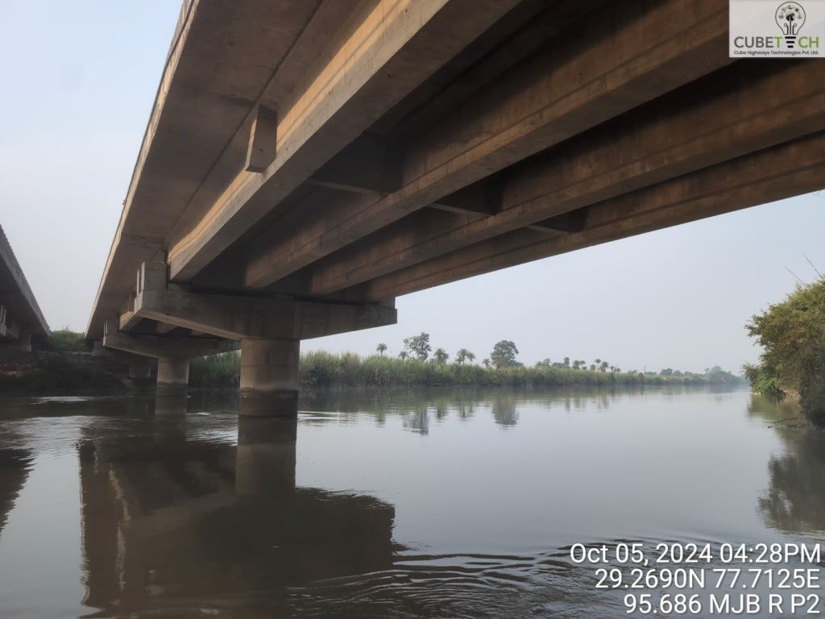
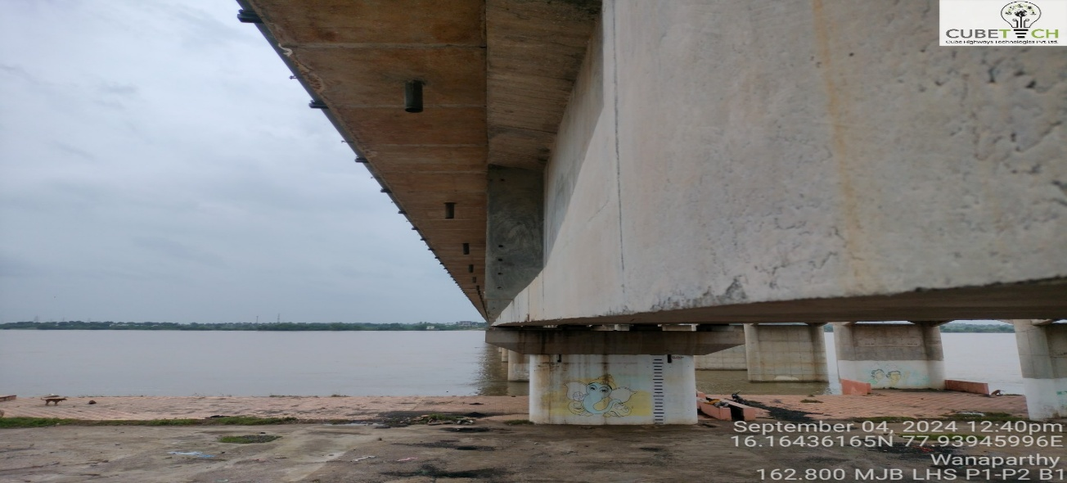
Revolutionizing Bridge Inspection: SetuSTHITI-Driven Automation with Drone Integration
CURRENT SCENARIO OF INSPECTION
How often is inspection done ?
Private and confidential
03

Slide 4
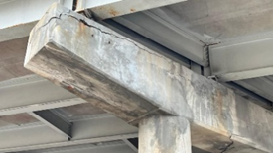


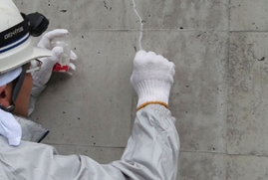
Revolutionizing Bridge Inspection: SetuSTHITI-Driven Automation with Drone Integration
CURRENT SCENARIO OF INSPECTION
Civil infrastructures in Road Sector are progressively deteriorating:
Bridges Flyovers Underpass
Reason: Aging, environmental factors, increased loading, damages caused by human or natural factors, and inadequate maintenance.
Periodic inspection, maintenance, and rehabilitation is needed to ensure that the planned life cycle is achieved or extended.
Inaccessible Area
Pen & Paper
Private and confidential
04

Slide 5
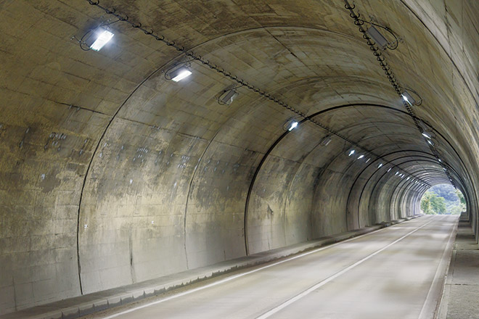
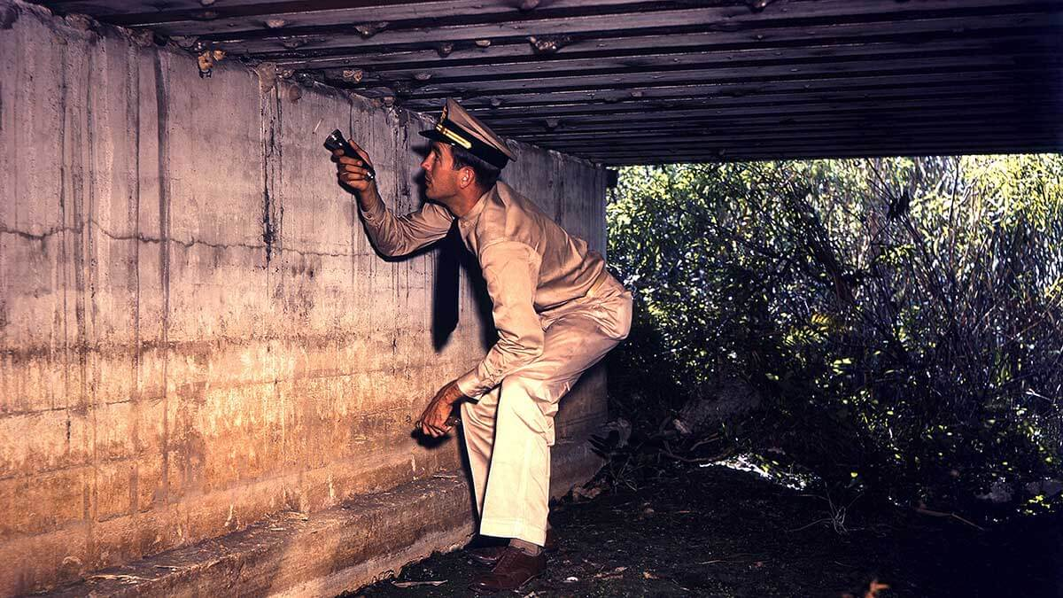

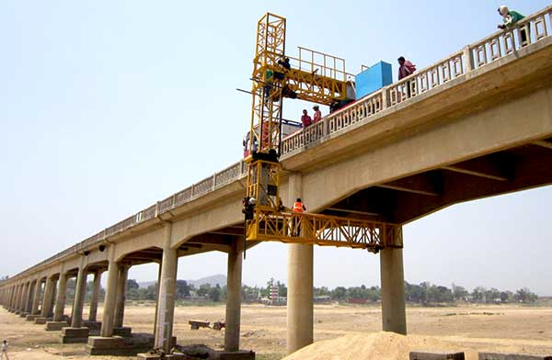
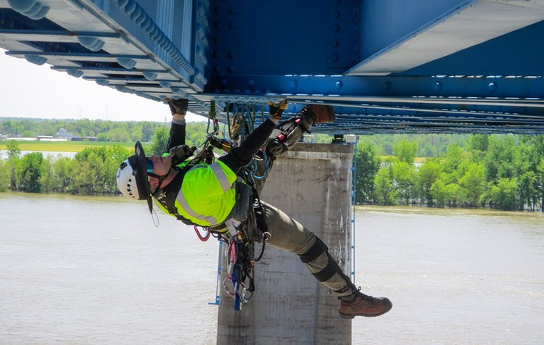
Revolutionizing Bridge Inspection: SetuSTHITI-Driven Automation with Drone Integration
CURRENT SCENARIO OF INSPECTION
CHALLENGES
Skilled labor intensive
Time Consuming
Poor visualization & Opinion based decisions
Expensive
Safety
Over 50% of inspection time is spent on collecting and processing this data. During human-conducted visual inspections it is possible to miss a defect, forget to record it, or record it incorrectly. The quality and quantity of data collected is often insufficient and fragmented.
Private and confidential
05

Slide 6
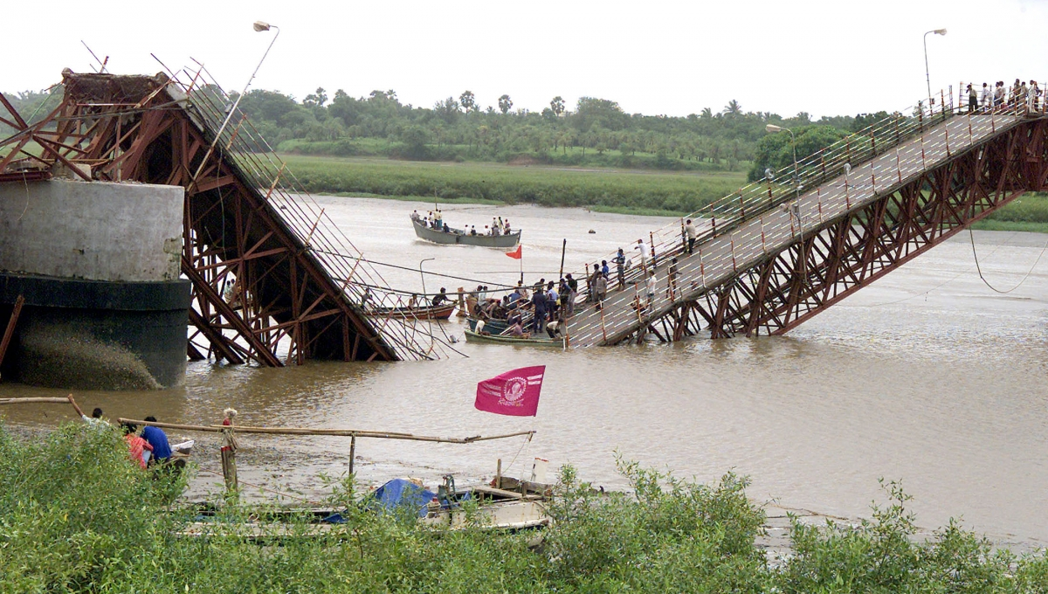
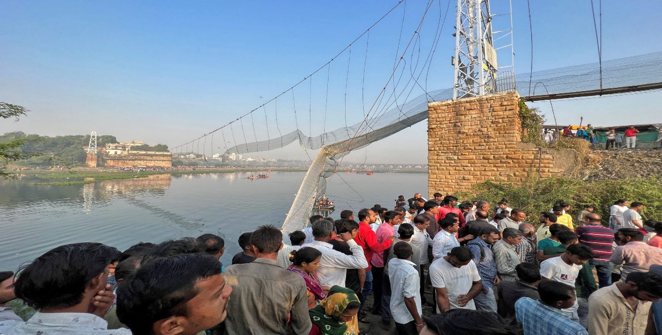
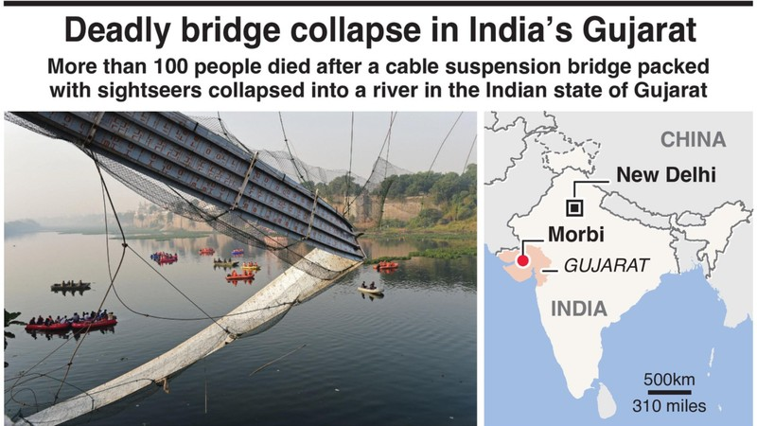
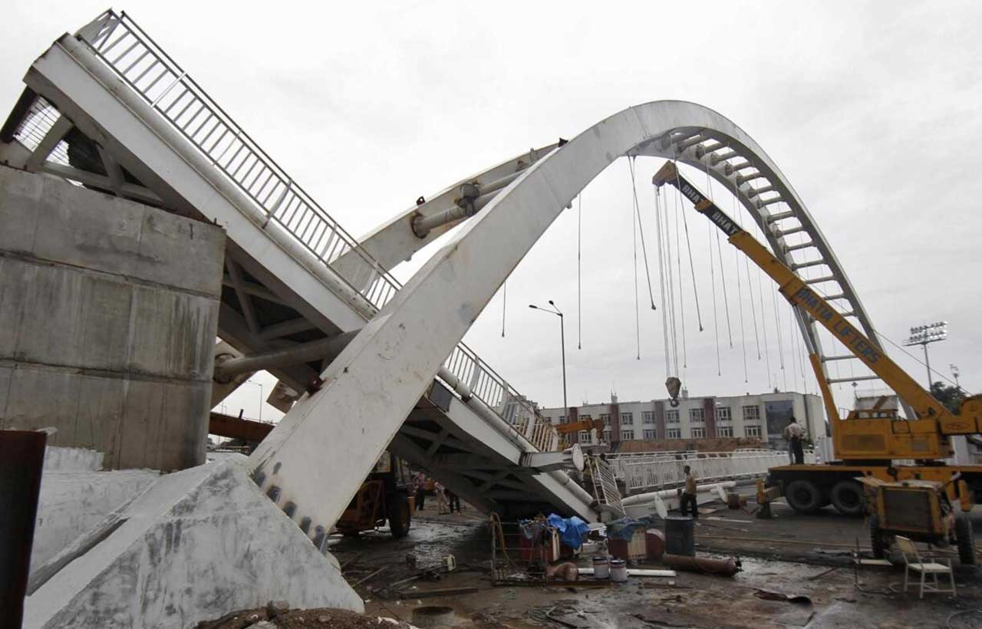
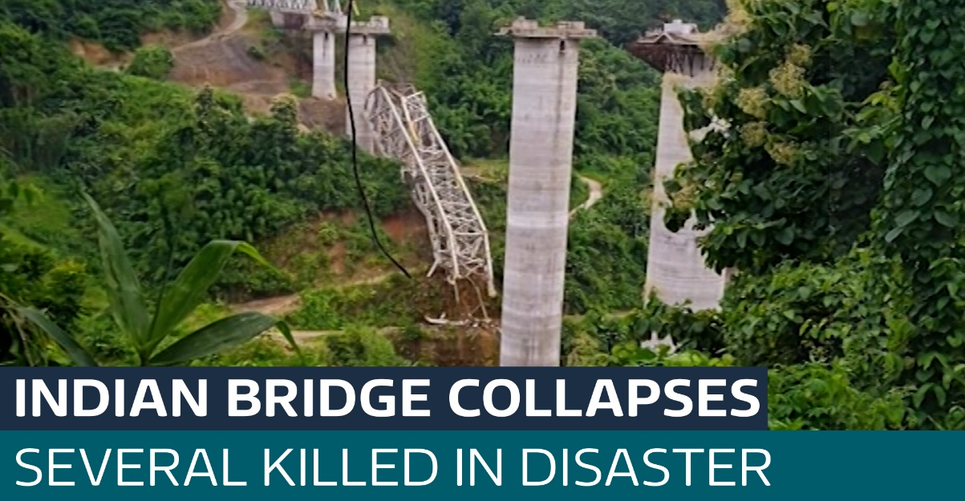
Revolutionizing Bridge Inspection: SetuSTHITI-Driven Automation with Drone Integration
Private and confidential
06

Slide 7

Revolutionizing Bridge Inspection: SetuSTHITI-Driven Automation with Drone Integration
INTRODUCTION TO REVOLUTIONIZING BRIDGE INSPECTION.
To address these challenges, a Structural Audit Application has been introduced.
Multi-platform functionality
Mobile and Desktop versions
  Real time documentation :
  Direct input of data including Uploading of Photos, audio memos and videos
  Compliance
  IRC SP 18-2000 and IRC SP 35 - 2016
Private and confidential
07

Slide 8
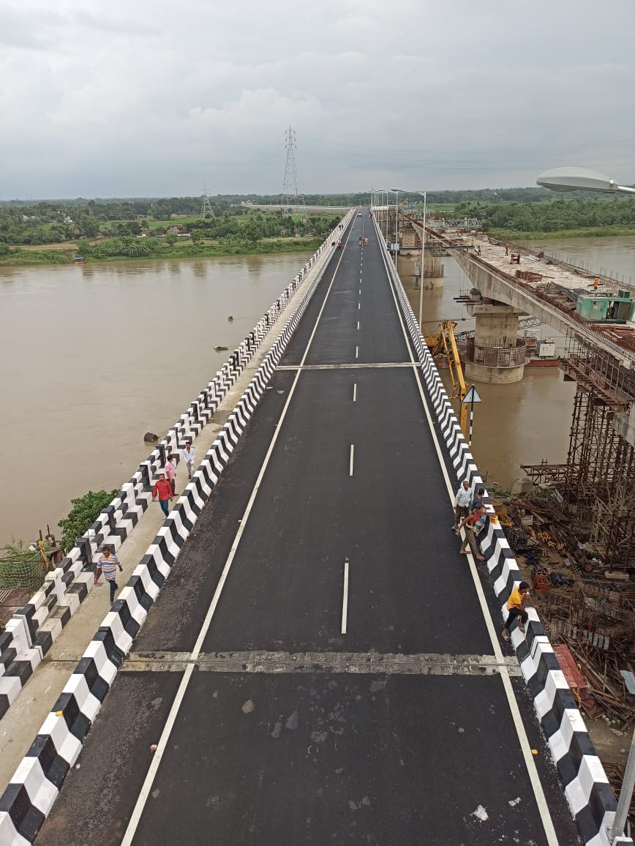
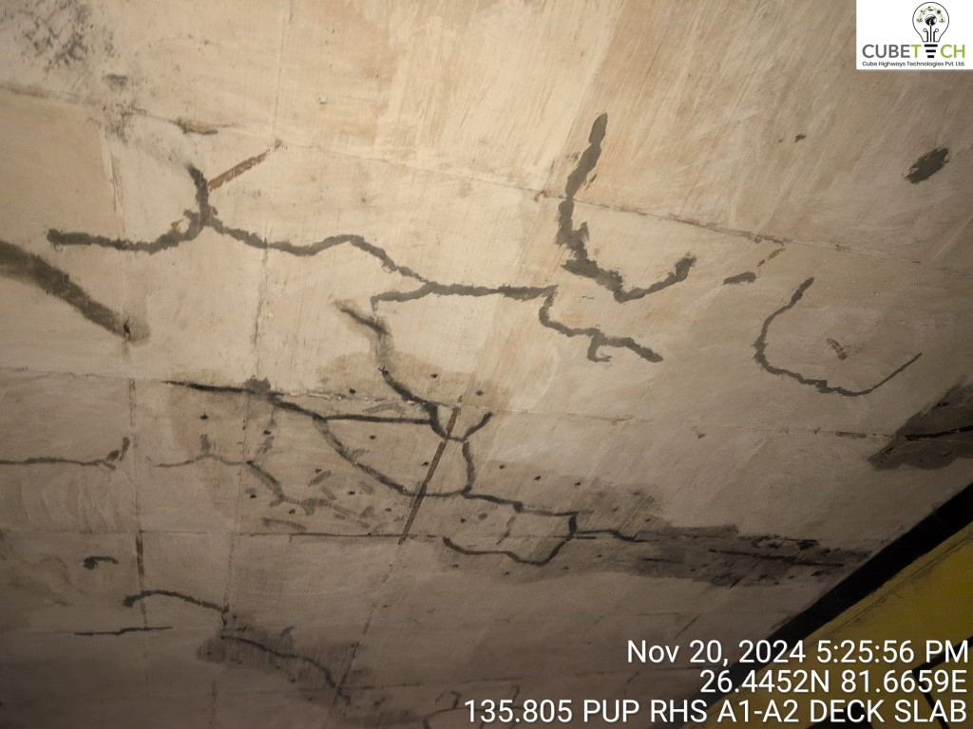
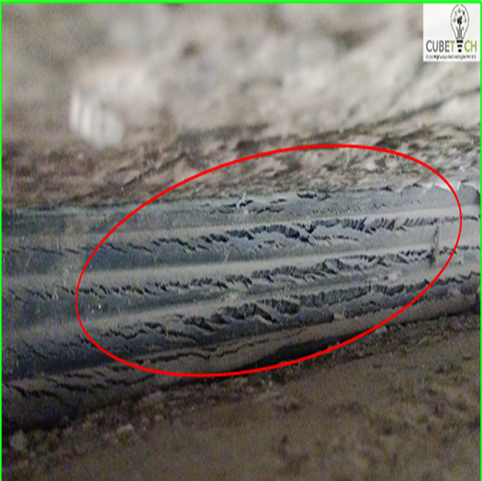
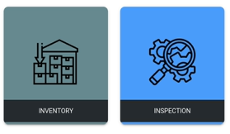
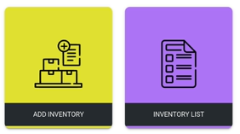
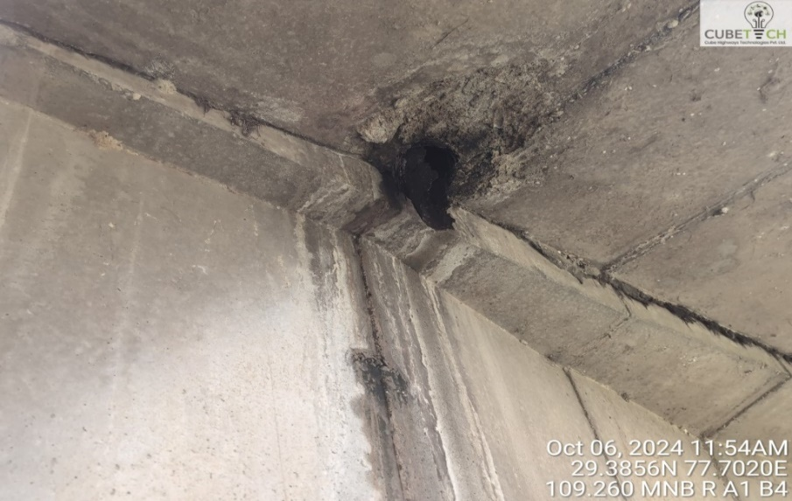
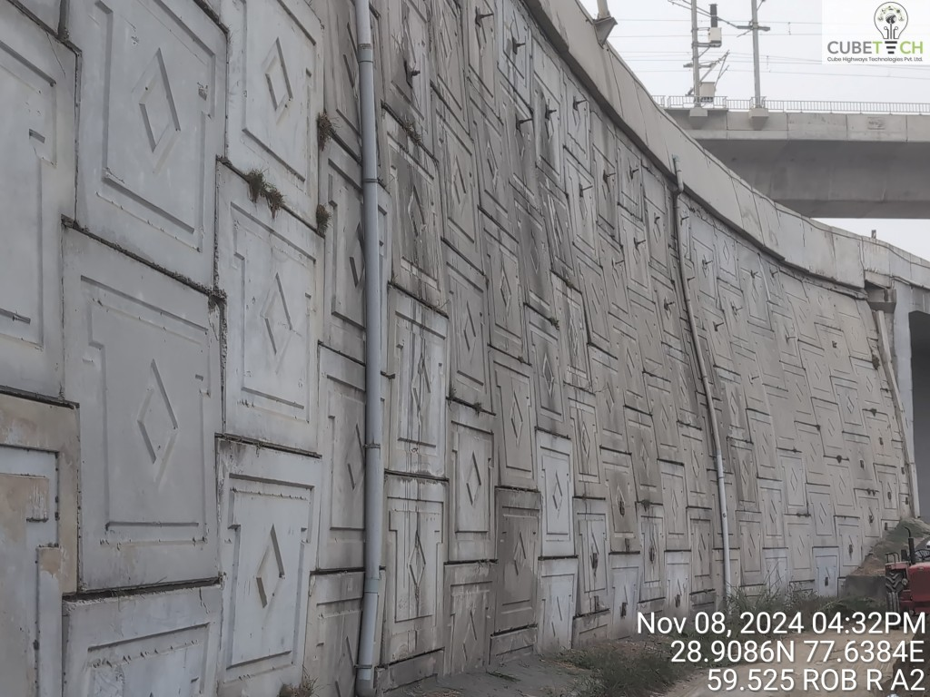
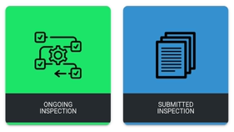
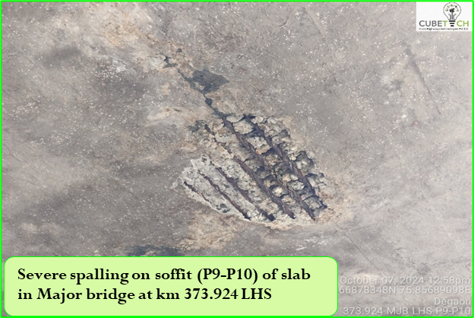
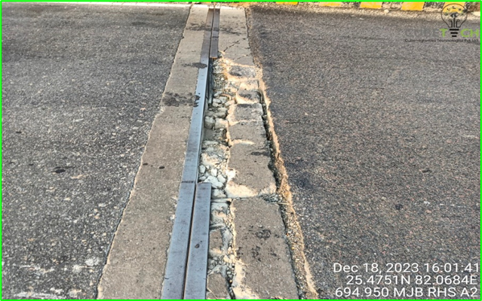
Revolutionizing Bridge Inspection: SetuSTHITI-Driven Automation with Drone Integration
  FUNCTIONALITY OF INSPECTION
  Input of Inventory
  Defect documentation
  3. Site Inspection Tools
Private and confidential
08

Slide 9
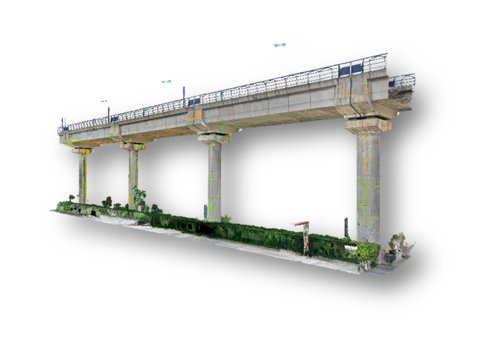
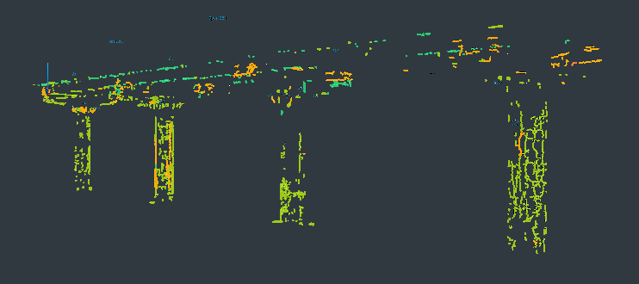
Revolutionizing Bridge Inspection: SetuSTHITI-Driven Automation with Drone Integration
SMART INSPECTION USING DRONE SURVEY
Step 1: Data Collection
Various Imaging Tools:
1. Video
2. Thermal
3. Lidar
Source Agnostic:
1. Drone
2. Digital Camera (Go Pro, Mobile)
Step 2: Data Processing
AI engine infused with Machine Learning & Civil Engineer algorithms for inspection automation:
Defect Detection – 2D
Defect Measurement – 3D
Defect Monitoring – 4D
Step 3: Data Visualization
Asset 3D Digital Twin
Defect Damage Severity
Asset Condition Summary
Ful Asset Portfolio Risk Assessment
Build In Civil Engineer Tools
Automatic Target Based Maintenance reports.
Dashboard and Analytics
Private and confidential
10

Slide 10
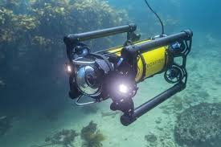
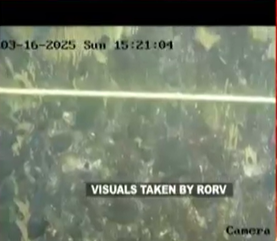
Revolutionizing Bridge Inspection: SetuSTHITI-Driven Automation with Drone Integration
SMART INSPECTION USING UNDERWATER ROBOTS
Bridges Constructed over Perennial rivers and water bodies pose challenges in inspecting substructures and foundation due to Continuous flow.
To overcome these challenges, Underwater Inspection robots are deployed for detailed assessment of submerged structural elements.
Key Advantages of Underwater Robotic Inspection:
Safe Operation with extended and uninterrupted endurance.
Effective performance in hostile and low-visibility environments.
Enhanced Inspection accuracy.
Digital reporting through an integrated dashboard.
Video- based documentation for detailed analysis and record keeping.
Private and confidential
11

Slide 11
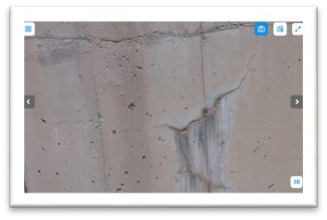
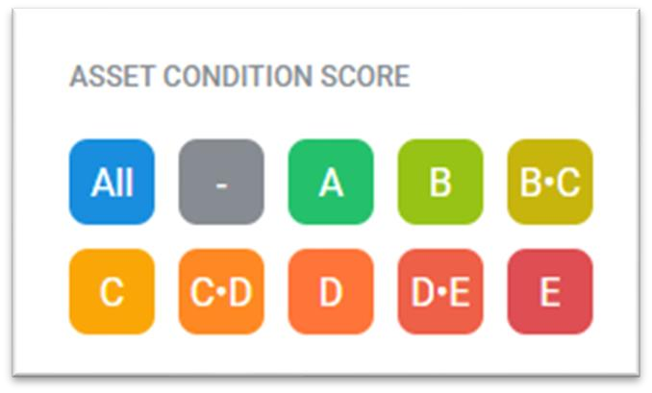
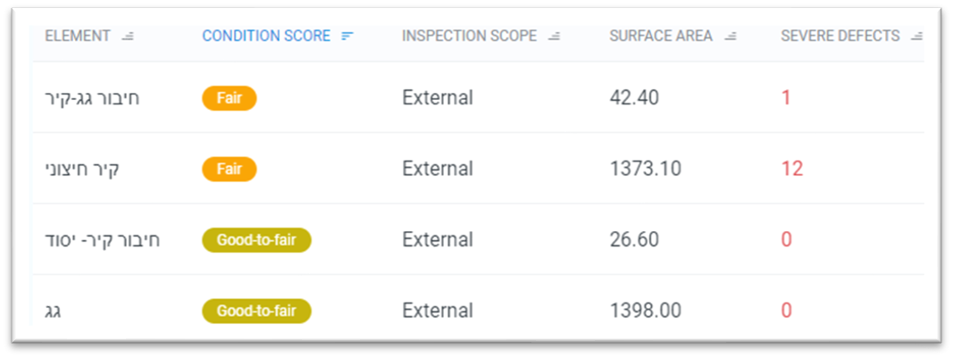
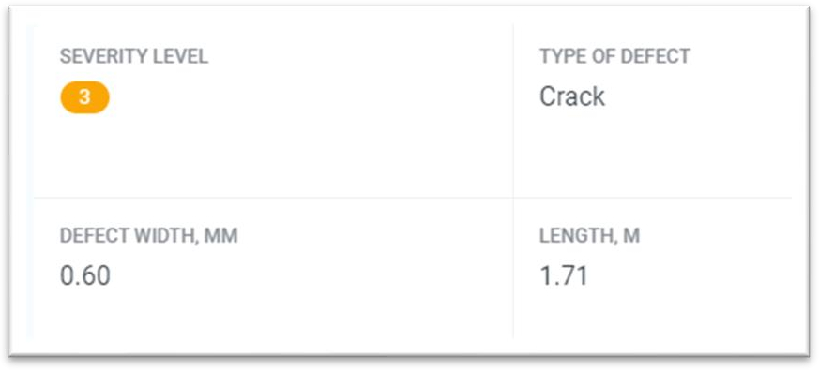
Revolutionizing Bridge Inspection: SetuSTHITI-Driven Automation with Drone Integration
STRUCTURAL HEALTH CONDITION ASSESSMENT
Asset Condition Score
Element
Defect
Weighted Average of Structural Elements
Calculation of Asset Condition Score
Structural Element Breakdown
Defining Element coefficient
Element Area Calculation
Severity Score per Element
Detection
Classification
Severity Assessment
Private and confidential
12

Slide 12
Revolutionizing Bridge Inspection: SetuSTHITI-Driven Automation with Drone Integration
STRUCTURAL HEALTH CONDITION ASSESSMENT
Time Efficiency:
Reduces time spent on inspections and report generation.
Accuracy:
Ensures precise documentation of structural conditions
Comprehensive Management:
Integrates inventory, inspections, and condition tracking
Advantages
Actionable Insights:
Facilitates repair and rehabilitation decisions.
Private and confidential
13

Slide 13
Thank You.
Private and confidential

