Slide 1
Highway Operators’ Association (I)
AI Powered Innovations in Construction & Maintenance
Presented by: Siddharth Gaikwad, Senior Manager (Pavement & QA), Sekura India

Slide 2
Operation & Maintenance
Elements in Highway O&M
Pavement
Structure
Inventory & Furniture
Distresses
Road marking
MBCB
Guard rails
Highway lighting
Kerbs
Miscellaneous
Water stagnation
Sand/soil accumulation
Vegetation growth
Billboards
RoW enchroachment
Signboards
Median plantation
Drain
RE wall Bulging
Expansion joints
Crash barrier
Downtake pipes
Lined drain
Unlined drain
Vegetation growth in RE walls/panels
Almost 100 elements

Slide 3





Pain points related to manual inspection
Manpower intensive
Limitation on frequency
Variation due to change of inspecting person
Additional safety requirements
Timelines for rectification of distresses/defects

Slide 4



Manpower intensive
Tasks
Less manpower requirement*
*Manpower can be used elsewhere – efficient manpower management
Machine
Limitation on frequency
Increased inspection frequency*
*Optimum frequency – provide the ground team sufficient time to rectify the defects
Human Intelligence
Variation due to change of inspecting person
Uniform results*
*Depends on how well is the algorithm trained and what quality data is used for training
Additional safety requirements
Reduced safety requirements
Timelines for rectification of distresses/defects
Artificial Intelligence (AI)
Meeting the deadlines efficiently

Slide 5


No decision making outside the set constraints
Data security
Filtering the defects based on common sense
Additional hardware requirement & its maintenance
Accuracy depends on data quality & quantity
Not a replacement but a helping hand

Slide 6
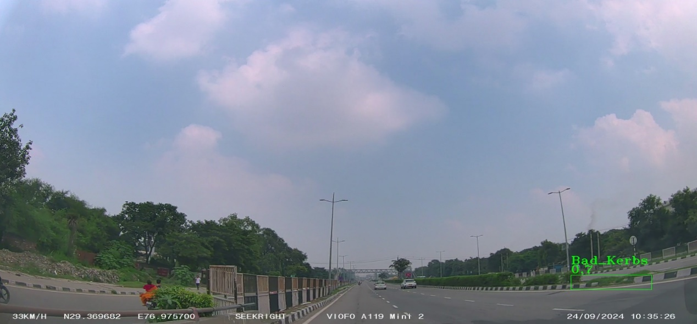
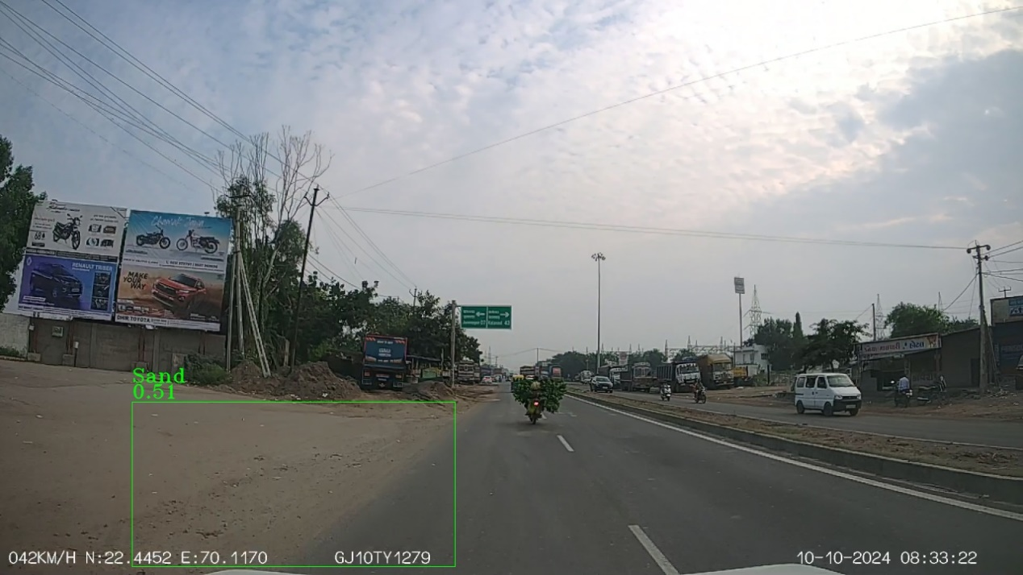
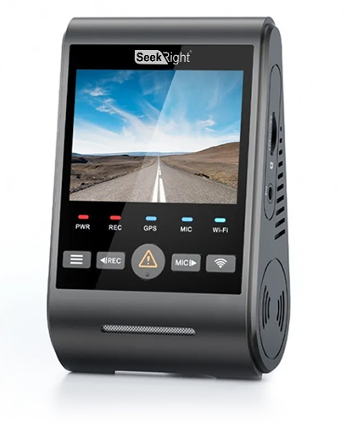
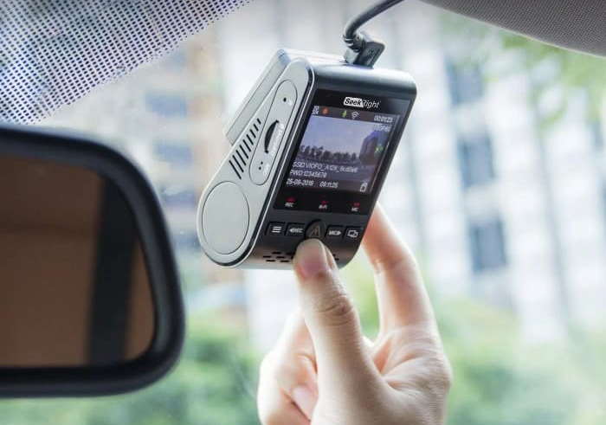
iHAMS – Intelligent Highway Asset Management System
State of art Computer vision-based machine learning solution to monitor the highway assets
A Dashcam is installed in all RPVs (Route Patrol Vehicles) and video is recorded while RPV is in motion.
An algorithm based software detects anomalies and deviations
Identified anomaly information actioned by site and HQ teams, restore the asset condition to its original status.

Slide 7
iHAMS
Video related to iHAMS

Slide 8













iHAMS – Key features & benefits
Key Features
Key Benefits
Digital twin
Creating digital replica of the highway along with plotting of the inventory
Real-time processing and analysis
Helps to attend to anomalies and damages as fast as possible, thereby saving money and lives
Complements the manual inspections with its pre-emptive detection and reduces manual dependency.
Accuracy – Over 95% accuracy in identifying anomalies
Brings in transparency – Anomalies can be remotely viewed, through highly analytical dashboard. This results in a communication between head office and site office ensuring that anomalies are resolved
Instant reporting – Sends notification to assigned team for action.
Accountability – Possible to monitor the closure of anomalies and measure the SLA deviations.
Data-driven decision making.
Above 95% accuracy
Enables to take informed decision
Geofencing & chainage mapping
Helps maintenance teams to the locate the inventory quickly
Comparison mode
Visuals of anomalies are compared against the master data library
Identification mode
Identifies potholes, damaged kerbs, and more anomalies without comparison
Night mode
Works under low-light conditions checking streetlights, solar blinkers, etc.
Customizable dashboard
Simple, intuitive interface that does not require special training to understand and consume.

Slide 9
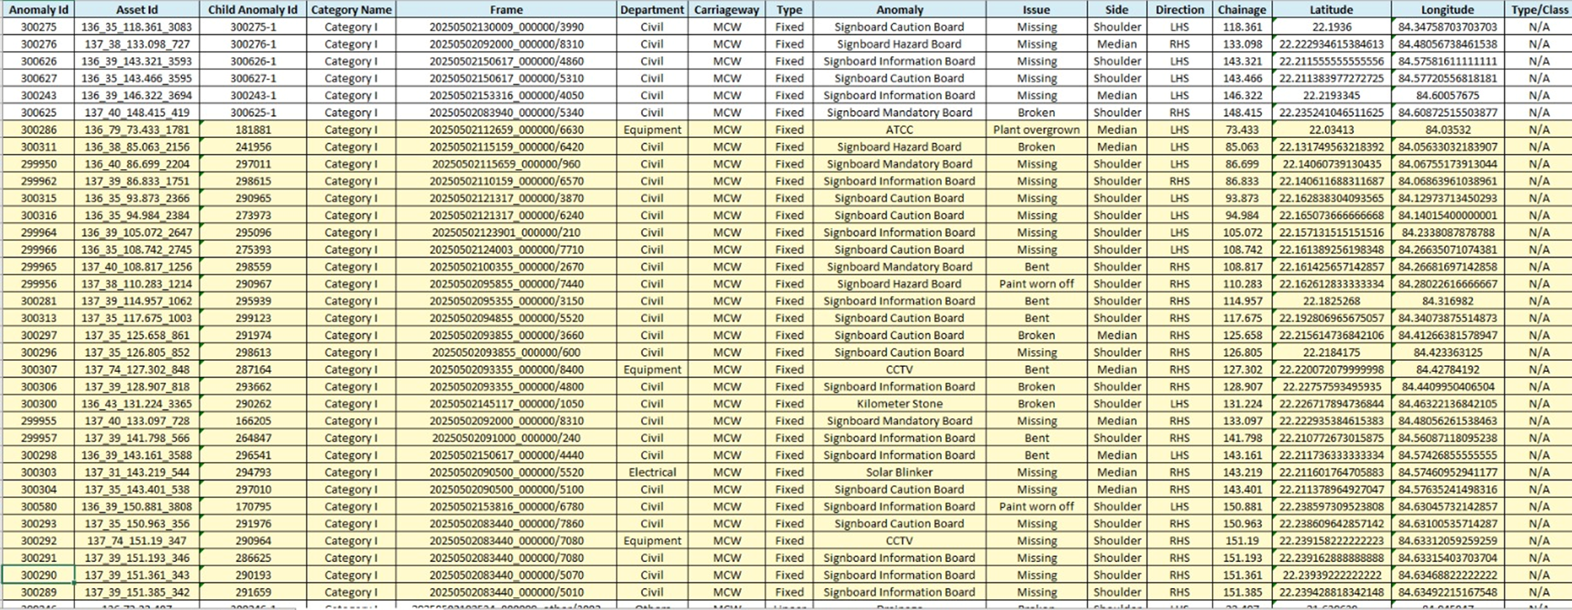
Report – Actionable reports for decision making

Slide 10
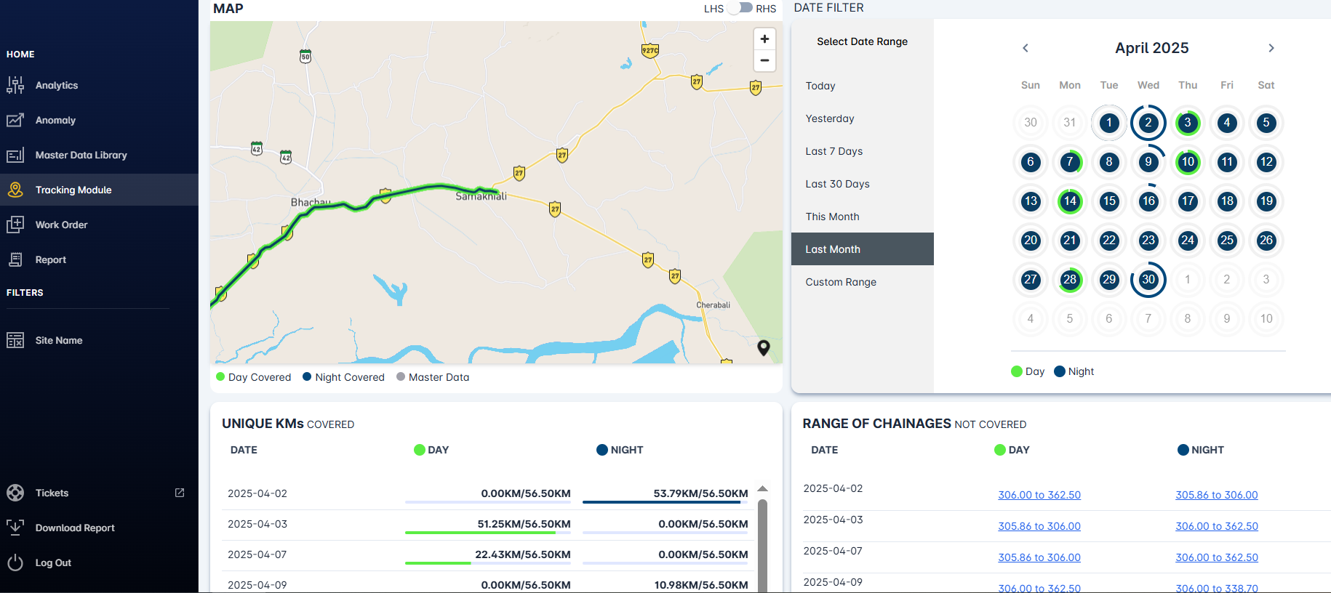

Slide 11
AI based Automatic Traffic Counter and Classifier (ATCC)
Problem statement: A 38 km road constructed by State PWD in 2014 is acting as an alternative route bypassing for one of the three toll plazas of the project.
Effect: Revenue loss
Primary solution: Classified Traffic Volume Count (CTVC) conducted every month on the alternative route and report was submitted to Authority for claiming the revenue loss
Pain point: Authority’s low confidence on the report supporting the claims
Improved solution: Installed 2 AI based ATCC cameras on the alternative route. The output of this system has an accuracy above 90%

Slide 12
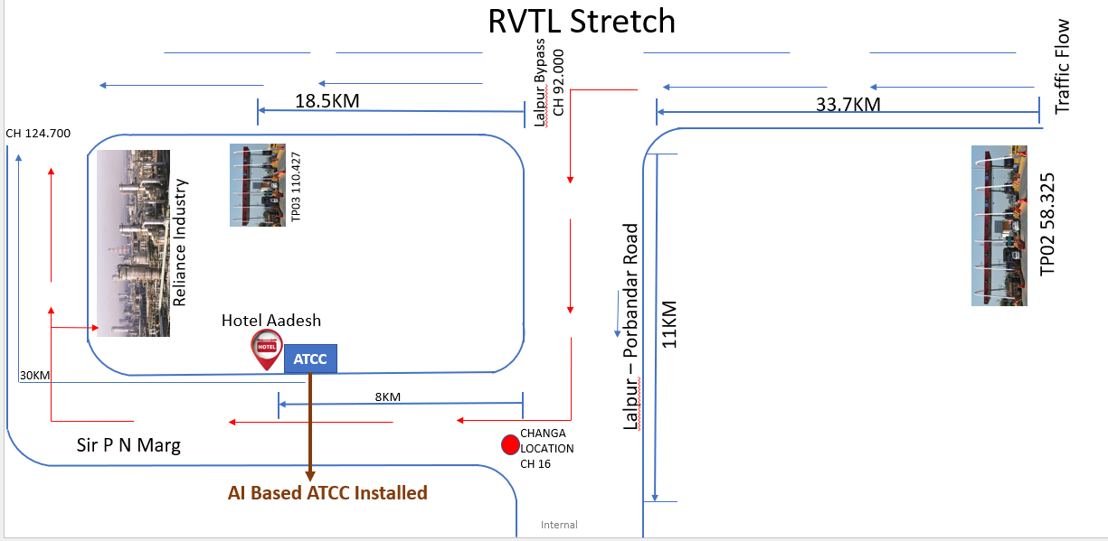
AI based Automatic Traffic Counter and Classifier (ATCC)
The cameras are connected to processing unit which identifies the categories of vehicles.

Slide 13
AI based Automatic Traffic Counter and Classifier (ATCC)
Video related to AI ATCC

Slide 14
Other AI powered Innovation in Highway sector

Slide 15
Automated & Intelligent Machine-aided Construction (AIMC) system
Automated & Intelligent Machines such as GPS aided Motor Grader, Intelligent Compactor and stringless Paver have been used in the Lucknow – Kanpur Expressway as a pilot project in India.
3D Machine control Dual GNSS Motor grader system
  Operator Display & Controller
  GNSS Receivers
  Hydraulic Control Valves
  Communication
  Power Module
  Valve Module
  RTK Base Station
  Softwares for design, drawings & monitoring
Intelligent Compaction technology
  GNSS Receiver for pass count mapping fitted on Roller
  RTK Rover
  Angle sensor or IMU sensor
  Accelerometer/ Compaction Sensor
  Control Box
  Modem/Wi-Fi
  IC software
Source: Office Memorandum of MoRTH dated 16th December 2024

Slide 16
Ideas for implementation in future
Automated Plant Watering System – sensors to detect moisture of the soil and automatically adjust the rate of flow of water.
Variable Message Signboards – linked to real time traffic on the highway, speed of vehicles and weather conditions.
Real time traffic management – useful in city roads to control the traffic flow using real time traffic data and controlling the traffic signal timings
Decision Assistant program – AI assisted program to decide regarding preventive maintenance based on existing pavement condition, climatic conditions, traffic loading, etc.
Traffic forecasting program – AI assisted program to forecast the traffic for an existing highway in O&M phase or new construction of a highway.

Slide 17
“AI should assist people…it should not replace them.”

