Slide 1
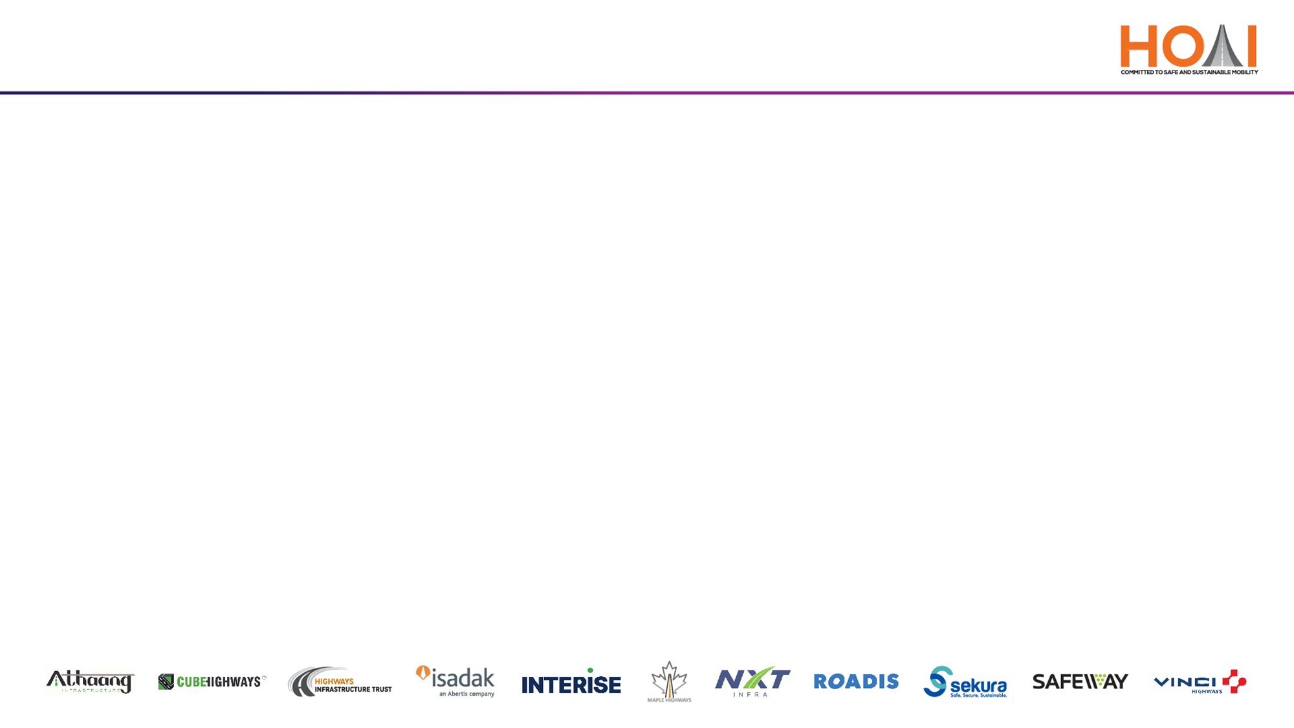
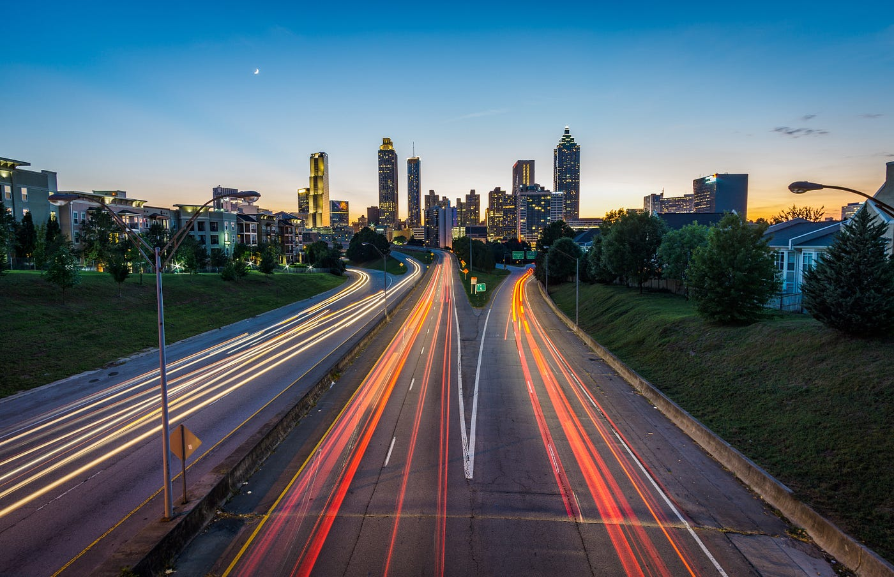
AI-Powered Innovations in Construction
&
Maintenance
Transforming Highway Infrastructure through Intelligence

Slide 2
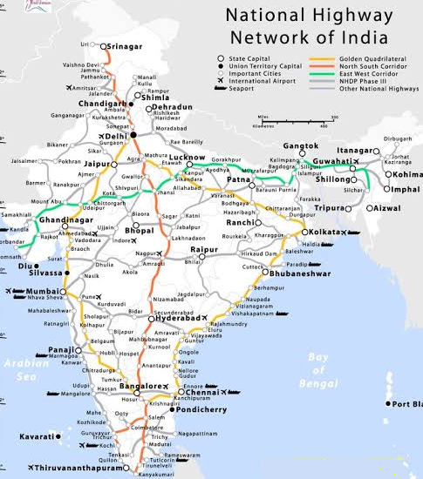


Introduction & Industry Context
India's Expansive Road Network
Second-largest globally with over 6.7 million km of roads.
Traffic Volume have grown by 12 % CAGR in last decade
Accounts 11% of global road accident deaths, with over 150,000 deaths each year
Challenges in Traditional Methods
AI as a Transformative Solution
Manual inspections - inefficiencies.
Delays & cost overruns in projects.
Safety concerns.
Enhances efficiency, safety & sustainability.
Enables predictive maintenance
Real-time monitoring.
Data-driven decision-making.
Globally, countries like the USA, UK, and UAE have embraced AI-powered road infrastructure solutions, achieving significant reductions in costs, accident rates, and maintenance downtimes

Slide 3
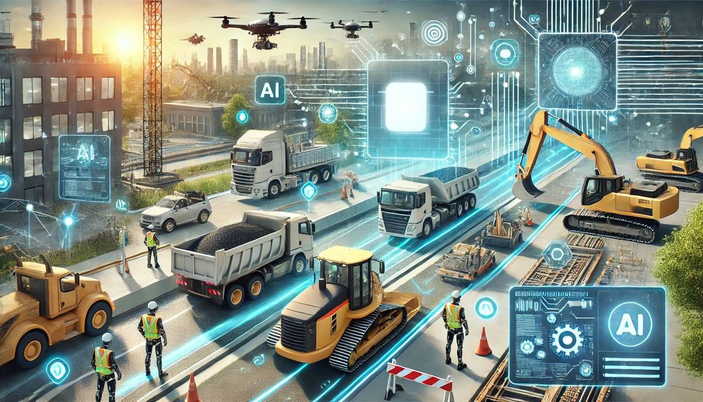
Need for AI in Construction & Maintenance
Addressing Project Delays & Cost Overruns
AI-driven simulations identify potential issues early.
Optimizes resource allocation and scheduling.
Enhancing Safety and Quality
Predictive analytics foresee structural failures.
Real-time monitoring ensures adherence to quality standards.
Global Perspective
Colorado Department ( USA) of Transportation uses AI to analyse real-time weather and
crash data to reduce emergency response time by 22% annual operational savings of $2.5 million
Indian Initiatives
Delhi–Mumbai Expressway for terrain mapping , geotechnical simulations, intelligent & traffic management.
cutting approval timelines by 60% & reducing design iteration costs by ₹3,200 crore (as per MoRTH estimates)

Slide 4
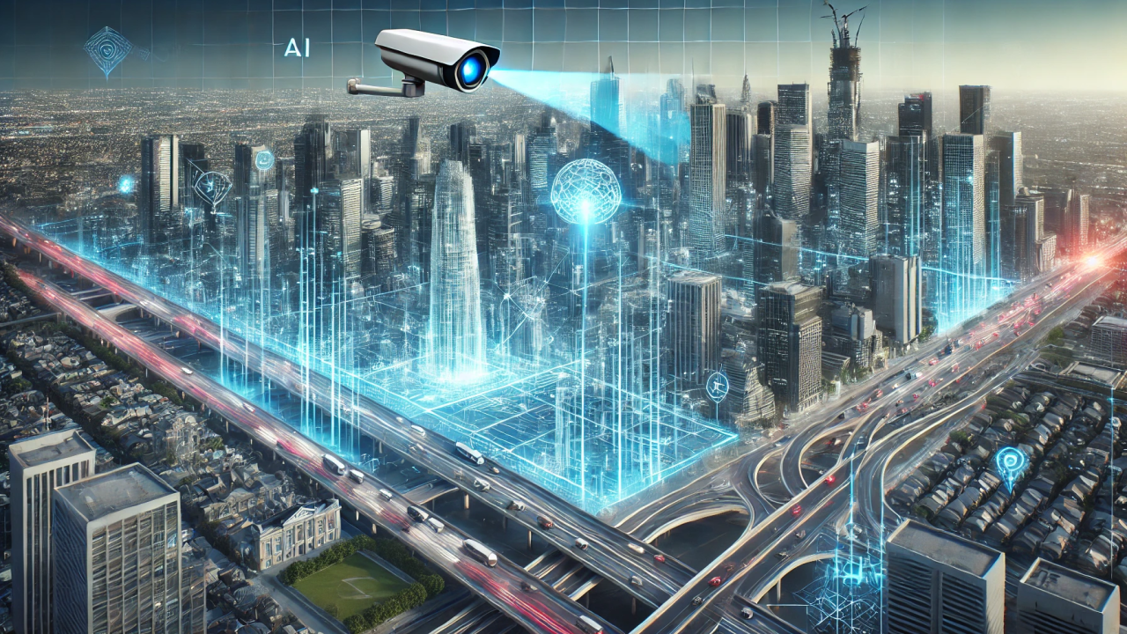
AI-Powered Machine-Aided Construction
Autonomous Machinery
GPS and LIDAR-guided equipment for precision.
Reduces human error and accelerates construction timelines.
AI-Driven Design & Simulation
Generative design models optimize structural integrity.
Simulations assess environmental impacts & material efficiency
Real-Time Monitoring
Sensors and cameras track construction progress.
Immediate detection of deviations from plans.
Global Example
Indian Example
Komatsu’s Smart Construction platform in Japan
utilizes drones and AI for site management.
Up to 40 % reduction in project timelines
Saved up to 20% in labor & fuel costs – Large Projects
Delhi–Mumbai Expressway employs AI for terrain modeling & stress analysis.
Helped to reduce design changes up to 30%
Such systems help authorities and EPC contractors to maintain accountability and ensure project milestones are met without physical re-inspections

Slide 5

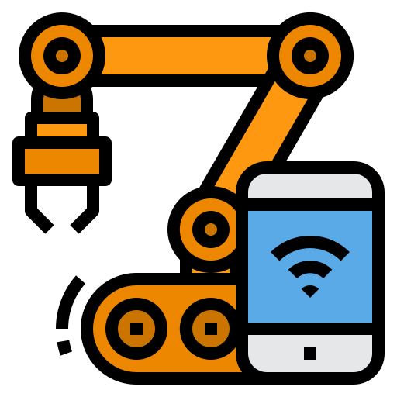
Drones & Robotics in Highway Projects
Aerial mapping for accurate
land assessments.
Monitoring construction
progress and detecting anomalies.
Automated machinery for tasks
like concrete pouring.
Enhances safety by handling
hazardous operations.
Drone Surveillance
Robotic Applications
Example
Singapore - Inspect structural joints on Expressways
Reduced inspection time from 3 days to 6 hours
Increased worker safety by 40%
NHAI’s - "Drone as a Service" initiative for biweekly
project audits
USA – 3D-Printed Bridge Components -
Robotics used for prefabricated bridge parts
Cut build time by 60% and saved $600,000
per bridge on average
The combination of automation and precision leads to faster project timelines, lower costs, and improved safety and data accuracy

Slide 6
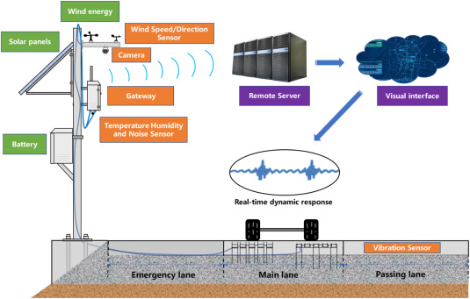
Predictive and Preventive Maintenance using AI
Image Recognition Models
Sensor-Driven Monitoring
AI analyzes road images to
detect cracks and potholes.
Prioritizes maintenance
based on severity.
IoT sensors track stress,
moisture, and vibrations.
Predicts structural failures
before they occur.
Global Example
Vinci Highways ( France) uses AI for road & asset defects monitoring reduce inspection costs by up to 50%
Kansas’(USA) Smart Pavement pilot uses IoT and AI for real-time analytics - saving $4.5 million
over two years in emergency repairs
Indian Initiative
Tamil Nadu's Road Asset Management Project incorporates AI for deterioration modeling - Reduced emergency
maintenance by 18%, reallocating ₹220 crore
Predictive models reduce unforeseen outages, extend equipment lifespan, and decrease costly emergency repairs.

Slide 7
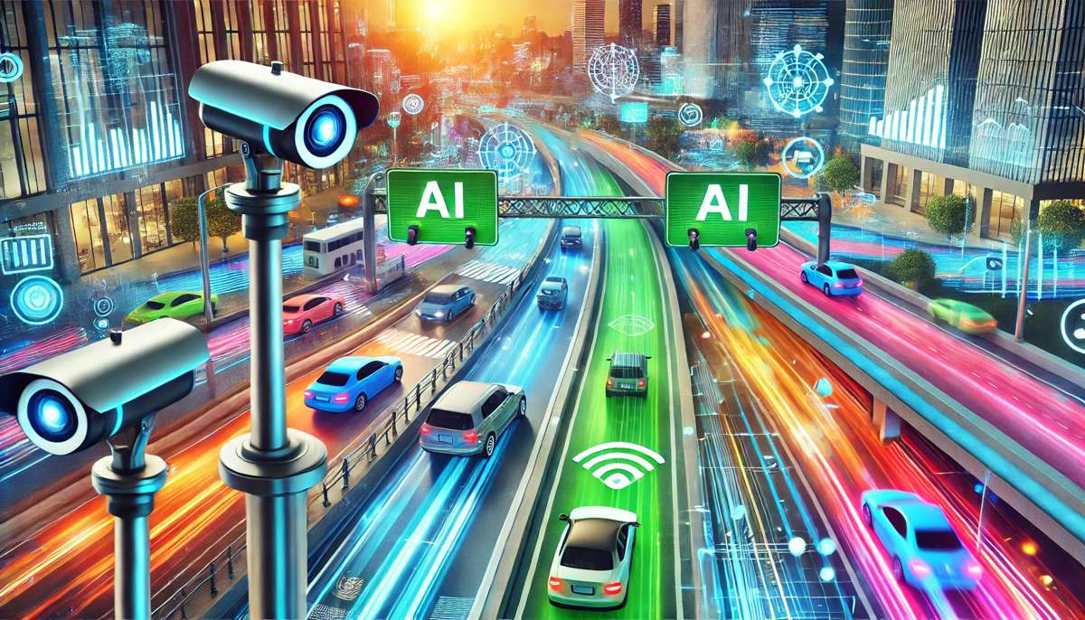
Smart Roads – The Emerging Paradigm
Smart Features
AI-powered dynamic speed signs & weather-based alerts.
EV charging lanes and solar pavements.
Benefits
Reduced congestion and real-time driver alerts.
Enhanced sustainability and safety.
Global Example
Indian Initiatives
Sweden’s eRoad Arlanda charges EVs while in
motion. Reduces CO2 emissions by 80-90 %.
Operational cost: €1 million/km, but recouped in
fuel savings in 7 years
In Nagpur–Hyderabad Smart Highway: Incident detection, adaptive lights -
Energy use dropped by 35%, toll revenue improved by 18% by smart road operations.
Smart roads can also interact with autonomous vehicles, enabling a V2X (Vehicle-to-Everything) future where roads are no longer passive but intelligent partners in mobility.

Slide 8
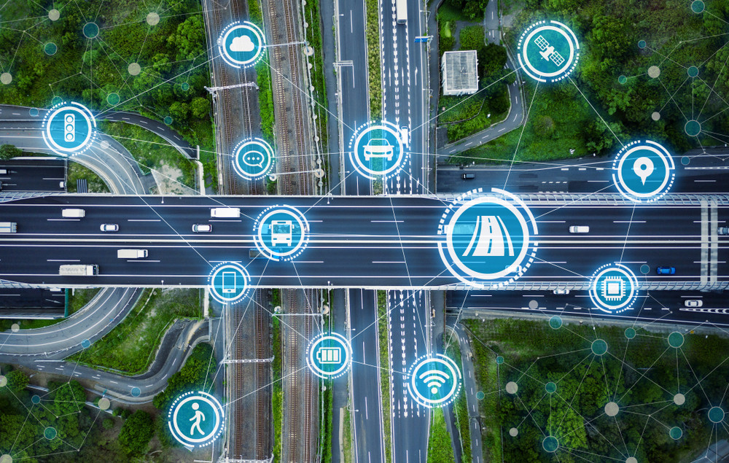
Real-Time Traffic Management using AI
Edge AI Cameras
Detect congestion, accidents, and violations.
Provide live data to control centres.
AI-Powered Variable Message Signs (VMS)
Update drivers with real-time traffic predictions.
Global Example
Netherlands' expressways use AI-fed VMS boards with frequent updates.
Adjusts speed every 60 seconds using predictive AI Reduced average travel delays by 22%
Indian Example
Mumbai–Pune Expressway- AI-based incident response time reduced by 40 %
AI systems can not only ease congestion but also provide insights into long-term urban planning and traffic design.

Slide 9
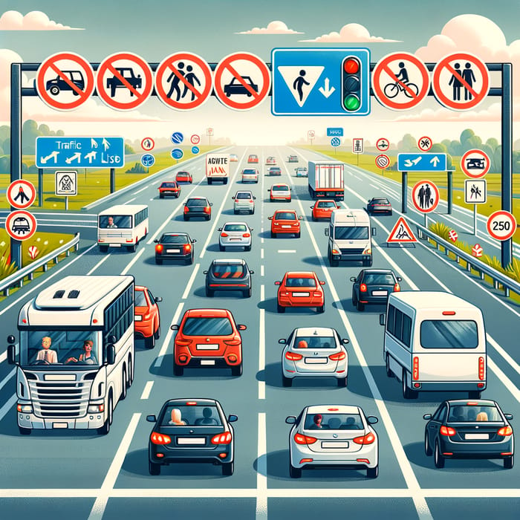
AI in road safety & Enforecement
Crash Prediction Models
Analyze historical data and traffic patterns to identify hotspots.
Speed Violation Detection
AI and License Plate Recognition (LPR) systems monitor over speeding.
Wrong-Way Detection
Analyze historical data and traffic patterns to identify hotspots.
Indian Implementation
Global Perspective
MSRDC-AI detects wrong-way driving, speeding, and license plate violations
Manual checks reduced by 70 %
Enabled better fine collections — boosting compliance and revenue
Such measures transform roads from passive spaces to active protectors of human lives.

Slide 10
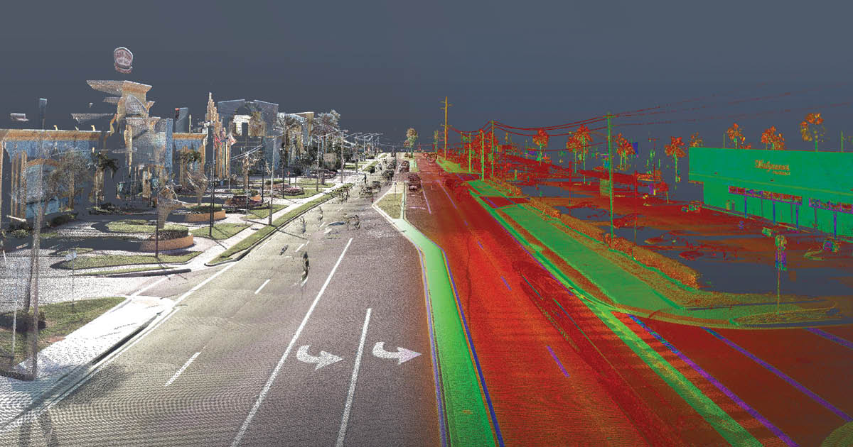
Digital Twins and Simulation
Definition
Applications
Global Example
Indian Progress
Digital replicas of physical assets for simulation and analysis
Simulate road behavior under various conditions.
Plan upgrades and maintenance digitally
Singapore's digital twin of its road network aids in congestion simulation Led to 12% better road usage efficiency and smarter urban planning
NHAI developing digital twins for Bharatmala corridors. Phase II, digital twins integrate toll data, weather, and construction logs
Digital twins allow simulation of road performance under future traffic and weather scenarios, enabling data-driven asset lifecycle management and budget optimization.

Slide 11
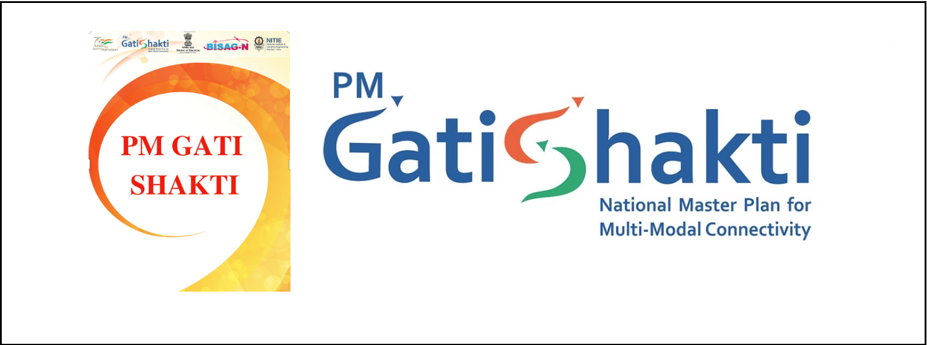
Integration with Gati Shakti & PM Gati Shakti Masterplan
AI as an Enabler
AI Analytics Aids
Goal
Supports Unified Logistics Interface Platform (ULIP).
Enhances road-rail integration planning.
Multi-modal transport prediction and corridor risk management.
Accelerate project clearances and improve alignment decisions.
Uses AI to optimize freight routes and reduce delays
Identified 23 key bottlenecks and improved cargo movement by 12%
Estimated to reduce logistics cost from 13% to 8% of GDP by 2030
It represents a transformative approach to infrastructure development, aiming to create a seamless and efficient multi-modal transport network across India

Slide 12


Barriers & Solutions
Challenges
Recommendations
High capital expenditure for AI equipment.
Skill gaps among engineers and contractors.
Data silos across agencies and cybersecurity risks.
Public-Private Partnerships for AI pilot projects.
Mandatory AI training for Private players :-via NHAI & MoRTH + IIT collaborations
Standardization of data collection protocols.
National Data Exchange for inter-agency AI model access

Slide 13

Vision 2030 – India’s Smart Highway Network
AI-Driven Lifecycle Monitoring
Reduction in Accident Fatalities
Real-Time Tolling and Maintenance
Collaborative Efforts
Continuous assessment of road conditions.
Early detection systems to prevent mishaps
Dynamic systems for efficient operations.
Integration of MoRTH, startups, academia, and AI industry
By aligning policy, investment, and technology, India can become a global benchmark in AI-powered road infrastructure. With AI, we can cut construction delays by 30%, improve road lifespan by 20%, and reduce accidents by 40% — if we work as one digital ecosystem.

Slide 14


