Slide 1
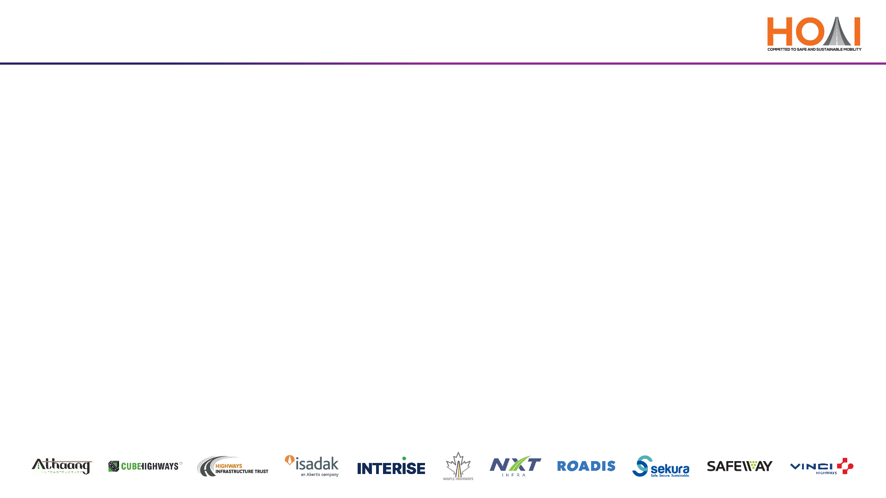
Highway Operators’ Association (I)
AI Powered Innovations in Construction and Maintenance
27th May 2025

Slide 2

Know Your Speaker
More than 24 Years of Diversified Experience
Project Management Professional, PMP®, Certified from PMI USA
FIE & Chartered Engineer from The Institution of Engineers India,
MBA (Project Management) & B.TECH (Civil Engineering)
Lead Auditor ISO 45001:2018
Internal Auditor ISO 14001:2015
Certified Trainer from TUV India, TÜV NORD Group, Germany
Major Projects:
  Highways – Construction and O&M
  Railways
  Delhi metro
  Rural Development/NGO
  Technology Innovation
  Synthetic Sports Surfaces & Stadium Development

Slide 3

Walk through
Automated and intelligent machine-aided construction and maintenance.
Use of emerging technologies in enhancing maintenance and monitoring of highways.
Smart Roads & AI solutions.

Slide 4
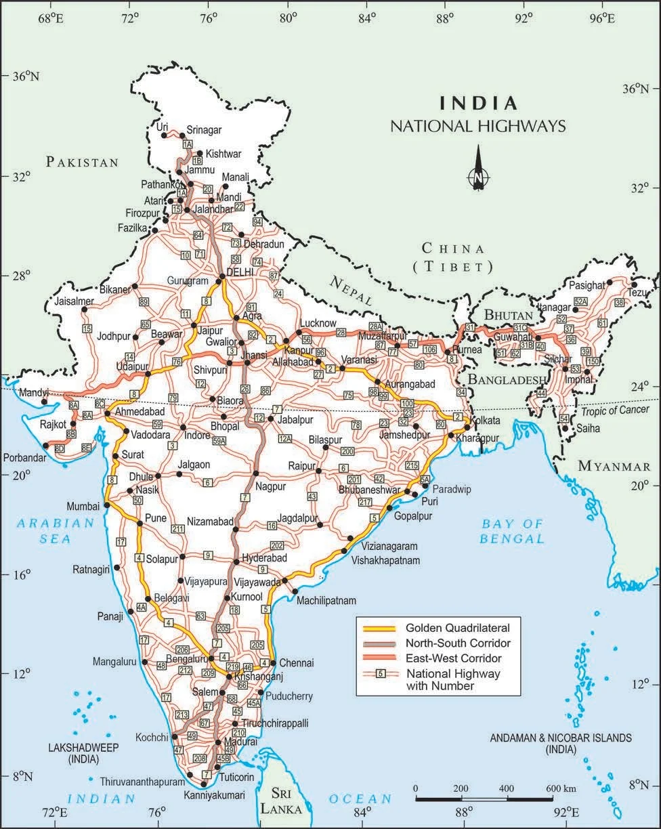
Introduction
Over 146,000 kilometers of highways—the second-largest network in the world.
About 56,700 km NH length has been constructed in the country during the last five years.
National Highways constitute only about 2% of India’s total road network, handle nearly 40% of the total traffic.
These roads carry 60% of our freight & underpinning a $3 trillion economy.
India aims to expand the NH network to 200,000 km by 2037.
We spent ₹15,000 crore annually on maintenance, yet 40% of our highways need urgent repairs due to soaring traffic—up 50% by 2030, as per industry projections—and monsoon havoc.

Slide 5
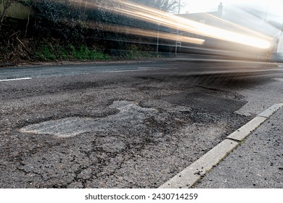
Challenge
Our maintenance has traditionally been reactive—fixing potholes after they form, repairing bridges after they groan. Other factors are:
- Delayed repairs due to manual inspections
- Aging Infrastructure
- High maintenance costs
- Safety risks for workers and commuters
Globally, predictive maintenance is cutting costs by 20-30%. For India, that could be ₹3,000-4,500 crore in annual savings. This is a $100 billion market by 2030, tied to NHAI’s upgrade plans.
But there’s an opportunity to shift gears—to move from reacting to predicting, from patching to preventing.

Slide 6
Why AI?
Efficiency
Automates repetitive tasks
Accelerates decision-making
Enhances operational workflows
🎯 Precision
Minimizes human error
Improves data-driven accuracy
Enables consistent quality
🔍 Predictive Maintenance
Forecasts equipment failures
Reduces downtime
Extends asset lifespan
💰 Cost Saving
Optimizes resource usage
Cuts labor and maintenance costs
Increases ROI through smart operations

Slide 7
“The Tech Revolution” : AI, IoT Network, Predictive Analytics
First, Artificial Intelligence. AI helps to processes huge of data—traffic flows, weather patterns, pavement stress—to spot issues before they are escalated. Globally, California’s using AI to analyze drone footage, detecting cracks 40% faster than humans. Imagine scaling this—AI could save ₹1,000 crore yearly by slashing repair delays, while making stretches safer. Many Indian firms already AI pioneers in logistics, could lead this charge.
Next, The Internet of Things. The Internet of Things (IoT) refers to interconnected sensors, devices, and systems that collect and share real-time data. IoT is like a highway’s nervous system—sensors embedded in roads and bridges, talking to us in real-time.
Finally, Predictive Analytics. This marries AI and IoT to forecast when and where maintenance strikes. The UK’s National Highways uses it to prioritize repairs, reducing emergencies by 15%.

Slide 8
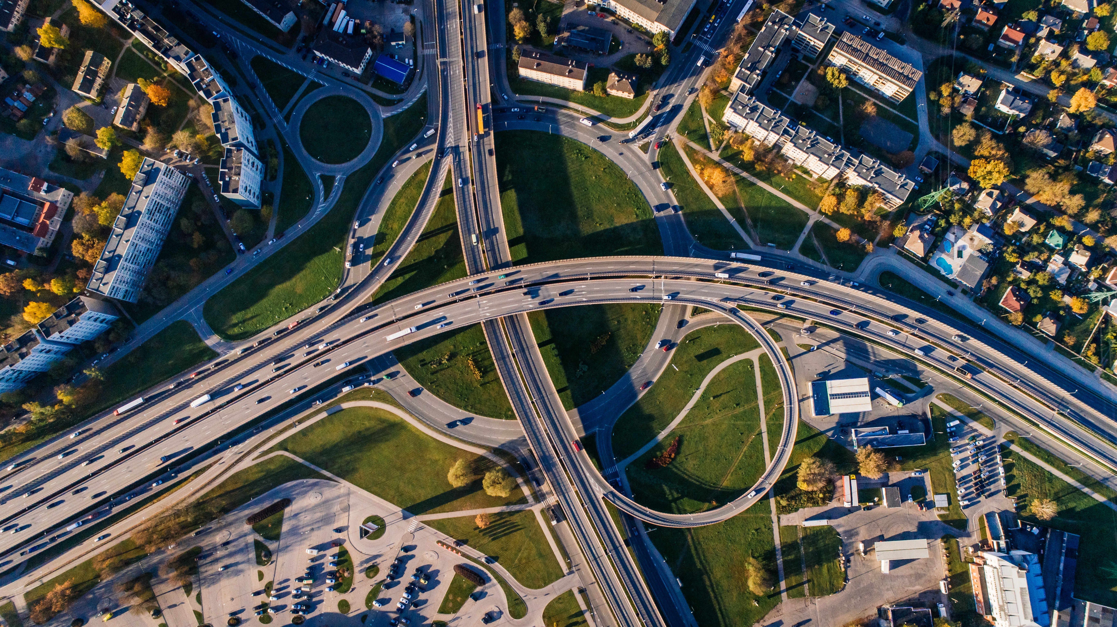
Automated and intelligent machine-aided construction and maintenance
An overview of automated construction, highway monitoring technologies, and smart road solutions
Autonomous Construction Equipment: AI and GPS-equipped machinery for precision tasks.
Drones for Site Monitoring: Real-time aerial surveillance for progress tracking and safety inspections.
Robotic Maintenance Systems: Robots for inspecting and repairing infrastructure.
Predictive Maintenance: AI models predicting equipment failures and optimizing schedules.

Slide 9
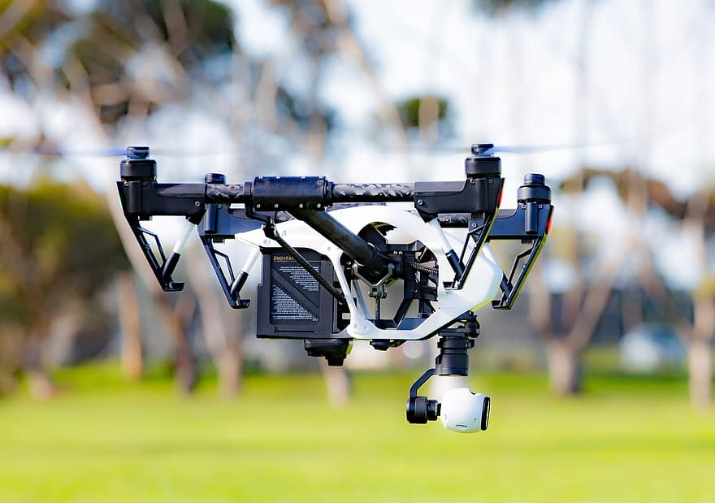
Emerging Technologies in Highway Maintenance and Monitoring
The Problem with Traditional Methods
Manual inspections
Delays, safety risks, inefficiencies
Increasing stress from traffic and climate change
Emerging Technologies
Drones & IoT Sensors: Embedded in roads and bridges for real-time monitoring.
Digital Twins: Virtual replicas simulating wear and tear for proactive maintenance.
Computer Vision: Mobile inspection units detecting cracks and surface degradation.
AI-Driven Traffic Management: Adaptive systems for traffic signals and vehicle rerouting.

Slide 10
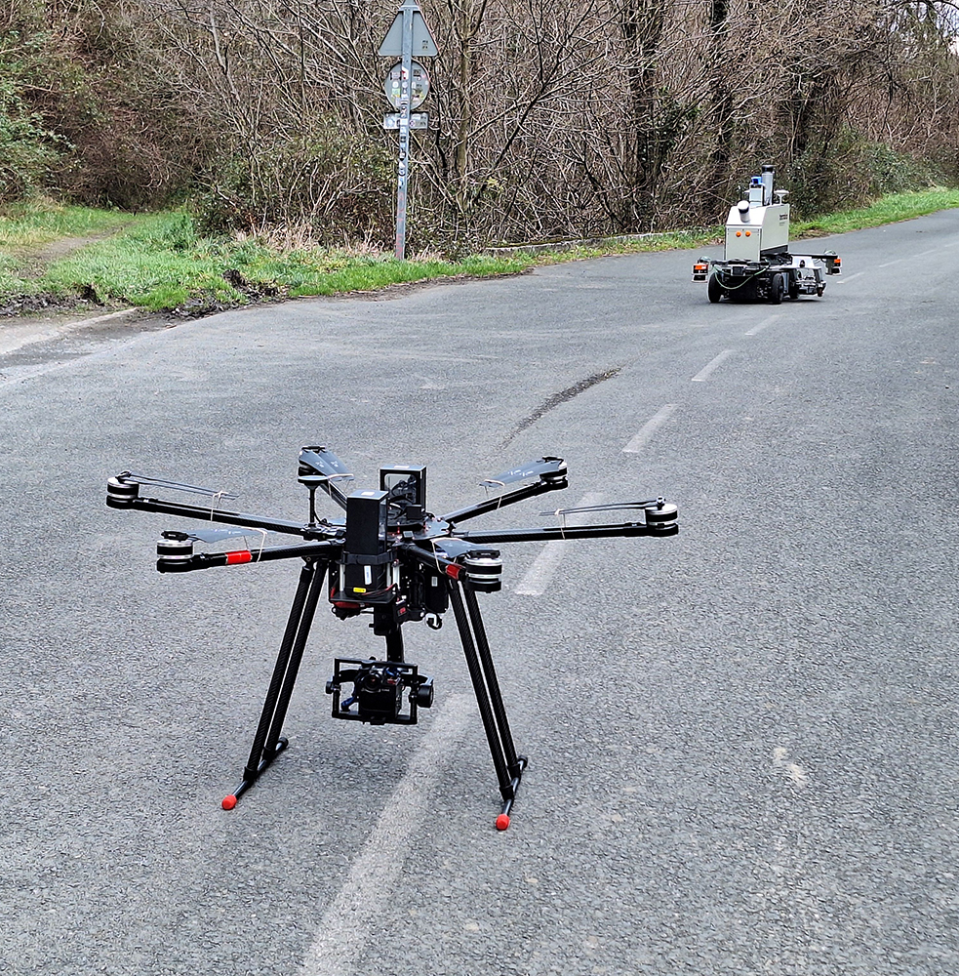
Emerging Technologies in Highway Maintenance and Monitoring
Drones and Aerial Imaging
High-resolution inspections
Infrared, LiDAR, photogrammetry
Example: bridge and tunnel monitoring
IoT and Smart Sensors
Embedded sensors in pavement and bridges
Real-time monitoring of stress, vibration, and moisture
Predictive alerts from central systems

Slide 11
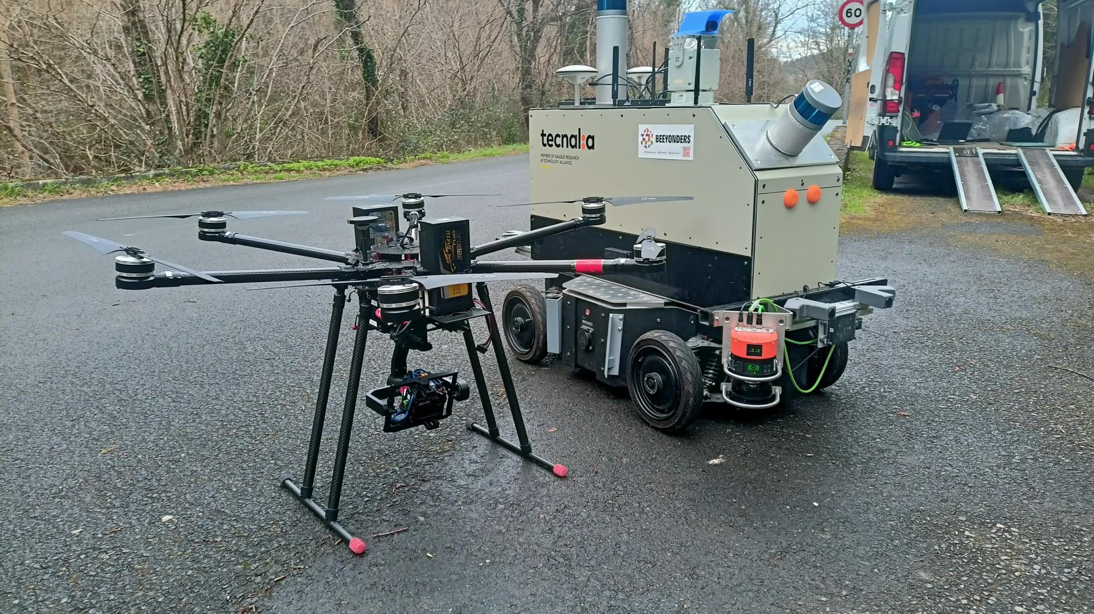
Emerging Technologies in Highway Maintenance and Monitoring
AI and Machine Learning
Real-World Applications
USA: drones post-disaster inspections
Japan: AI for aging infrastructure
Germany/Netherlands: smart pavements
Automated image analysis
Predictive models using historical data
Optimized scheduling and budgeting
Digital Twins
Virtual, real-time replicas of highway systems
Scenario planning: deterioration, weather, traffic loads
Improved decision-making and planning
Autonomous Inspection Robots
Robots for tunnels, drains, confined spaces
24/7 operations in hazardous environments
Safety + efficiency

Slide 12
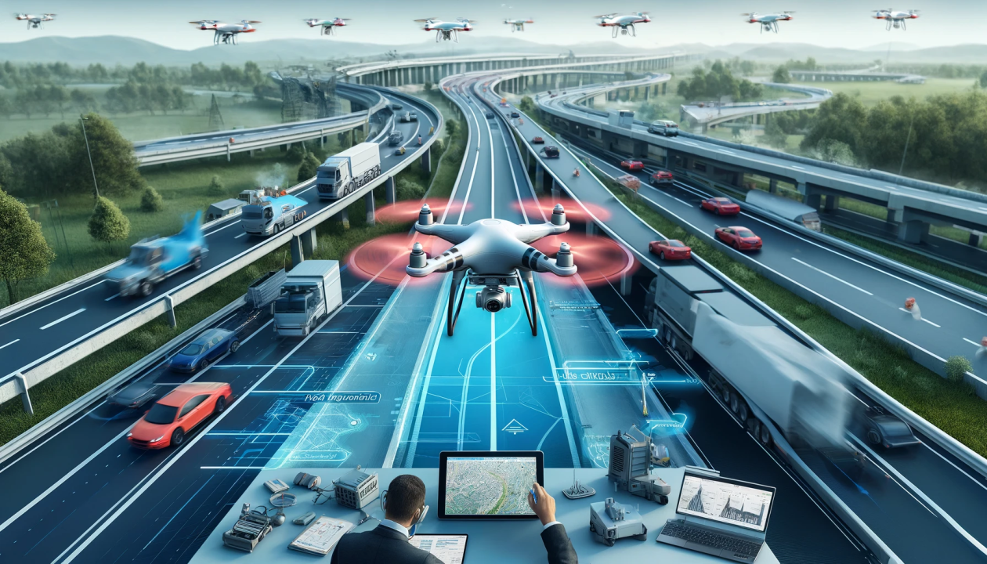
Emerging Technologies in Highway Maintenance and Monitoring
Benefits Summary
Increased safety
Reduced costs and downtime
Sustainability through fewer repairs
Improved road user experience
Call to Action / The Way Forward
Invest in innovation and workforce development
Encourage public-private partnerships
Treat roads as smart, evolving systems
Challenges Ahead
System integration with legacy assets
Skills and training gaps
Upfront investment
Data security
Conclusion
“From roads to smart infrastructure”
Embrace tech for safer, smarter mobility
“The future of highway maintenance is intelligent.”

Slide 13
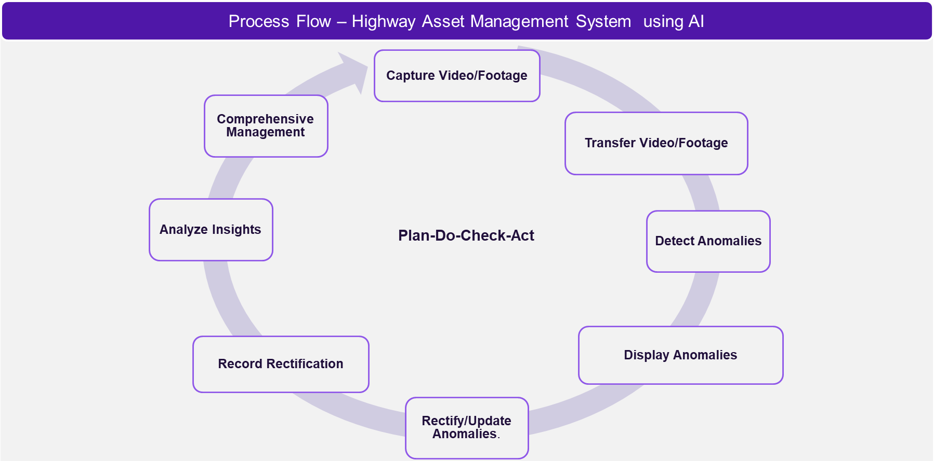
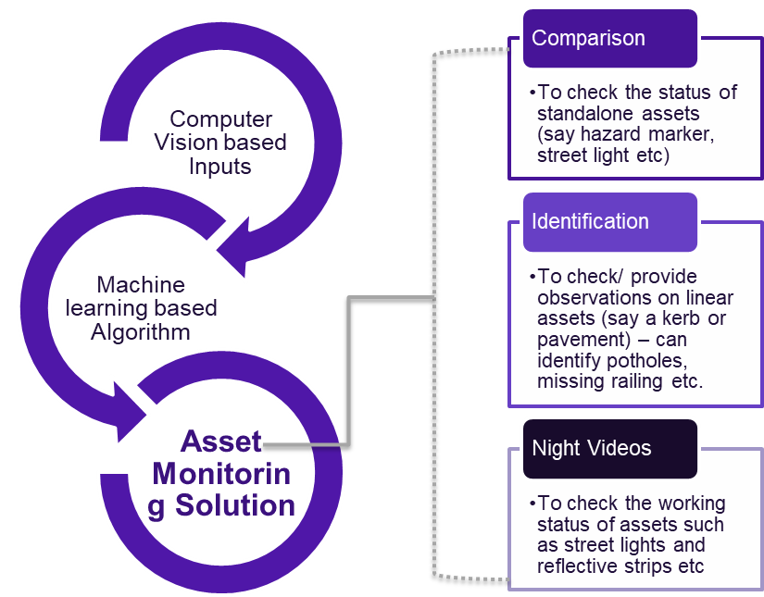
Highway Asset Management System - Pavement
Management system that is used to collect, manage and analyse data for Highway Maintenance Planning and Programming purposes as well as enables to manage road related Assets information. Its uses Machine learning, a subfield of artificial intelligence, which enables machines to learn from past data or experiences without being explicitly programmed.

Slide 14
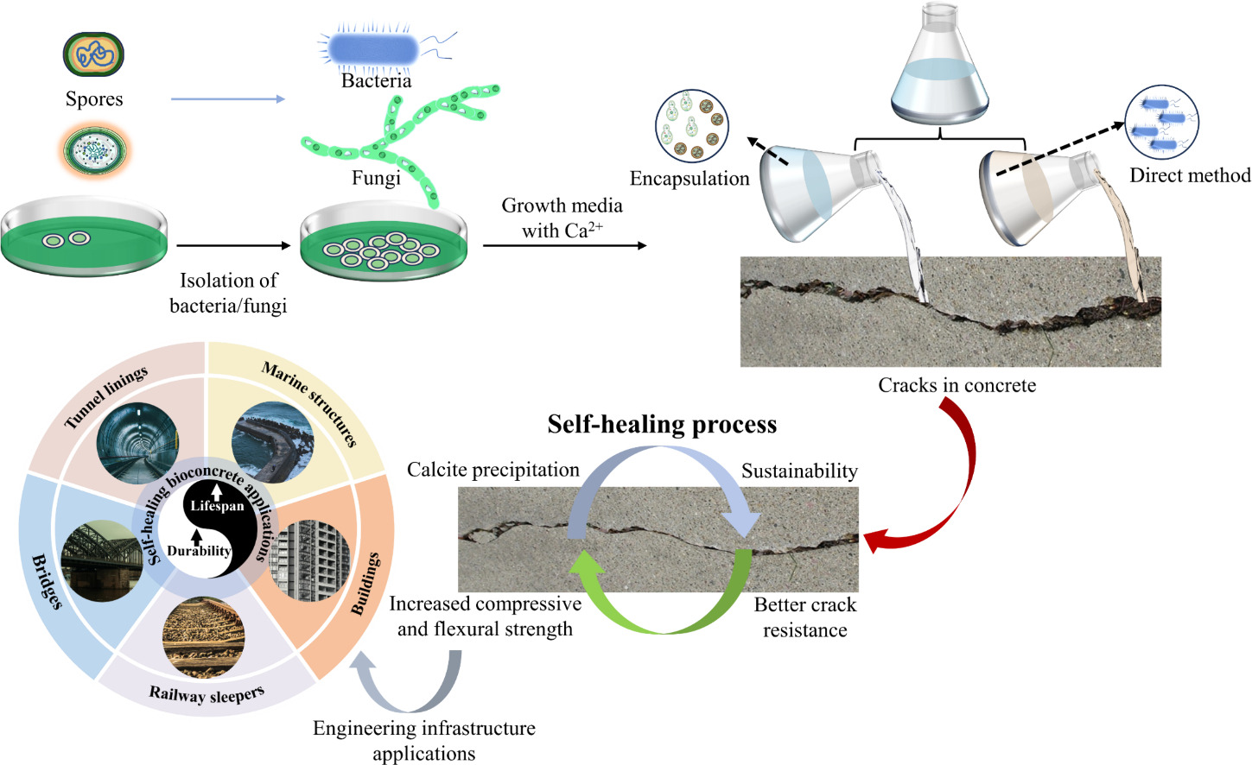
Emerging Technologies in Highway Maintenance and Monitoring
Self Healing Roads
Bioconcrete, enabled by self-healing mechanisms harnesses the metabolic pathways of microorganisms to autonomously mend cracks.
The efficiency of this innovative repair process is influenced by a variety of environmental parameters, including pH balance, ambient temperature, and moisture levels, all of which play a critical role in modulating microbial activity and the overall success of the healing action.

Slide 15

Smart Roads & AI Solutions
Dynamic Lane Management: AI systems adjusting lanes and speed limits.
Vehicle-to-Infrastructure (V2I) Communication: Real-time data exchange for alerts.
Solar and Self-Healing Roads: Roads with solar panels or self-repairing materials.
AI-Powered Tolling and Surveillance: Automated toll collection and AI-based monitoring.

Slide 16
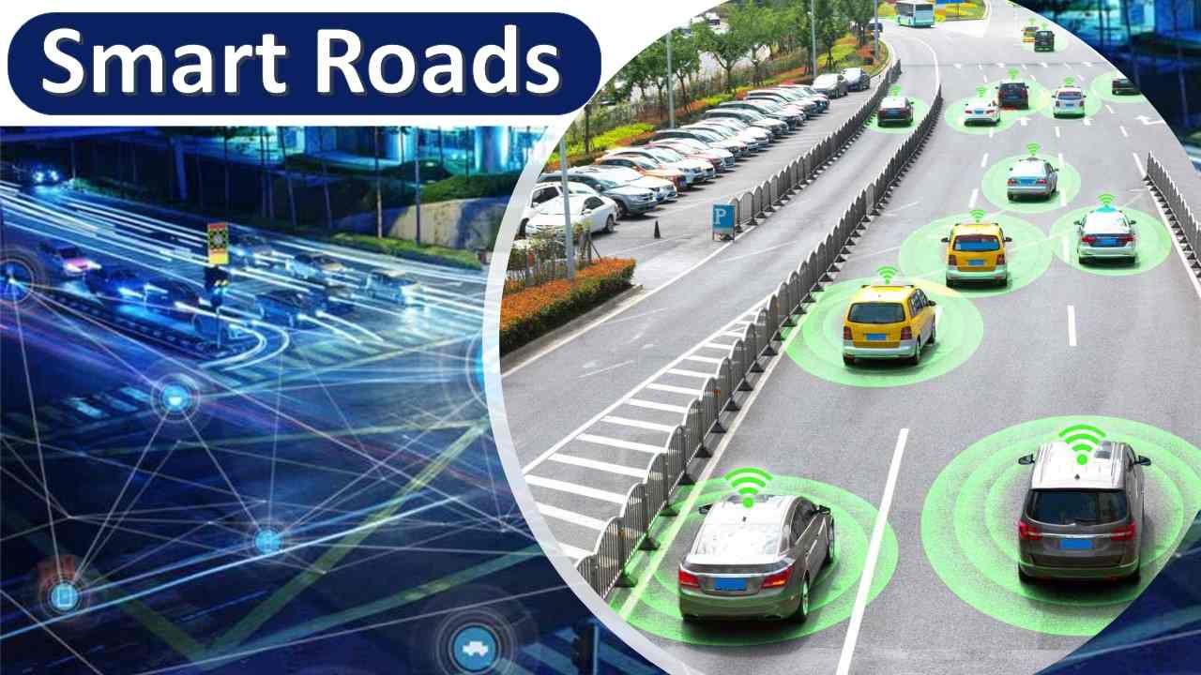
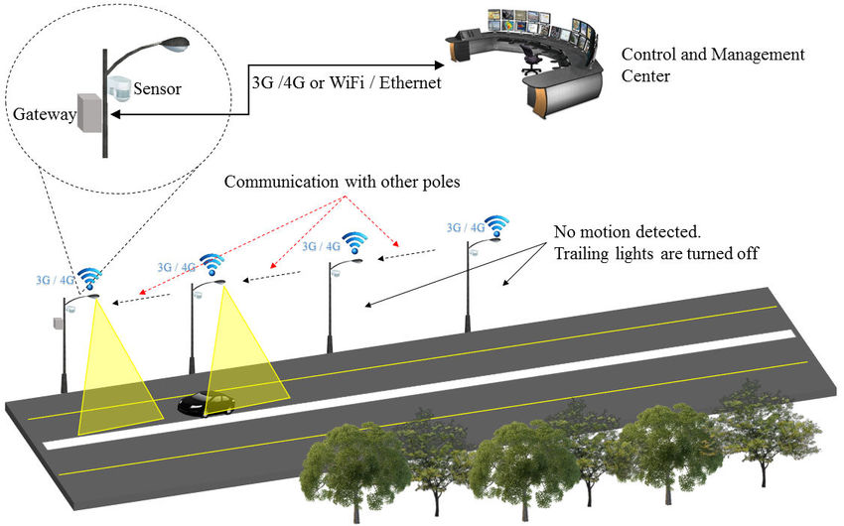
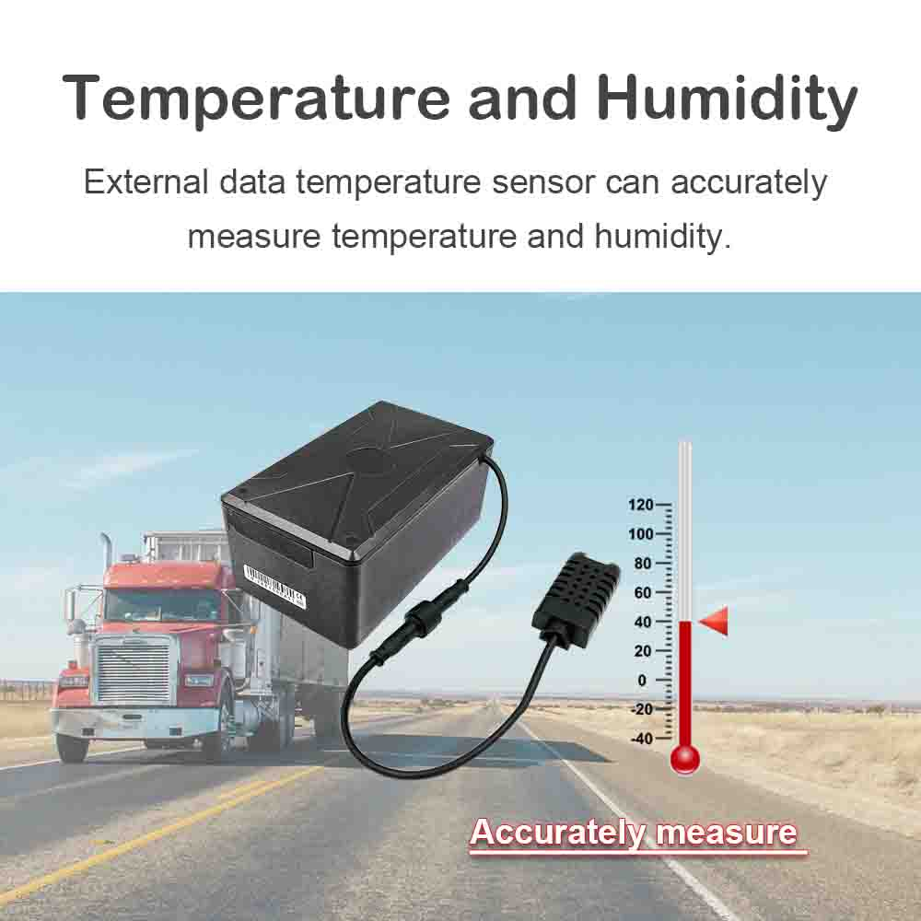
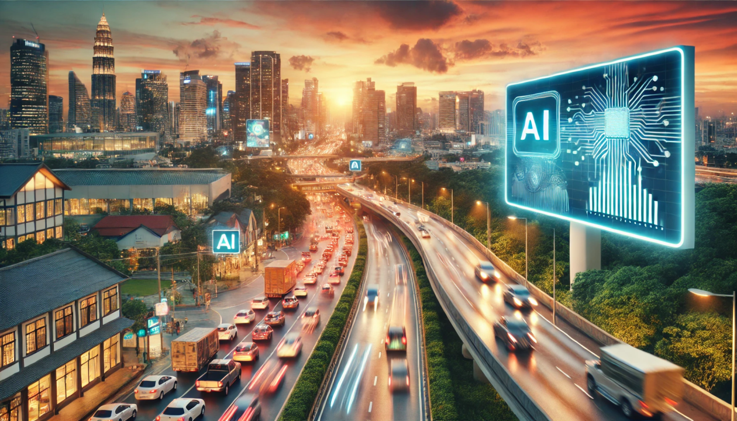

Innovations developed in Road Maintenance
Intelligent lighting
Temperature and humidity sensors
Using artificial intelligence and big data
Self-Healing Roads with AI Integration

Slide 17
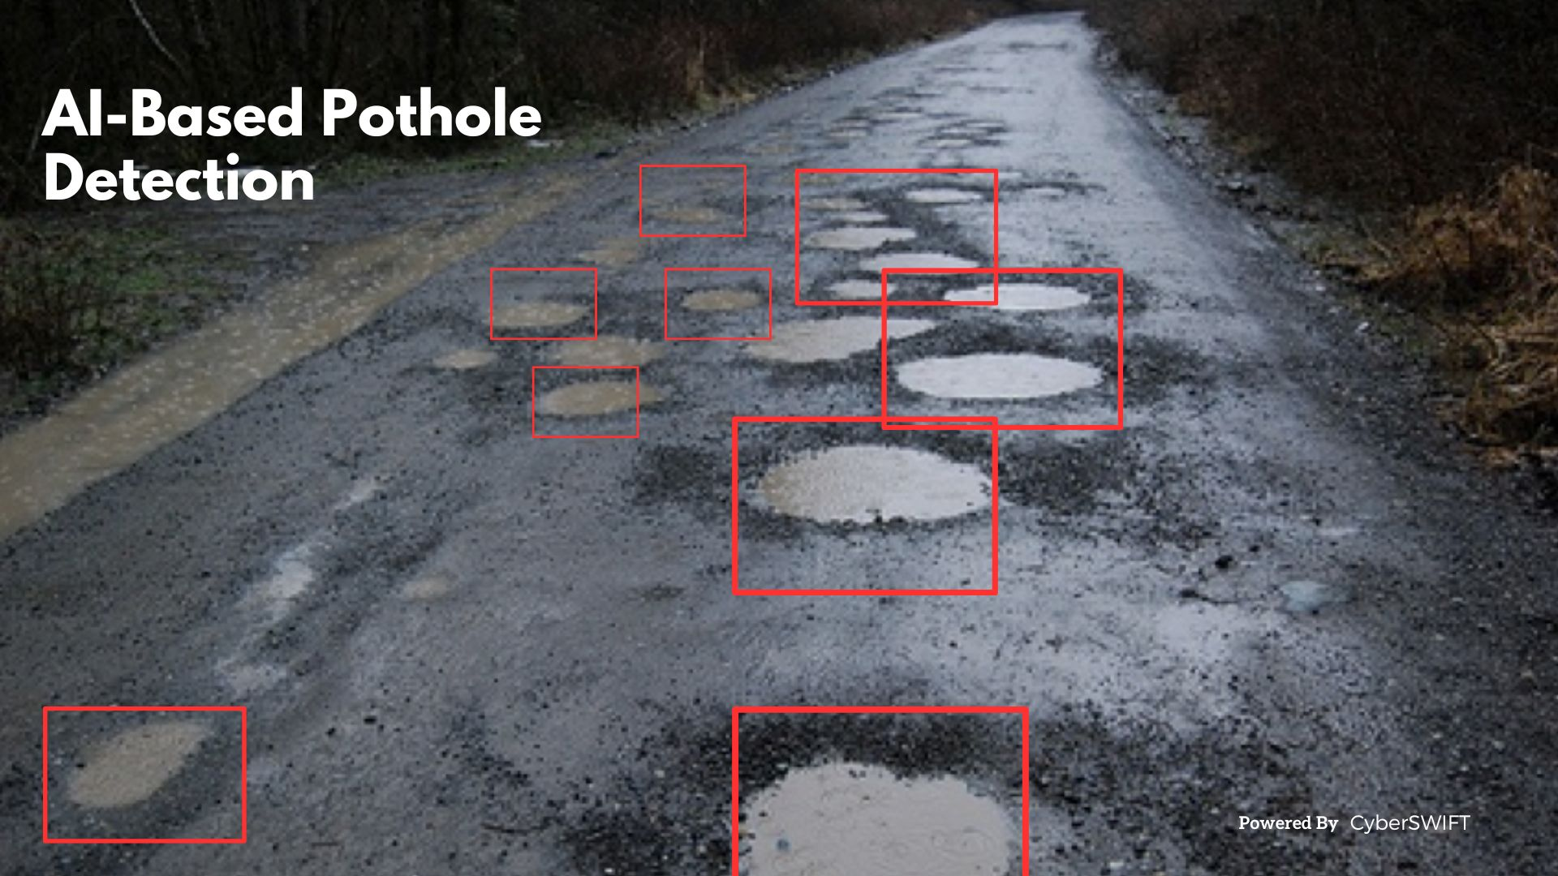
Smart Roads & AI Solutions
AI as the Core Enabler
Machine learning algorithms analyze traffic, weather, load data.
Supports dynamic traffic control, congestion management, and safety systems.
Enables predictive analytics for maintenance.
Integration of sensors, embedded systems, and data networks into highways.
Supports real-time monitoring, traffic optimization, and infrastructure feedback.

Slide 18
Smart Roads & AI Solutions
Key Technologies in Smart Highways
IoT sensors for pavement stress, temperature, vibration
Fiber optic sensing for strain and acoustic data
Edge computing for on-site data processing
AI vision systems for automated inspections
Smart Highway Infrastructure Applications
Dynamic lane management
AI-integrated tolling and traffic routing
Real-time structural health monitoring (bridges, pavements)
Weather-responsive lighting and signage
Benefits for Highway Systems
Improved safety: hazard detection, faster emergency response
Reduced maintenance costs via early detection
Data-driven asset management
Scalable platforms for connected/autonomous vehicles
Future readiness: supports EVs and AVs

Slide 19
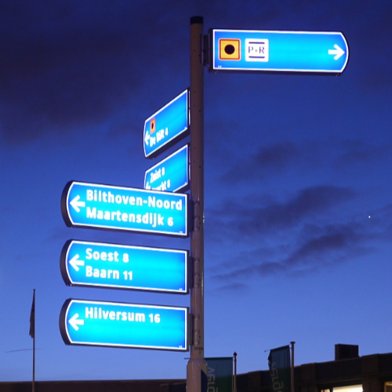
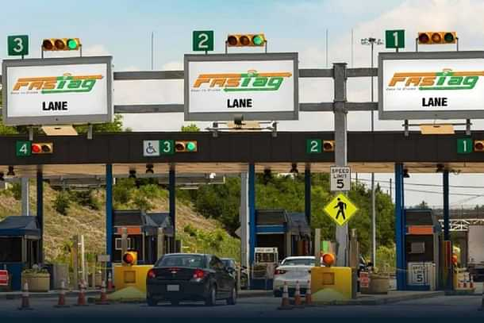
Smart Roads & AI Solutions
Case Studies
Netherlands: Smart lighting and dynamic signage
USA (Georgia/Michigan): AI-enabled traffic flow management
China: Solar-powered roads and inductive charging lanes
India: FASTag + AI tolling
South Korea: AI pavement monitoring
Netherlands: Smart lighting and dynamic signage

Slide 20
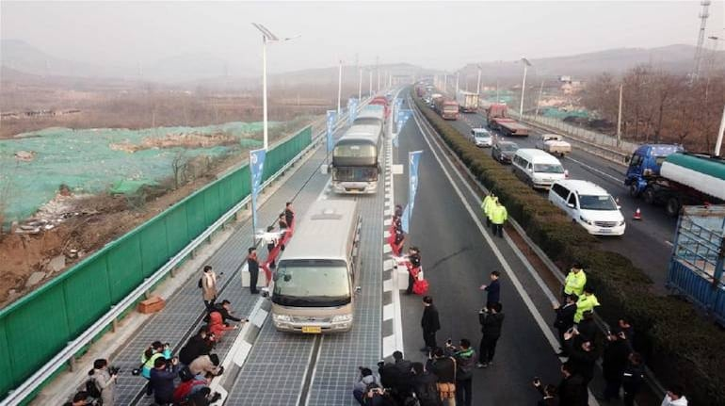
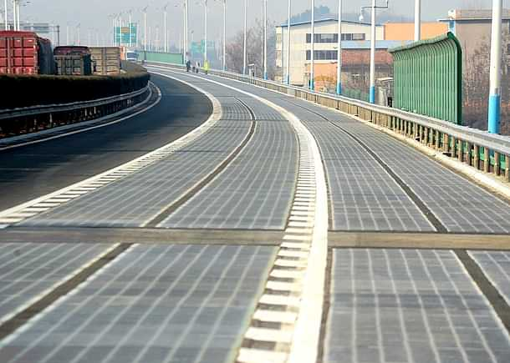
Case Studies
China: Solar-powered roads and inductive charging lanes

Slide 21
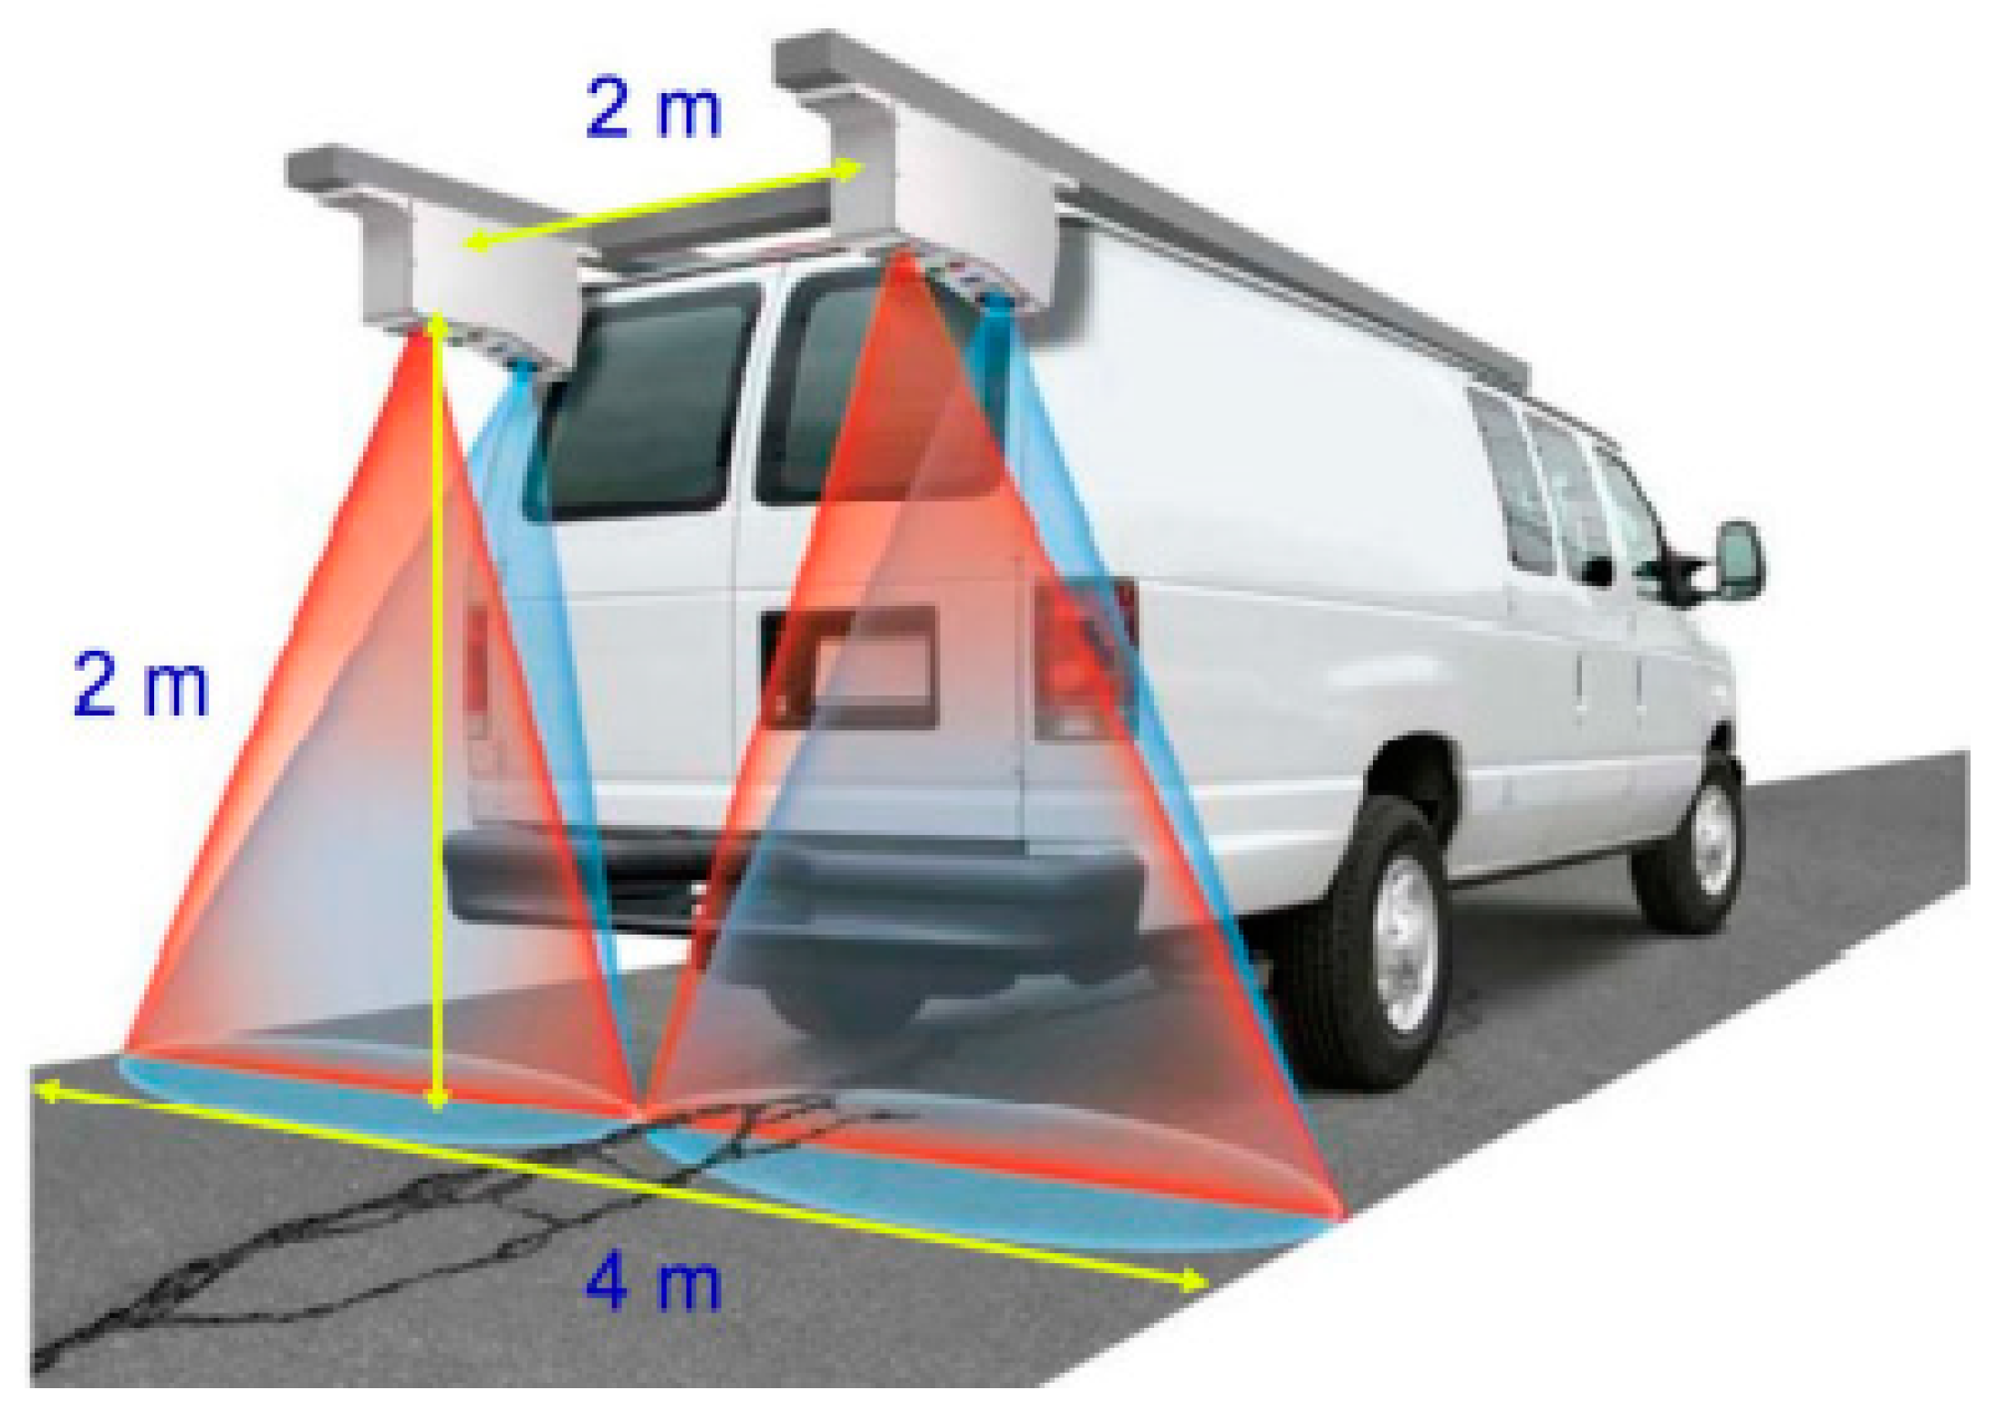
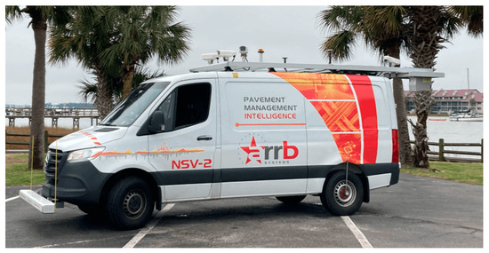
Case Studies
South Korea: AI Pavement Monitoring System
Pavement Detection Vehicle

Slide 22
Smart Roads & AI Solutions
Implementation Challenges
Infrastructure retrofitting complexity
Data governance and cyber resilience
High CAPEX for smart system deployment
Standardization across jurisdictions
Maintenance of tech infrastructure
Conclusion
Smart highways are critical to next-generation mobility
AI and intelligent systems enable safer, more efficient, and resilient infrastructure
Strategic investment and cross-sector collaboration are key

Slide 23
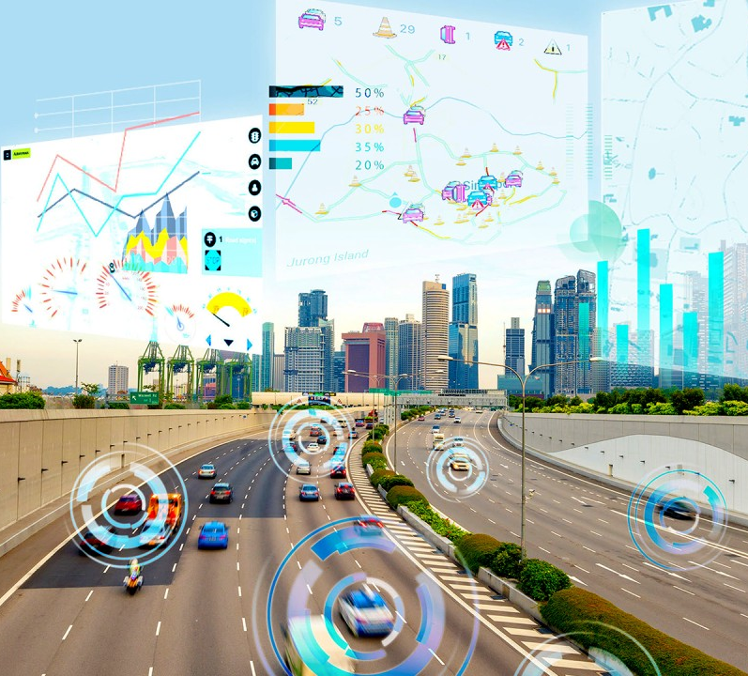
Let’s Pave the Future
“Whatever we’ve done till now - AI to detect defects, use of drones to monitor bridges and roads - is just a beginning. But the way forward for our industry is bold, transformative, and within our grasp. With AI, IoT, and predictive analytics, we can:
Keep roads clean, pothole-free, and crack-free - smart sensors and analytics catching flaws before they form.
Shrink our carbon footprint - 20% less emissions through targeted repairs.
Cut unnecessary expenses - saving ₹10,000 crore yearly by predicting, not patching.
Save lives - 50,000 fewer tragedies on our highways, every year.
Be an Enabler for a $5 trillion economy - smart highways powering freight, autonomy, and growth.
This isn’t a dream - it’s our blueprint. Let us pilot these tools. Let us fund the future. Let us back the visionaries.
Together, let’s pave highways that don’t just connect India - they lift it to greatness.”

Slide 24

THANK YOU !

