Slide 1
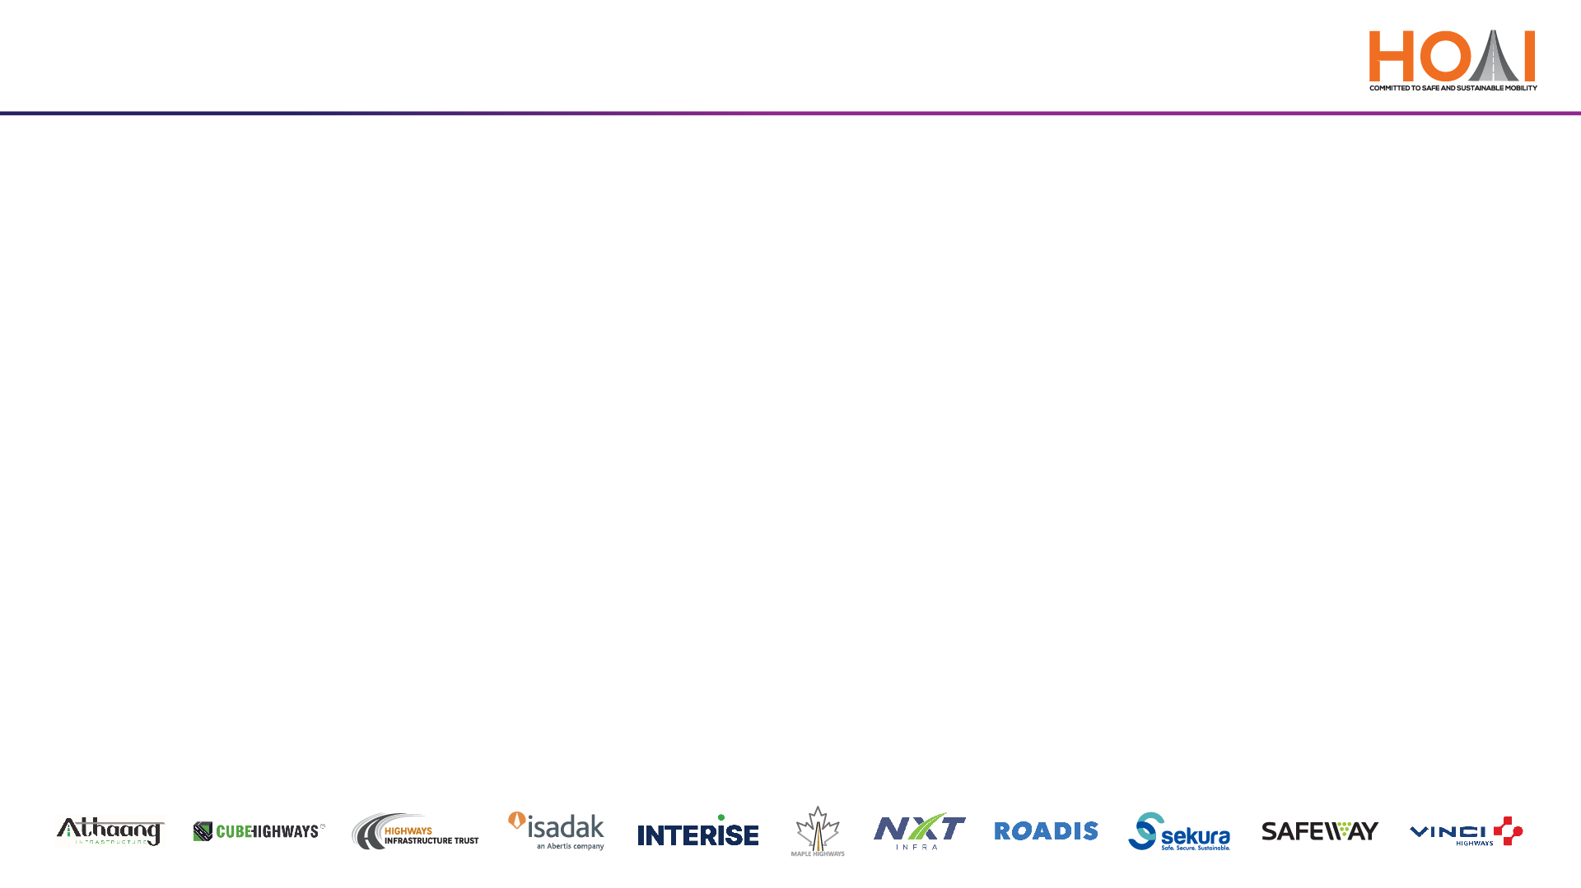
Highway Operators’ Association (I)
Navigating the Challenges of Lifetime/ Annual/ Monthly Passes for Highway Operators
Meeting 13 May 2025

Slide 2
Index
Introduction
Current issues related to Annual & Lifetime Pass
Proposed solution for Annual and Lifetime passes

Slide 3
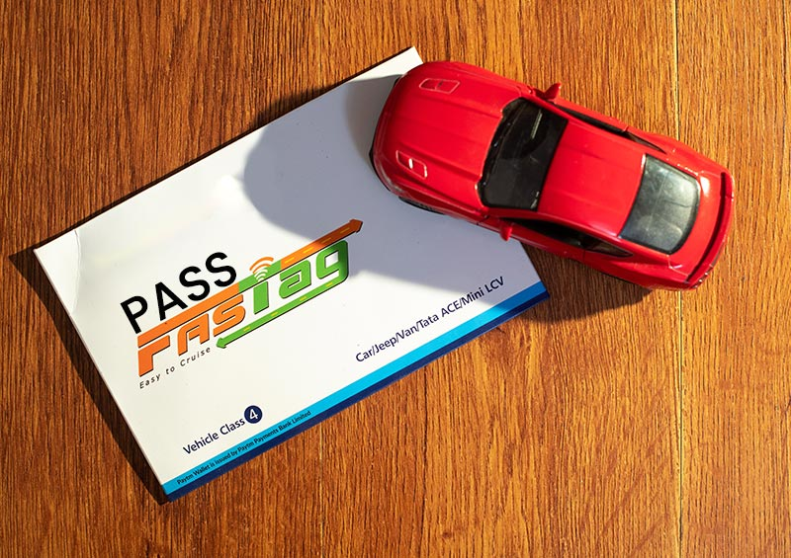
Introduction
The government is considering implementing annual and lifetime toll passes on national highways, potentially offering a way for frequent travelers to avoid frequent toll payments. These passes would be integrated with the existing FASTag system for CJV traffic as described below:
Annual Toll Pass:
This pass would allow unlimited travel on national highways and expressways for a year for a one-time payment of ₹3,000
Lifetime Toll Pass:
This pass would provide toll-free travel for 15 years for a one-time payment of ₹30,000.

Slide 4
Current issues related to Annual & Lifetime Pass
The new system is anticipated to provide significant benefits to private vehicle owners. Presently, private automobiles account for 26% of the total toll revenue.
The implementation is a welcome step in resolving many ongoing issues like local exemptions and violations, avoiding conflicts from the users who are unwilling to pay and ask for discounts etc. However, the implementation of this system requires certain clarifications before it’s rollout. A few major concerns are listed below :
The new discounted pass for CJV is not as per the Concession Agreement, to enable the change a Supplementary Agreement has to be signed between the Authorities and the Concessionaire.
Current Supplementary Agreement with the Acquirer bank has to be modified to incorporate new discounting pass (Annual / Lifetime pass).
The reimbursement mechanism (incl. identification and timeline for payment credit to the concessionaire’s account) for all CJV vehicles availing such passes has to be proposed and agreed by all parties.
Conflicts arising due to applicability of local monthly passes for CJV (as per existing CA) and new Annual Toll Pass, this needs careful deliberation with possible implications.
How will this be ensured that the CJVs opting for new Annual / Lifetime Toll Pass should mandatorily surrender the old Fastag as per “One Vehicle One Tag” policy.

Slide 5

Proposed solution for Annual and Lifetime passes
As a way forward, the following steps are proposed to mitigate the identified issues :
Gazette Notification / Amendment to the Fee Rule : A new Gazette Notification needs to be published by the MoRTH for introduction of new Annual / Lifetime Toll Pass and it’s incorporation in the existing fee rule structure and deletion of local monthly passes for CJV category.
Supplementary Agreement with Authority: A new agreement with revised fee rules, clearly detailing the new Annual/Lifetime Toll Pass for CJVs and it’s reimbursement mechanism to be finalized and signed between the Authority and Concessioniare.
Modification in existing Contract terms with the Acquirer Bank : The existing contract agreement signed between the Concessionaire and Acquirer Bank needs to be modified to incorporate the new business rules and remittance mechanism and timeline for remittance.
Automated Reconciliation Mechanism: A daily reconciliation mechanism shall be implemented, wherein actual vehicular usage through the pass system is recorded and validated via FASTag transaction data and further bifurcated to identify the local user or a through journey user.

Slide 6

Proposed solution for Annual and Lifetime passes
Monthly pass remittance: A monthly audit and reconciliation process shall be additionally instituted to verify the monthly pass settlement and the accuracy of disbursements and resolve any discrepancies, with scope for escalation in case of consistent shortfalls.
Creation of a Central FASTag Pool Account: A centralized FASTag pool account shall be established and managed by the Authority. All revenues collected under the new pass system from private vehicles shall be deposited into this pool account for remittance to the concessionaire.
T+1 Settlement Cycle: Funds corresponding to the concessionaire’s share of the revenue, based on recorded traffic and applicable toll rates, shall be remitted to the respective concessionaire’s designated bank account on a T+1 (transaction day plus one working day) basis.
Dashbard: A separate dashboard to be made functional through acquirer bank for uploading all transactions under this category for raising LOR on Daily/weekly and Monthly Basis.

Slide 7
Thank You

