Slide 1
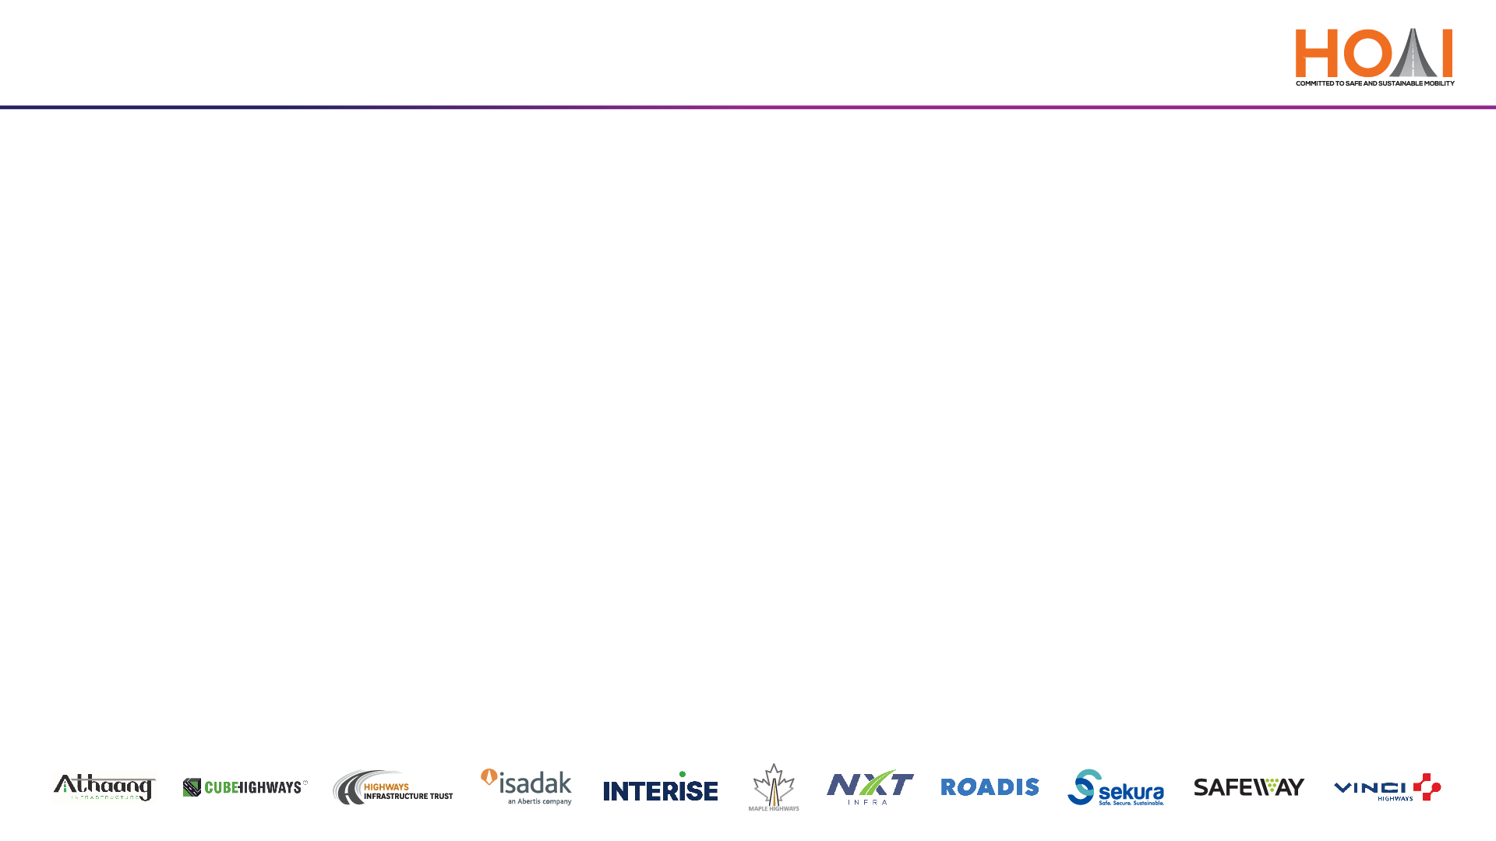
Highway Operators’ Association (I)
Proposed Lifetime/ Annual/ Monthly Passes – Future Challenges
for Highway Operators
13th May 2025

Slide 2
Disclaimer
The content presented herein is based on publicly accessible information and reflects the personal opinions of the author. It does not represent the views or official positions of any affiliated organizations, employers, or entities. While efforts have been made to ensure the accuracy of the information, no guarantees are provided regarding its completeness or reliability. This content is intended for informational purposes only and should not be construed as professional advice. Readers are encouraged to conduct their own research and consult appropriate professionals before making decisions based on this information.

Slide 3
Introduction – Structure of proposed pass
Possible future challenges related to Annual & Lifetime Pass
Proposed suggestions to implementing Authorities

Slide 4
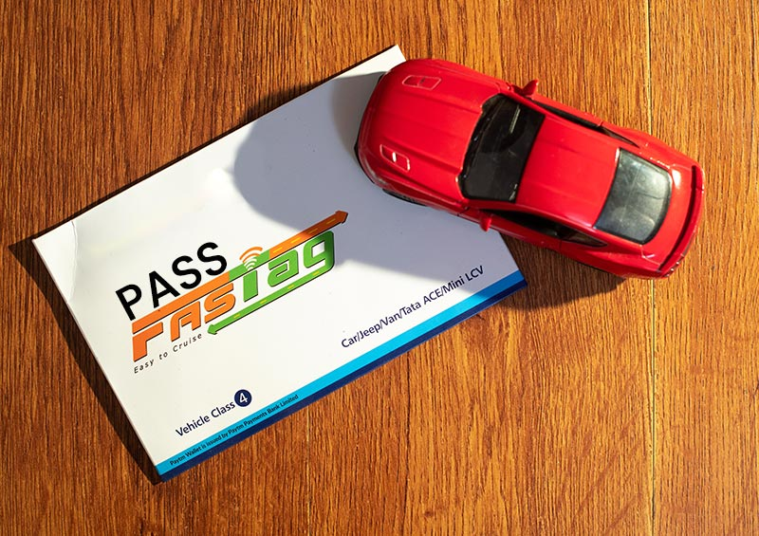
Introduction
The government is considering implementing annual and lifetime toll passes on national highways, potentially offering a way for frequent travelers to avoid frequent toll payments. These passes would be integrated with the existing FASTag system for CJV traffic as described below:
Proposed Annual Toll Pass:
This pass would allow unlimited travel on national highways and expressways for a year for a one-time payment of ₹3,000
Proposed Lifetime Toll Pass:
This pass would provide toll-free travel for 15 years for a one-time payment of ₹30,000.

Slide 5
Comparison: Current Monthly Pass vs. Proposed Annual Pass

Slide 6
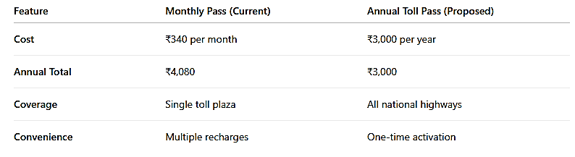
Operational workflow
The Pass is only applicable for private passenger vehicle, Fastag class 4.
The pass will substitute all current local monthly passes
The pass can be obtained on Rajmarg Yatra App by linking VRN
Rajmarg Yatra App will be linked with Vaahan portal so that it can be only issued to private passenger vehicles
The pass will be linked with NPCI and NPCI will manage central registry
NPCI will be responsible for updating the data to the toll plazas directly

Slide 7
Plaza infrastructure
Deployment of ANPR system
Dedicated PMLV lanes with fixed width and height barrier
PMF will be distributed through NPCI, Issuer bank during issuing of POS
Local monthly passes will be discontinued

Slide 8
Future Challenges of Annual & Lifetime Pass
The new discounted pass for CJV is not as per the Concession Agreement, to enable the change a Supplementary Agreement must be signed between the Authorities and the Concessionaire.
Current Supplementary Agreement with the Acquirer bank must be modified to incorporate new discounting pass (Annual / Lifetime pass).
The reimbursement mechanism (incl. identification and timeline for payment credit to the concessionaire’s account) for all CJV vehicles availing such passes must be agreed by all parties.
Conflicts arising due to applicability of local monthly passes for CJV (as per existing CA) and new Annual Toll Pass, this needs careful deliberation with possible implications.

Slide 9
Current Challenges related to Annual & Lifetime Pass
Dependency on compensation process for toll revenue for concessionaire
Lack of clarity on availability of funds with NHAI to compensate concessionaires on timely basis for the revenue loss due to passes.
Currently there is no bifurcation available between Fastag of Private and commercial car users.

Slide 10

Proposed suggestions to implementing Authorities
Gazette Notification / Amendment to the Fee Rule: A new Gazette Notification needs to be published by the MoRTH for introduction of new Annual / Lifetime Toll Pass and it’s incorporation in the existing fee rule structure and deletion of local monthly passes for CJV category.
Supplementary Agreement with Authority: A new agreement with revised fee rules, clearly detailing the new Annual/Lifetime Toll Pass for CJVs and it’s reimbursement mechanism to be finalized and signed between the Authority and Concessioniare.
Modification in existing Contract terms with the Acquirer Bank: The existing contract agreement signed between the Concessionaire and Acquirer Bank needs to be modified to incorporate the new business rules and remittance mechanism and timeline for remittance.
Automated Reconciliation Mechanism: A daily reconciliation mechanism shall be implemented, wherein actual vehicular usage through the pass system is recorded and validated via FASTag transaction data and further bifurcated to identify the local user or a through journey user.

Slide 11

Proposed suggestions to implementing Authorities
Monthly pass remittance: A monthly audit and reconciliation process shall be additionally instituted to verify the monthly pass settlement and the accuracy of disbursements and resolve any discrepancies, with scope for escalation in case of consistent shortfalls.
Creation of a Central FASTag Pool Account: A centralized FASTag pool account shall be established and managed by the Authority. All revenues collected under the new pass system from private vehicles shall be deposited into this pool account for remittance to the concessionaire.
T+1 Settlement Cycle: Funds corresponding to the concessionaire’s share of the revenue, based on recorded traffic and applicable toll rates, shall be remitted to the respective concessionaire’s designated bank account on a T+1 (transaction day plus one working day) basis.
Compensation mechanism: Need to have following key points for fair compensation to the concessionaire;
  The compensation formula need to include only Tollable vehicles (excluding exempt traffic)
  The passes should be issued only to the private passenger vehicles
  Local Monthly passes should be discontinued
  Revenue settlement to be done with T+1 TAT in line with Fastag revenue

Slide 12
Let’s Talk…

Slide 13
Thank You

